Slide 1
Regional actions – bringing it together to move forward
G Srinivasan
Regional Integrated Multi-hazard Early-warning System (RIMES) for Asia and Africa
South Asia Heat Health Summit
suffixed to the International Conference on Climate Services (ICCS-6), 11-13 Feb Pune, India
14 February 2020, The Meghdoot Complex Room, IITM, Pune

Slide 2
Available Climate information
Provide Climate information and Services on a
continuum of time-scales to Manage Disaster Risks
Impacts/Risks/Adaptation
Current Climate Variability
Future Climate Change
Observed climate
Sub-seasonal
~ 2 weeks to a month
Decadal
~ 10 years
Interannual
~ year to year
Climate Change Scenarios
~ several decades – centuries
Weather scale
~ 3 – 10 days
Seasonal
~ months - season
Climate Services
Weather Services
Notes:
Defining climate and available range of climate information

Slide 3
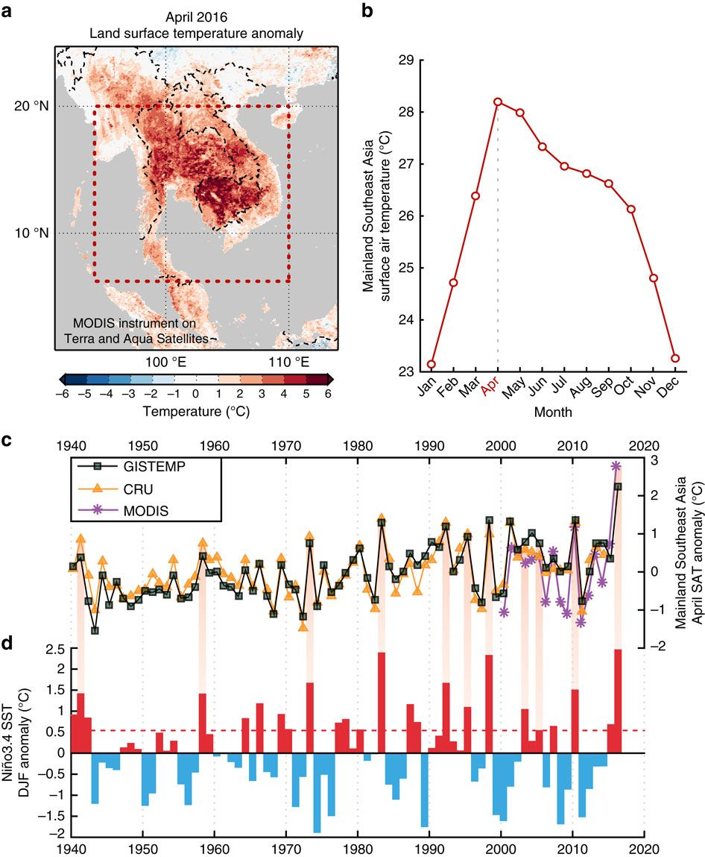
Surface temperatures over Mainland Southeast Asia
Robust relationship between ENSO and temperatures wherein virtually all April extremes occur during El Nino
years.
Long-term warming and the 2015–16
El Nino lead to the extreme April 2016
results indicate that global warming increases the likelihood of record-breaking April extremes
Source: Thirumalai, K. et al. (2017) Extreme temperatures in Southeast Asia caused by El Nino and worsened by global warming. Nat. Commun. 8, 15531.
Notes:
(a) Satellite-derived (MODIS instrument on Terra and Aqua satellites) land surface temperature anomaly during April 2016 in the Mainland Southeast Asia (MSA) region (base period: 2000–2016), where the dashed red box represents the region selected for our analysis.
(b) Surface air temperature (SAT) climatology in MSA based on the entire CRU data set (1901–2014), which indicates that April is the warmest month in the region.
(c) April SAT anomalies in the MSA region from the GISTEMP (green squares) and CRU data sets (yellow triangles) spanning from 1940 to present (base period: 1951–1980; ref. 34). MODIS-based land surface temperature anomalies for MSA (purple stars) are also plotted with the reference base period adjusted to equal the April average of the other two data sets
(d) The December–January–February (DJF) anomaly of sea-surface temperatures (SST) in the Nino-3.4 region, Central Pacific Ocean, where SSTs are taken from the HadISST1.1 data set.
As an indicator of El Nino events, a dashed red line is plotted at 0.5 C. Shaded red bars connect El Nino events to hot Aprils in MSA.

Slide 4

Key points
Range of climate products, and capacities to generate more
Regional and National Climate Forums in-place
Create, enhance and sustain operational systems for Heat health Advisories, Warnings and Alerts
Ingest research and innovations
Supported by ongoing initiatives in the region
A regional network of interest groups (GHHIN - SA)

Slide 5

…thank you
srini@rimes.int
Notes:
5

