Slide 1

Heat Waves Possible Early Warning Methods, and Heat – Health Action Plan for Sri Lanka
Shiromani Jayawardena (PhD)
Meteorologist/Deputy Director
Department of Meteorology
Colombo 07
Heat Health Summit
2020-02-14@ IITM Pune India

Slide 2
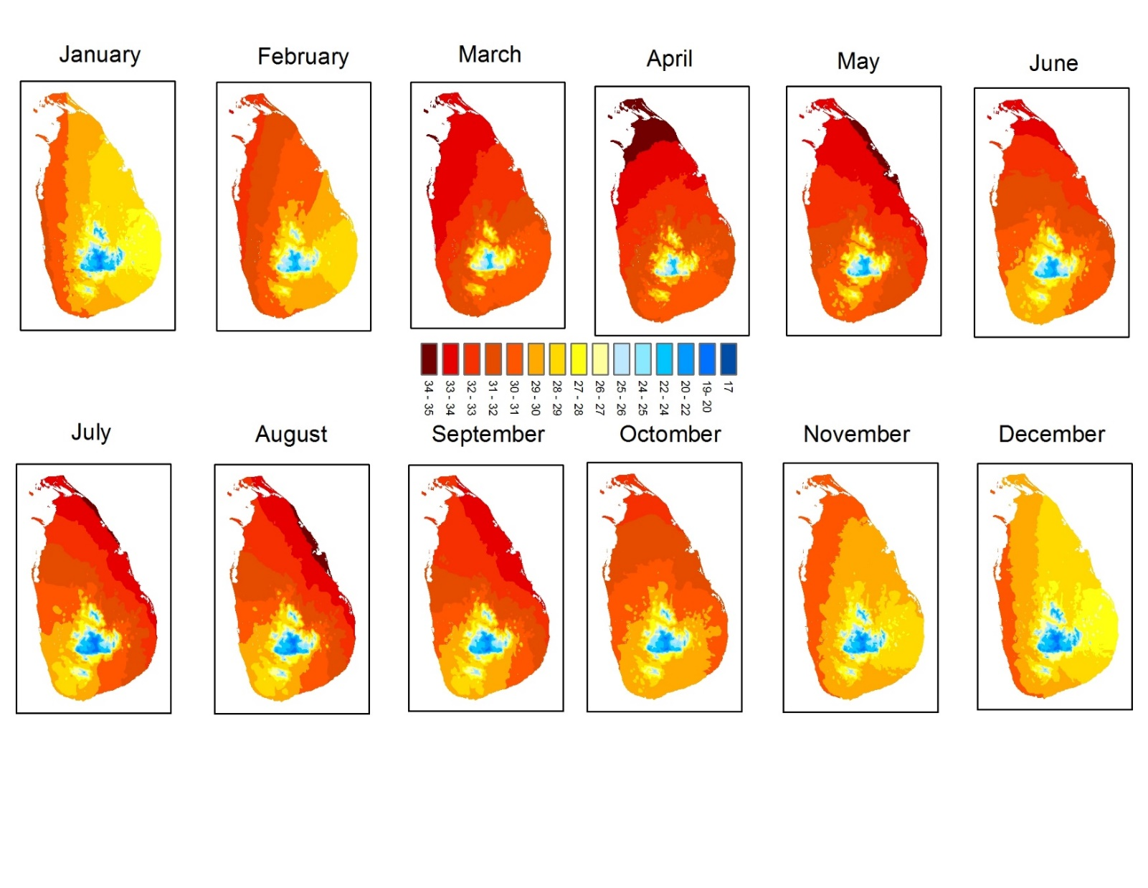
Tmax Climatology
four climatic seasons
First Inter Monsoon (MA), Calm winds
SouthWest Monsoon (MJJAS), South-westerly winds
Second Inter Monsoon (ON) Calm winds
North East Monsoon (DJF) North-easterly winds
Warmer Temperatures
2-4 degrees warmer day and night temperatures experienced during January 2020 (up to 19th January 2020)

Slide 3
What is Sri Lankan Condition ?
Is Sri Lanka getting Heat Waves ?
Are we getting health impacts from high temperatures or heat wave ? Lack of studies
Do we have enough Meteorological and health data ? Yes / No
Any studies or Research activities regarding Heat and Health? No or less
High Risk of Heat waves in Sri Lanka near Future
Global Warming
Urbanization
Increase of Population
Migrate people to urban areas
This is the time for pay attention for heat waves and its preparedness

Slide 4
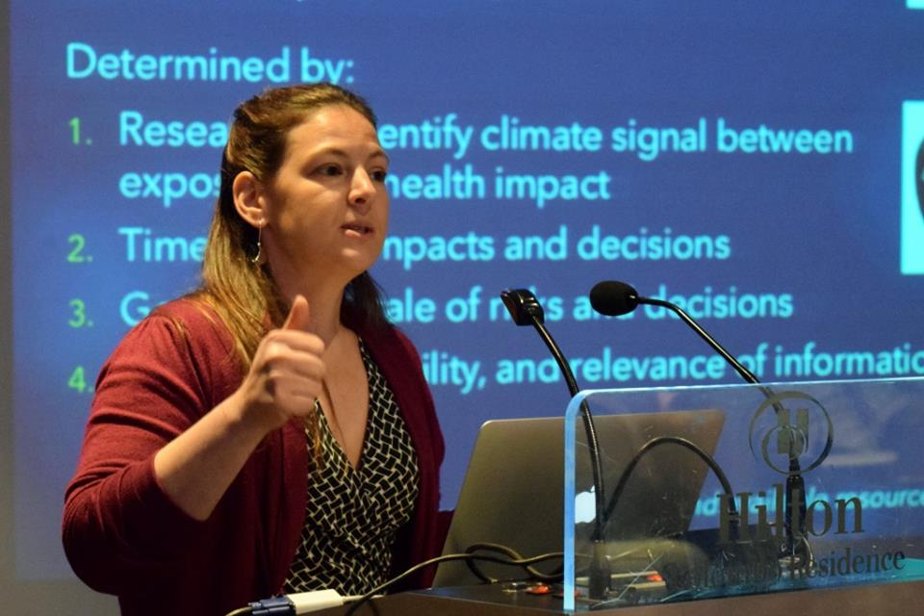
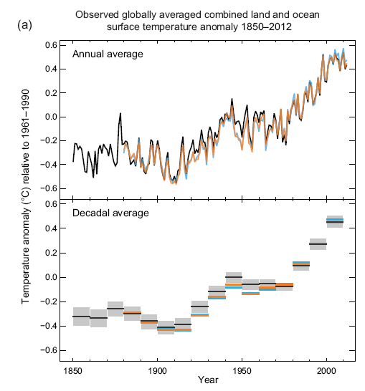
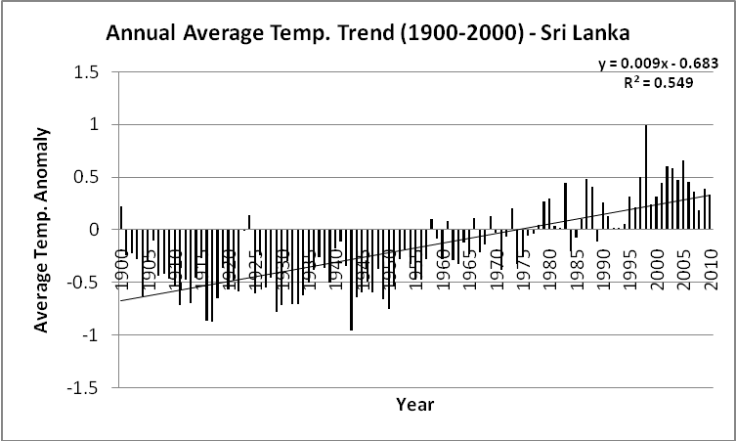
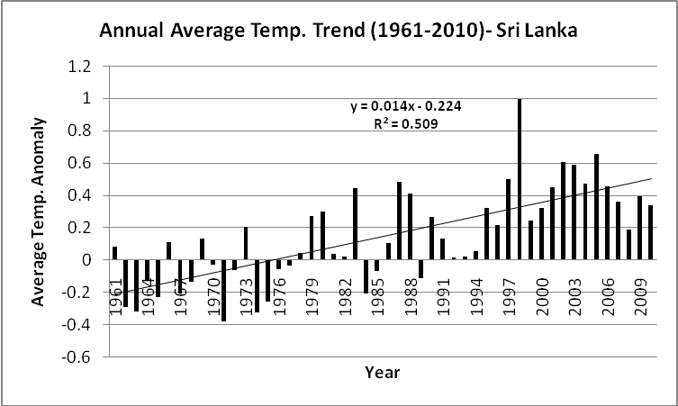
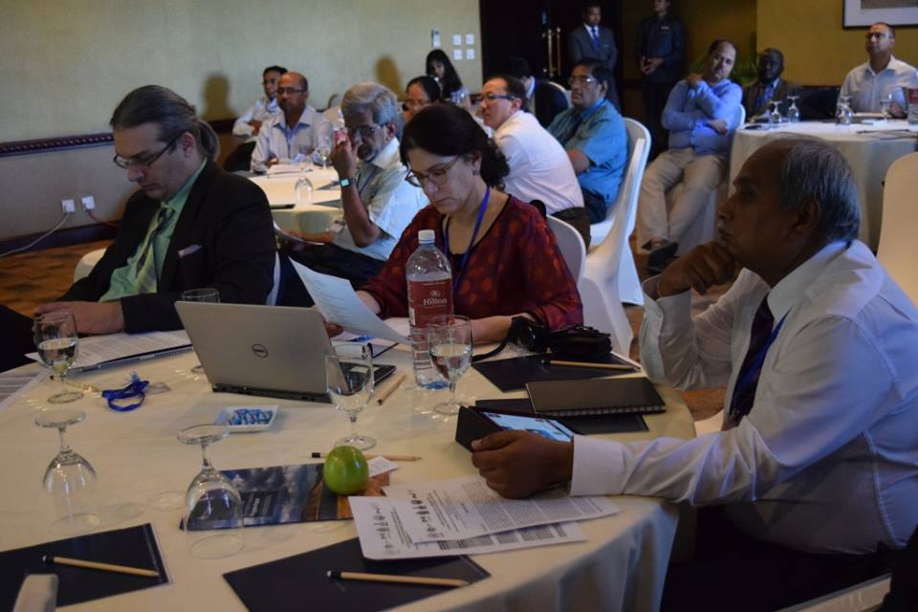
2016 SASCOF Meeting was held in Sri Lanka and there was a separate forum for Climate and Health – 1st Climate Service user forum for Health
Forum focused to Heat Waves in Asian Region
WHO / WMO insisted to prepare Heat – Health Action Plan
Because Heat related mortality is one of the most hazardous disasters
Global and local atmospheric temperature has been increased
Global
Local
Increase of temperature for the period 1900 – 2010
0.9 degree Celsius
Increase of temperature for the period 1961 – 2010
1.4 degree Celsius
0.85

Slide 5
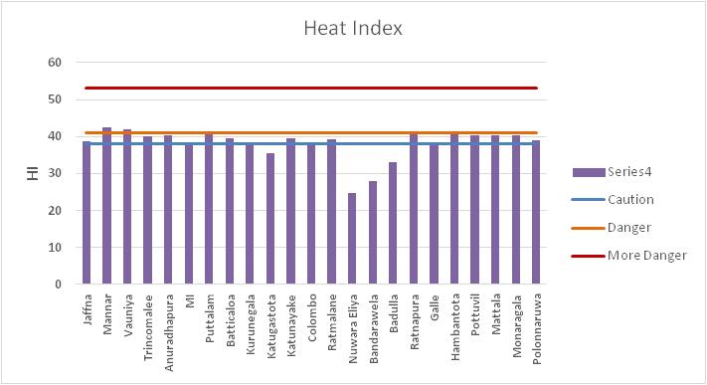
Heat Index
Combination of air temperature and relative humidity — how hot it actually feels.
HI is widely used in the USA
Heat Index(HI) = -42.379 + 2.04901523(Tf) + 10.14333127(RH) - 0.22475541(Tf)(RH) -6.83783x10**(-3)*(Tf**(2)) - 5.481717x10**(-2)*(RH**(2)) + 1.22874x10**(-3)*(Tf**(2))*(RH) + 8.5282x10**(-4)*(Tf)*(RH**(2)) -1.99x10**(-6)*(Tf**(2))*(RH**(2))
Where Tf = air temperature in degrees Fahrenheit, RH= relative humidity
March 21st 2016
at 1430
Source : Premalal 2017

Slide 6
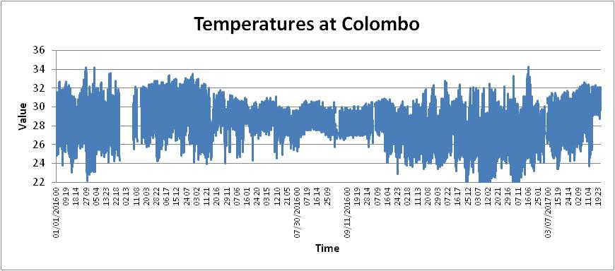
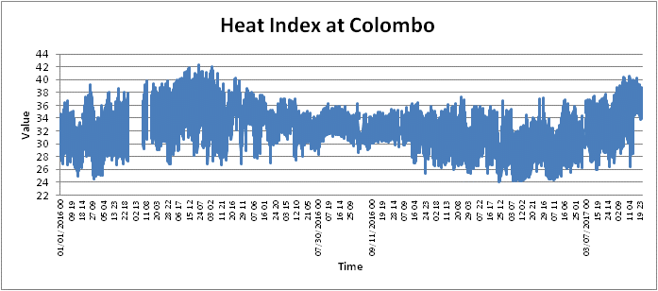
Temperatures and Heat Indices - 2016 and 2017
Low RH
High RH
40⁰C
Source : Premalal 2018

Slide 7
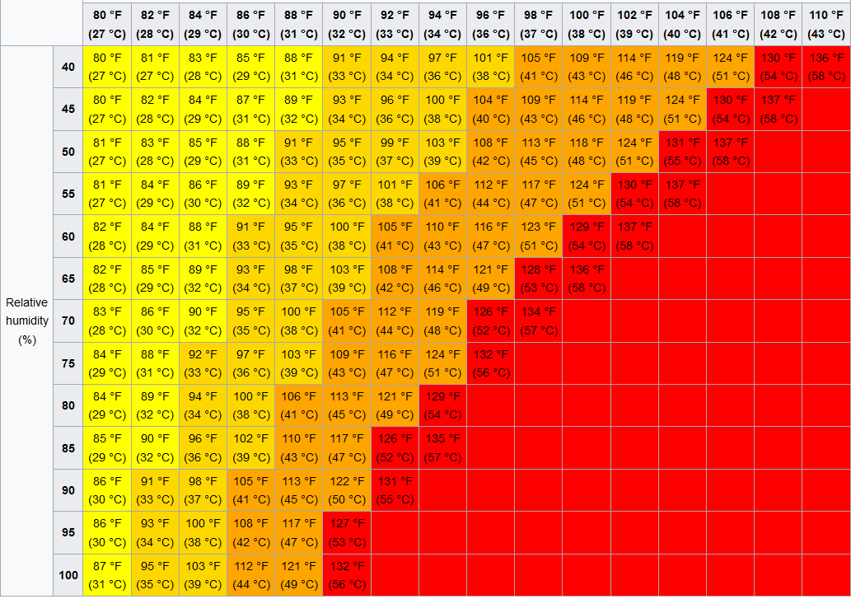
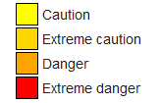
Criteria for For Heat Wave Declaration
But PETER J. ROBINSON Stated that

Slide 8
Heat alert system in Sri Lanka
Heat Alerts are started to issued from 2018 by Department of Meteorology Collaboration with Heath Ministry and Disaster Management Center

Slide 9
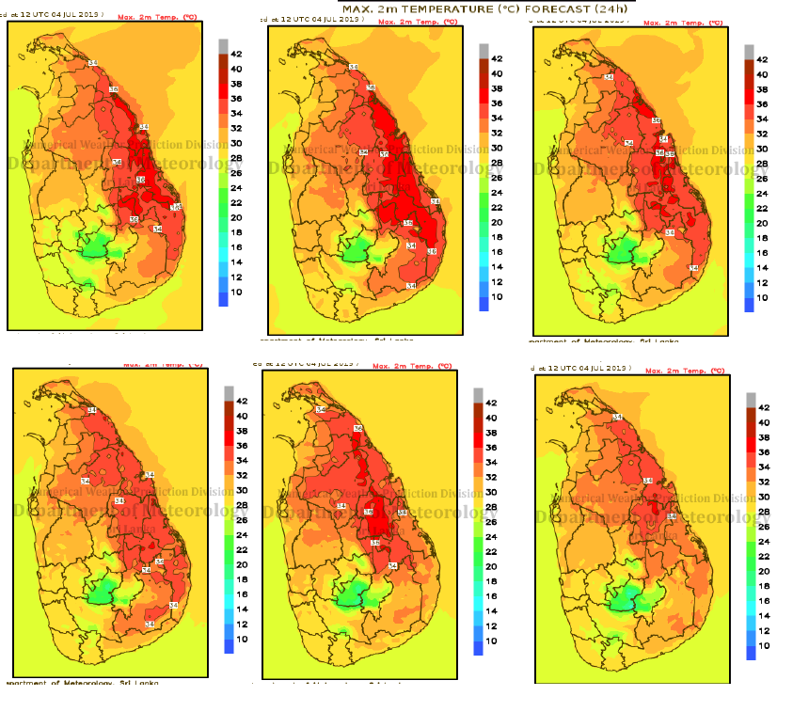
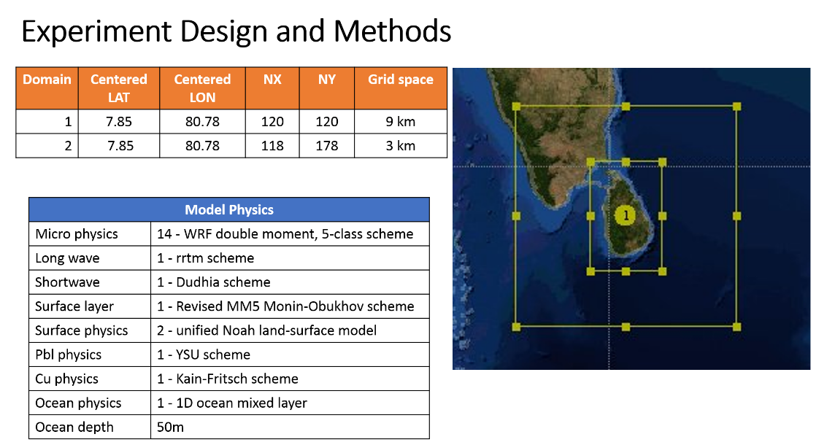
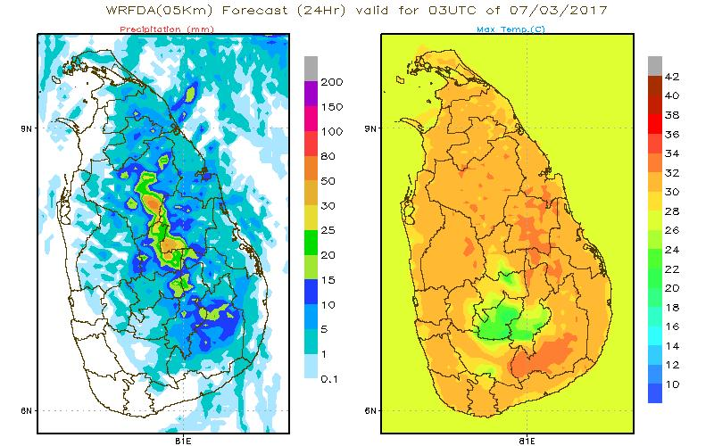
Numerical Weather Prediction
WRFDA ( 5X5km)
GFS reanalysis data (50 km) and ECMWF as boundary and initial conditions from the NCEP Global Data Assimilation System

Slide 10
Heat weather Alerts Department of Meteorology Collaboration with Heath Ministry and Disaster Management Center

Slide 11
Heat weather Alerts Department of Meteorology Collaboration with Heath Ministry and Disaster Management Center

Slide 12
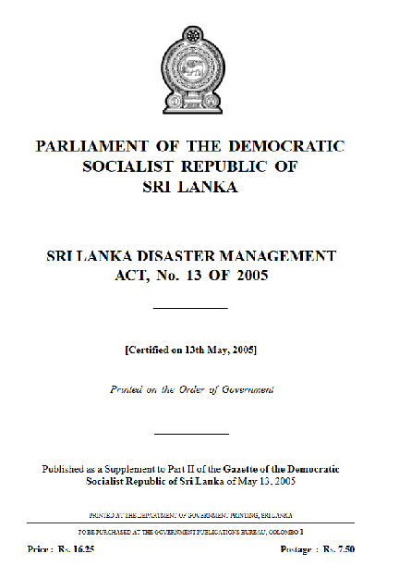
Sri Lanka Disaster Management Act, No 13 of 2005
Landslide
Cyclone
Flood
Drought
Industrial hazard
Tsunami (seismic wave)
Earthquake
Air hazard
Maritime hazard
Fire
Epidemic
An explosion
Air raids
Civil or internal strife
Chemical accident
Radiological emergency
Oil spills including inland and marine oil Spills
Nuclear disaster
Urban and forest fire
Coastal erosion
Tornados, lightening strikes and severe
thunder storms;

Slide 13
If High Temperature / Heat Wave Include in the Disaster Act
Possible to Implement Some Policies
Architectural Designs
Urbanization
High rise Building
Labour rules etc.
Sri Lanka Disaster Management Act, No 13 of 2005
Landslide
Cyclone
Flood
Drought
Industrial hazard
Tsunami (seismic wave)
Earthquake
Air hazard
Maritime hazard
Fire
Epidemic
An explosion
Air raids
Civil or internal strife
Chemical accident
Radiological emergency
Oil spills including inland and marine oil Spills
Nuclear disaster
Urban and forest fire
Coastal erosion
Tornados, lightening strikes and severe
thunder storms;

Slide 14
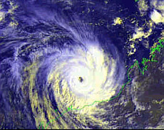
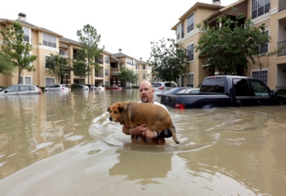
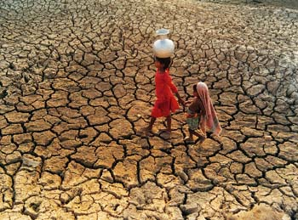
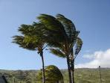
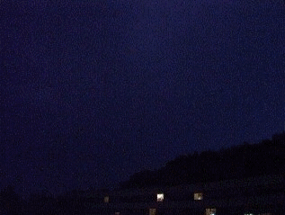
Heat-waves are among the most dangerous natural hazards, but rarely receive adequate attention
Not Adequate Data and Studies (Research)
Disaster Professional / Managers paid more attention for
Cyclone
Flood
Drought
Strong Winds
Thunderstorms
But for high temperatures
Very less attention
Loss and Damages no clearly visible , difficult to Identify / Estimate
Categorized as Silent killers
No proper definition
Lack of awareness from top to bottom
No country specific Threshold values (Heat Index) to categorize the risk

Slide 15


