Slide 1
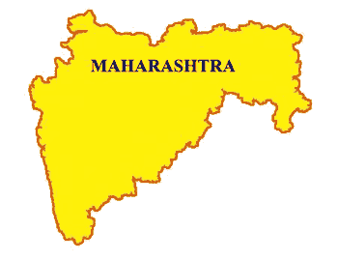
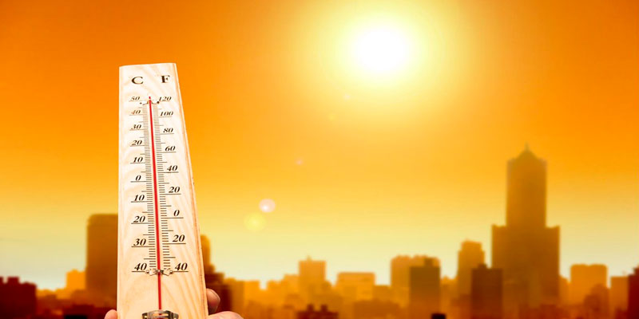
Heat Wave
MITIGATION & RESPONSE

Slide 2
Heat Wave???
No universal definition. Generally defined as a prolonged period of excessive heat.
Based on Actual Maximum Temperature
  40°C or more for the plains.
  37°C or more for the coastal regions
  30°C or more for the hilly regions
The level of heat discomfort is determined by a combination of meteorological (temp, Relative Humidity, wind, direct sunshine), social/cultural (clothing, occupation, accommodation) and physiological (health, fitness, age, level of acclimatization) factors.

Slide 3
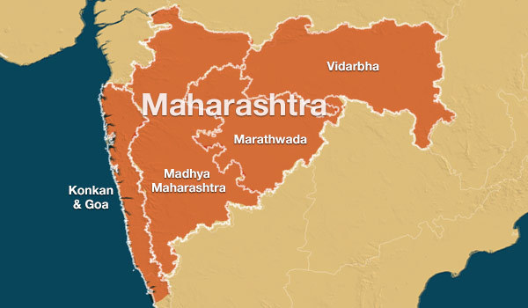
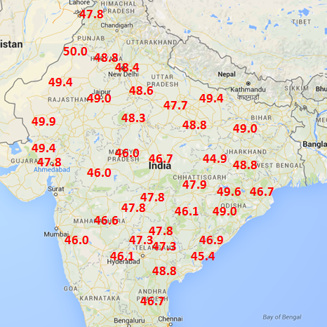
Heat Wave in Maharashtra
Vidharbha, Madhya Maharashtra and Marathwada region highly susceptible to Heat Wave in the State

Slide 4
High Temperatures Recorded in the State
District | Temperature | Date
Nagpur | 45.6°C | May 2, 2013
Brahmapuri | 47°C | May 28, 2013
Chandrapur & Wardha | 46.5°C | May 28, 2012
Chandrapur | 47°C | May 25, 2012
 | 45°C | May 16, 2016
 | 46°C | May 17, 2016
Nagpur | 44.2°C | April 15, 2016
 | 45°C | May 14, 2016
 | 44°C | May 25, 2016
Wardha | 45°C | April 15, 2016
Chandrapur | 46.7 C | April 19 2017
Nagpur | 46.4 C | April 20 2017

Slide 5
Extreme Heat Days in Vidharbha
Year | April |  |  | |May |  |  | June |  |  | Total Hot Days
 | < 42.9°c | 43-44.9°c | > 45°c | < 42.9°c | 43-44.9°c | >45°c | < 42.9°c | 43-44.9°c | > 45°c
2010 | 7 | 19 | 4 | 8 | 8 | 15 | 21 | 8 | 1 | 56
2011 | 30 | 0 | 0 | 20 | 11 | 0 | 28 | 2 | 0 | 13
2012 | 29 | 1 | 0 | 12 | 8 | 11 | 24 | 4 | 2 | 26
2013 | 25 | 5 | 0 | 3 | 11 | 17 | 27 | 3 | 0 | 36
2014 | 28 | 2 | 0 | 24 | 4 | 3 | 21 | 3 | 6 | 18
2015 | 27 | 3 | 0 | 12 | 8 | 11 | 29 | 0 | 1 | 23
2016 | 10 | 17 | 3 | 9 | 11 | 11 | 20 | 6 | 4 | 52
2017 | 18 | 98 | 3 | 12 | 11 | 8 | 29 | 1 | 0 | 32
2018 | 22 | 6 | 2 | 4 | 12 | 15 | 30 | 0 | 0 | 35
2019 | 22

Slide 6
Heat Wave Mitigation & Response
The State Government has prepared a Heat Wave Action Plan for the State in 2018-19.
The Plan has been prepared on the lines of the National Guidelines for preparation of Heat Wave Action Plan.
The Action Plan is activated in the vulnerable areas whenever heat wave conditions prevail in the State.
The Nagpur Municipal Corporation in association with the State Health Dept. has prepared a Heat Wave Action Plan for the Nagpur region for 2019.

Slide 7
Response Phase
Early Warning & Information Dissemination
  The DMU & Health department in regular coordination with the IMD.
  Sends heat alerts to all Division Commissioners, District Collectors, and Municipal Commissioners in the State when predicted temperatures are likely to meet heatwave thresholds.
  Various methods used for information dissemination – telephone, email, SMS
  To ensure last mile dissemination at the district level, the District Collector uses various forms of media
    SMS Blaster
    Local TV ads
    Pamplets, Posters Hoardings
    Local Newspapers
    Radio Jingles
    Whatsapp & Other social media

Slide 8
Colour Coding for heat Wave
Temperature Range | Colour Code
Above 45°C | RED Alert – Take Action
43°C - 44.9°C | Orange – Heat Wave – Take all precautions
Below 43 C | Yellow – Be ready on Standby

Slide 9
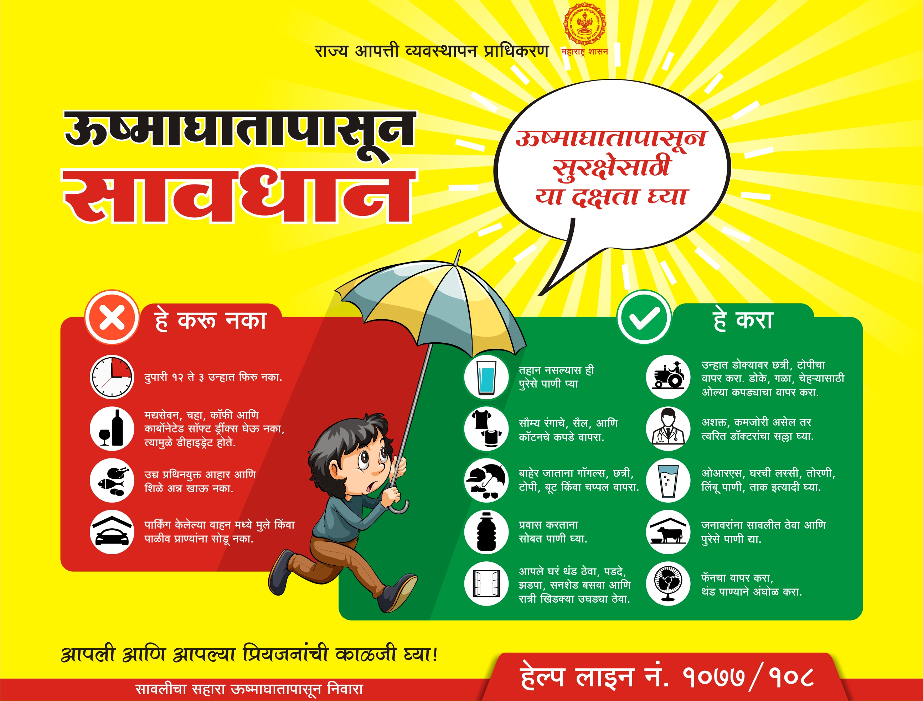

Slide 10
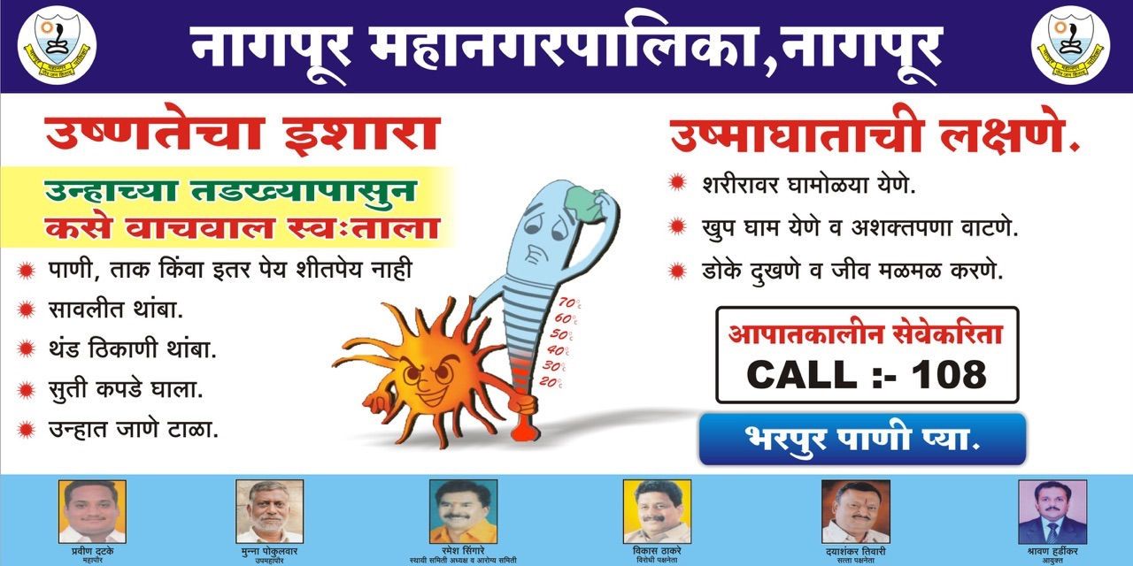
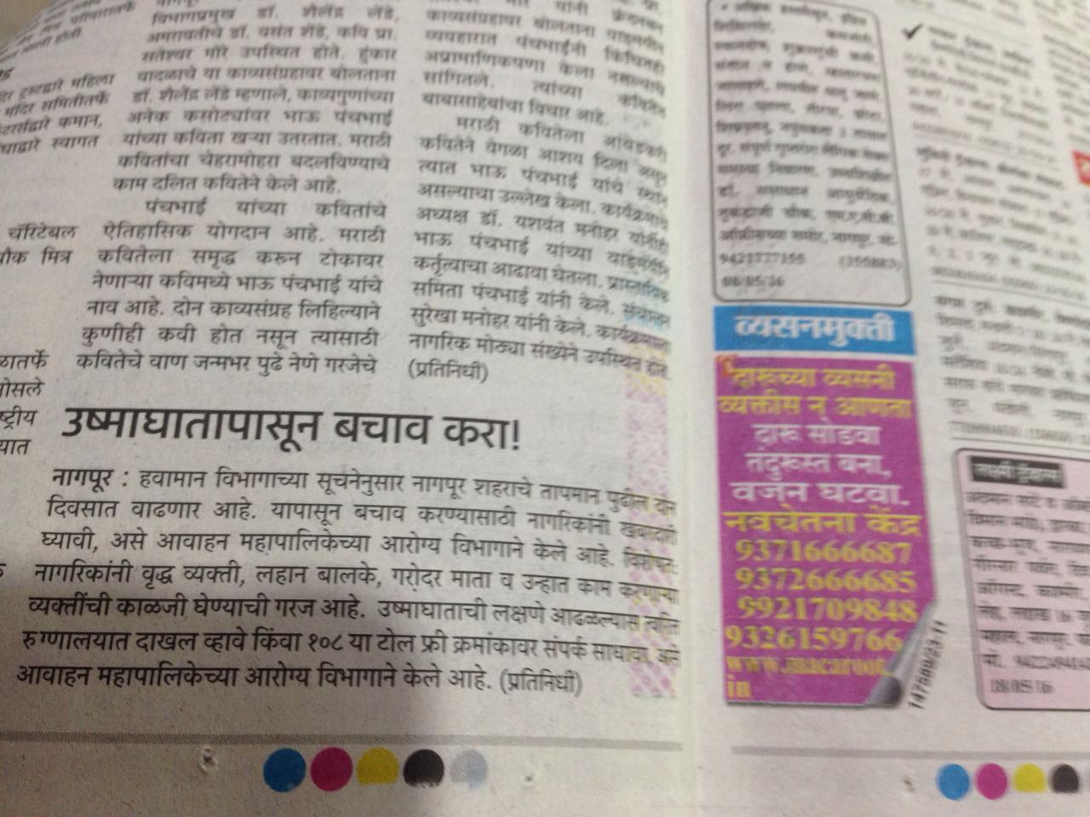
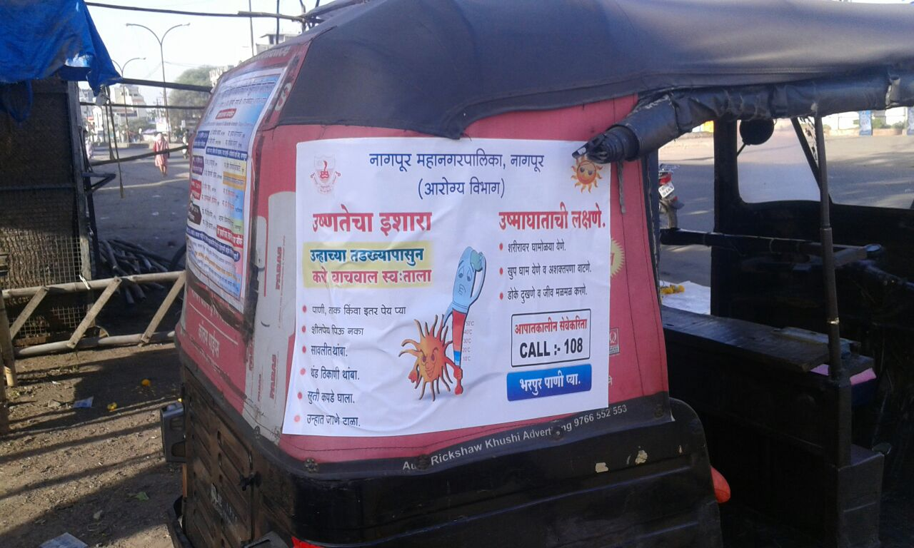

Slide 11
Nodal Departments at the State Level
The DMU – Coordinate with the IMD for early warnings and disseminate the warnings to concerned decision makers at the concerned districts and to the Health department. Assist in trainings of stakeholders.
The Health Department – Act as the main nodal department - update the HWAP – create modules and assist districts in carrying out trainings – coordinate with all hospitals
DMU & Health department together must carry out awareness campaigns & carry out capacity building activities.

Slide 12
State Level Initiatives…
The DMU under the MDRM program carries out programs for orientation and trainings of stakeholders like the Hospital staff, District DM authority officials etc. about their role in combating heat wave.
The Health department taking trainings with hospital staff, ASHA workers, Para medical staff
Workshops with IMD in affected regions.
Long term measures – Afforestation – Planting of more trees – more drinking water spots – Public Shelter spots

Slide 13
Some Other Notable Initiatives
Change in school timings – No schools after 15th April.
Change in working hours for Labour
Markets Closed from 12 to 4 in the afternoon
No load shedding in afternoon hours.
Sprinklers for cool mist on railway platforms
Change in corporation timings
Gardens open in afternoon (7 am to 9 pm)

Slide 14
Some Other Notable Initiatives
Do’s and Don’ts disseminated through Smart City LED TV’s.
Cool Jackets and helmets distributed to Traffic Police
Forecast through SMS in Gadchiroli
Rain Water Harvesting made compulsory
Use of light colours in Government Buildings, Schools, Offices and Housing Societies
Permanent Roofs in Market Places for salesmen

Slide 15
Long Term Initiatives being Undertaken
Creation of more Drinking Water Spots and Gardens
Tree Plantation in Nagpur City
Shelters for on duty traffic police
Use of green nets in market area

Slide 16
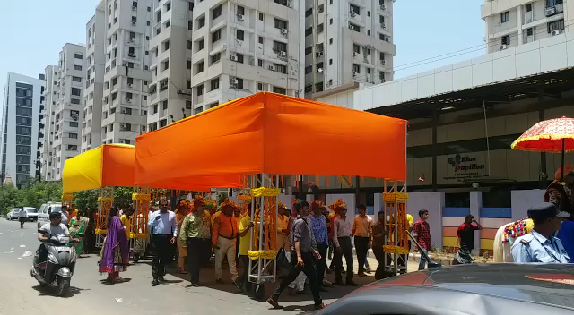
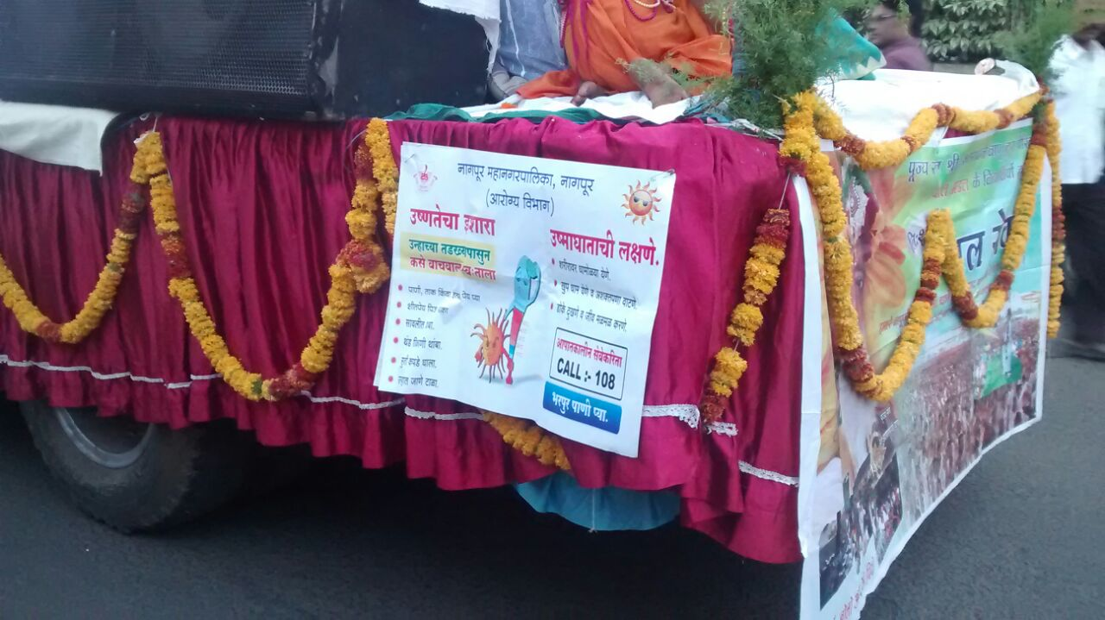

Slide 17
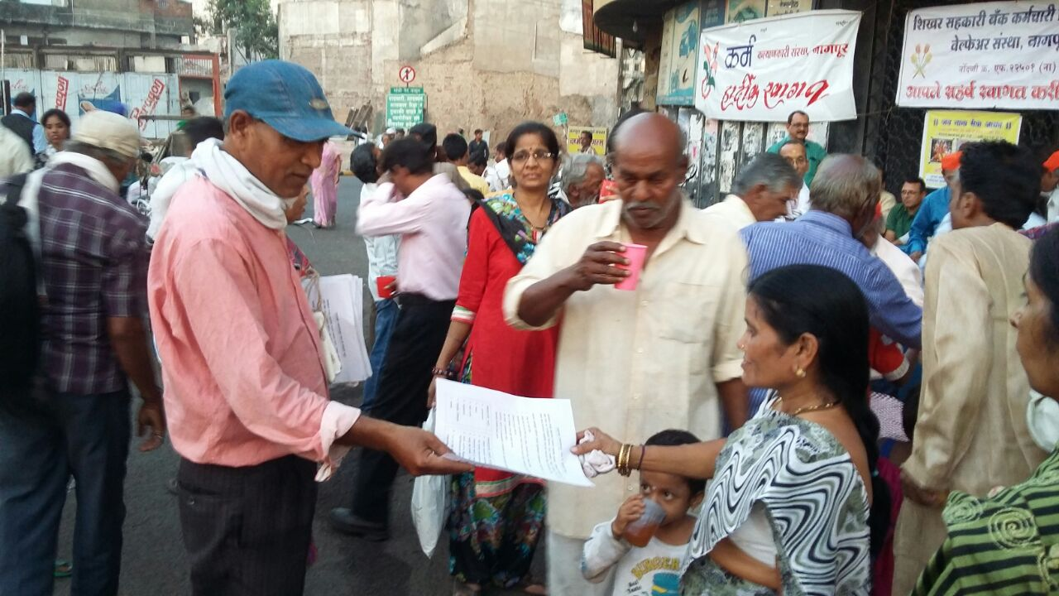

Slide 18
THANK YOU.

