Slide 1
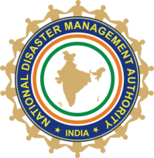

Heat Action Plan
Process and Implementation in India
Anup Kumar Srivastava
National Disaster Management Authority (NDMA)
Government of India, New Delhi

Slide 2
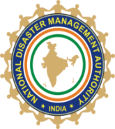
Background
India, with 1.4 billion population (Census 2019), 31% urban and 69% live in rural areas
Climate change is increasing extreme weather events
Heat waves condition are becoming more frequent, severe and long duration
In India increasing trends of heat-wave (9, 13, 17, 19 and 23 states affected in 2015, 2016, 2017, 2018 and 2019 respectively)
Heat waves caused 25,743 deaths between 1992 and 2016

Slide 3
Objectives and challenges
Objectives
Reduce the negative impact of extreme heat
Reduce the risk of loss of lives, livestock and livelihood.
Challenges:
Lack of accurate information and data related to Heat – health impact
Lack of Institutional mechanism
Lack of Awareness
Lack of Capacity /understanding
Lack of inter-agency coordination
Heat-wave is not a notified as natural disaster list in India

Slide 4
Initiatives and process
Pro-active initiatives/Actions
Assessed the complexity of the issues
Heat wave is preventable
Multi - Sectoral, multi dimensional approach
Strengthen the governance to tackle heat wave
Decided to prepare a guidelines for preparation of action plan, aims to provide a framework for implementations, coordination and evaluation of extreme heat response activities
Get involve the various experts
Constitute an Expert Group i.e. Meteorological expert, Health experts, Disaster managers, Policy maker, Research Institutions, and Government Administration etc.
Organise Expert Group Meeting time to time and get inputs

Slide 5
Process Followed for Preparation of Guidelines and Action Plans
1. Identify felt need and determine objective
2. Lay down road map with milestone
3. Constitute core group/expert groups
Core Group Deliberations
  a. Analysis of the needs & objectives
  b. Evolve & Examine possible options
  c. Possible Initial draft
1. Build on existing strengths and take care of identified gaps
2. Define approach
3. Identify partners & stakeholders
Detailed Examination and Firming up of Option
Finalization draft (Core group/expert group)
Consultation with partner & Stakeholders
Prepare Final Draft (Guideline)
Shared with ministry/department/states and expert groups for comments
Revised and finalized Guideline
Put up for vet and approval
Issued of the Guideline for preparation of Action Plan by all Central Ministry/Department and states

Slide 6
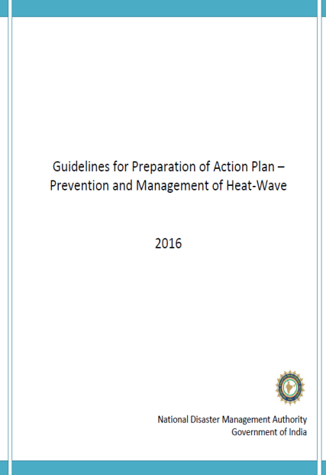
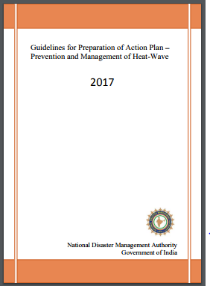
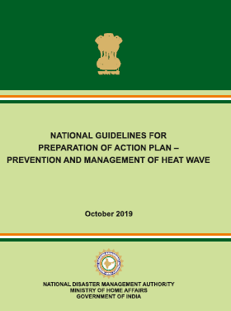
Heat Wave Guidelines
National Guidelines of Heat wave
“Guidelines for Preparation of Action Plan – Prevention and Management of Heat-Wave –issued in 2016”
“Issued a Revised Guidelines for Preparation of Action Plan – Prevention and Management of Heat-Wave-2017 and 2019”
To facilitate preparation of a Heat Wave Management Plan.
To help in mobilization and coordination of various stakeholders

Slide 7
The National Guidelines for preparation of Heat Action Plan
2. Preparing Action Plan
(Heat wave under DM Act, Rational, Objectives key strategy and steps for develop an action plan)
1. Background and Status
(Including Introduction, definition, impact and Past experiences)
3. Early Warning and Communications
(Forecast and issuance of Alert/warning, Colour Code signals for Heat Alters, communication and dissemination strategy etc)
The Guidelines comprise of 5 Chapters,7 Annexure
4. Dealing with Heat related Illness (Prevention and Management of Heat wave, Hospital preparedness for heat wave illness and identification of heat related illness and deaths
5. Roles and Responsibilities Matrix for Managing Heat wave by Ministries/Dept and states
Annexure:
Local Threshold Determination & EWS, Case Definition, Heat illness treatment protocol, Do’s and Don’ts
Annexure:
Record of data and documentations (Reporting & documentation format – for district to national level)

Slide 8
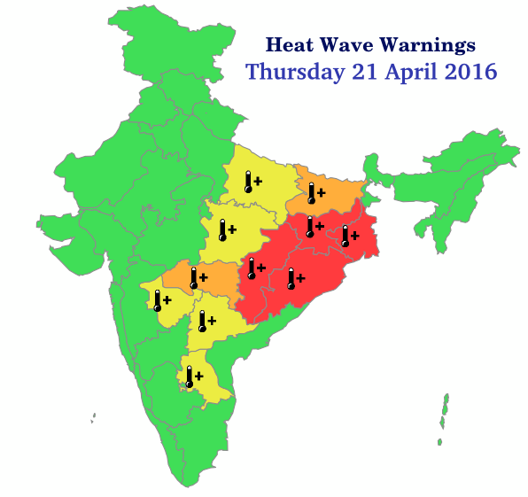
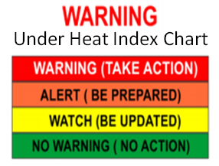
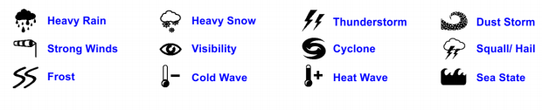
Heat-Wave Early Warning System
IMD Initiatives
  ‘Nowcasting’ - 3 to 6 hours
  Short Range - 1 to 3 days
  Medium Range - 4 to 10 days
  Long Range - > 10 days
  Local forecast - District and Sub District Level
  Also Issued an Advisory to all states
Source: Indian Meteorological Department (IMD)

Slide 9




IDSP-NCDC (MoH&FW) Initiative
Update heat health action plan
Issued an Advisory of Hospital preparedness
Coordination and facilitation of State Health Departments
Surveillance & weekly monitoring
Collecting data from states & maintain at national level
Capacity building of health personnel's

Slide 10
Steps to Develop Action Plans
Step 1: Government Engagement
Step 2: Appointing a State Nodal department and Officer
Step 3: Vulnerability Assessment
Step 4: Drafting and Developing the Action Plan
Step 5: Team Preparation and Coordination
Step 6: Implementation and Monitoring
Step 7: Evaluating and Updating the Plan
Step 8: Strategies for Adapting to Climate Change (Long term plans)

Slide 11

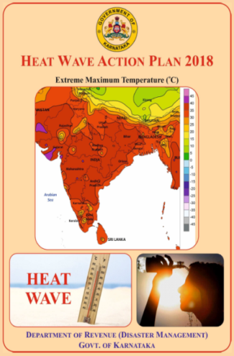
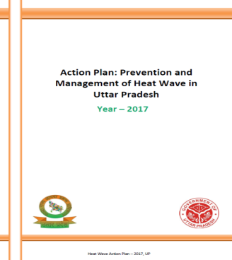
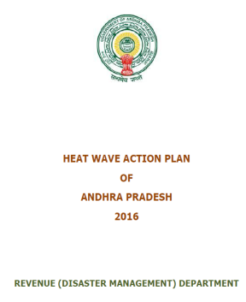
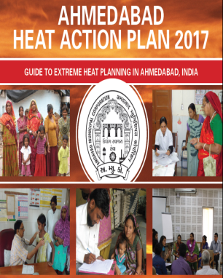


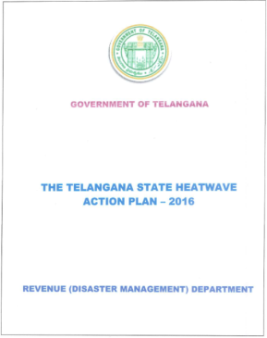
Heat-Wave Action Plan align with National Guidelines
15 states and more than 100 district/cities have a plan

Slide 12
Overall heat-waves management strategy
Develop Inter agency coordination and response
Early Warnings and communication system
Develop Institutional mechanism to effective work for prevention preparedness mitigation and response actions
Health system capacity building
Public awareness and community outreach
Technical support to states to preparation of HAP
Regular follow up with state government for preparing HAP and implementing them.

Slide 13

Early warning
Issue of warning/alerts
Warnings published in local media
colour coding for heat wave
Mitigation Meas.
Special shelters
Drinking water
Change Work timings
Animal shelters
Awareness generation
Issued Advisory
Do’s and Don’ts and
IEC material
Long term measures
Cool roof Technology
Forest Coverage
Green areas
Integrate climate variability
Added in school curriculum
Review and Monitoring
Heat Action Plans
Video Conferencing
Data collection and Analysis
Preparedness Meas.
Implementation of HAP
Capacity Building
Repairing Drinking Water
Stockpiling of (ORS
Setting up control room
Heat waves Implementation
National Disaster Management Authority, A-1, Safderjung Enclave, New Delhi, India

Slide 14
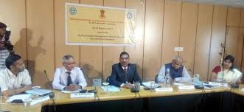
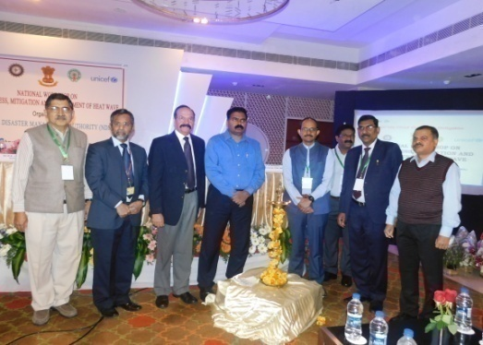
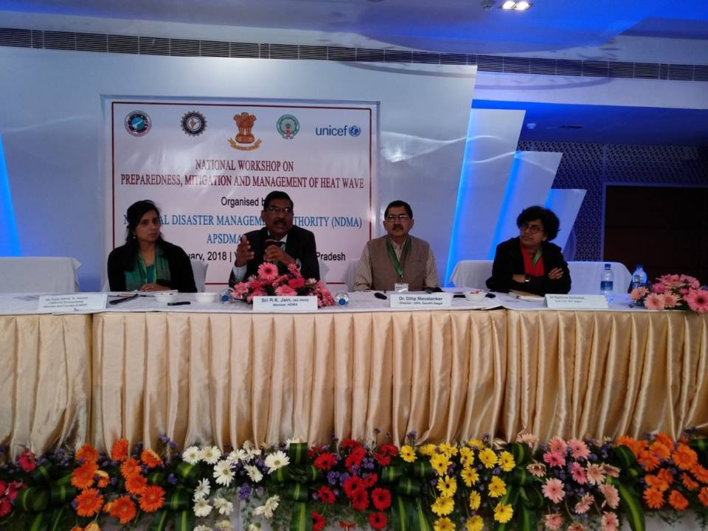
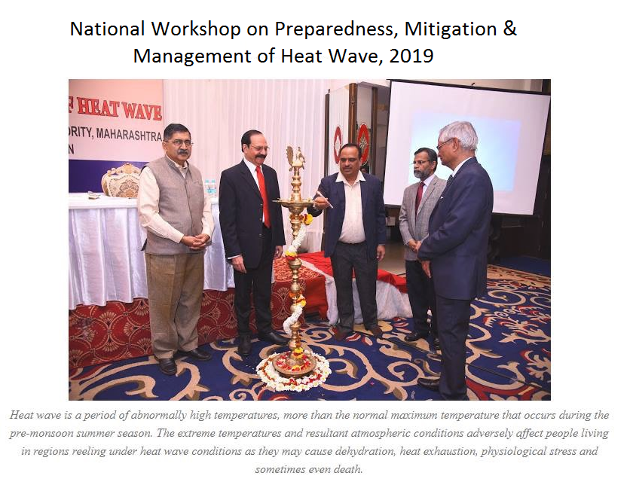
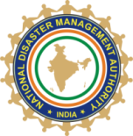
National Workshop on Heat wave in collaboration with State governments
The overall goal of the workshop to guide states in the operationalzing of heat action plans in their respective states to protect communities from extreme heat and save lives.

Slide 15
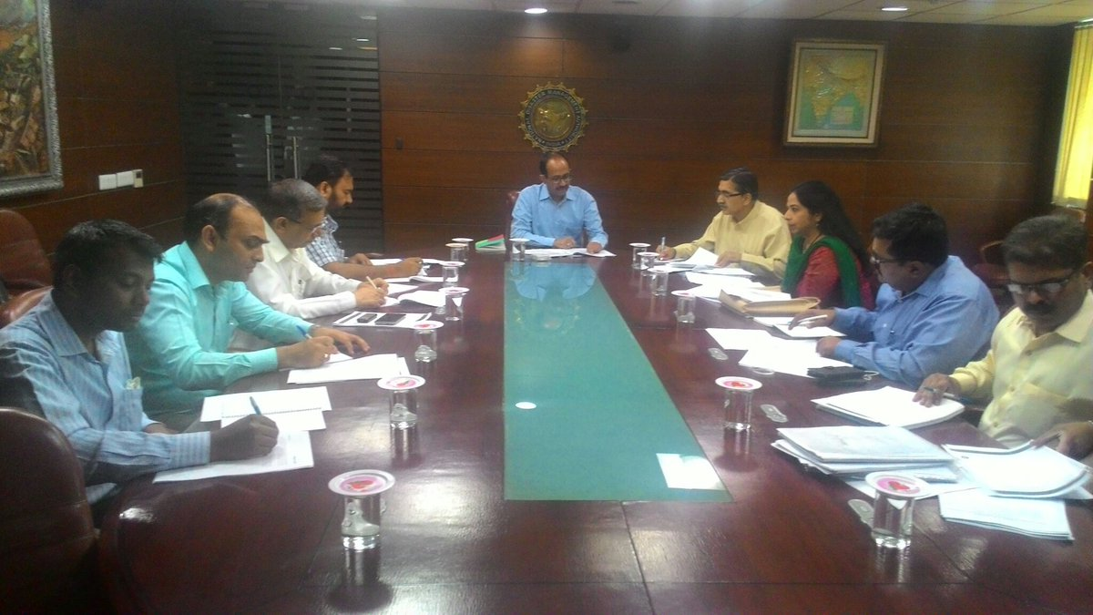
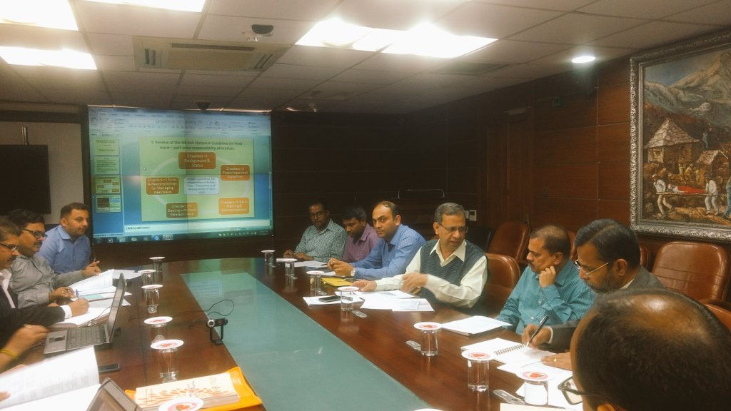
Constitute Expert Committee
Frequently meet with Expert Committee
Technical Inputs

Slide 16
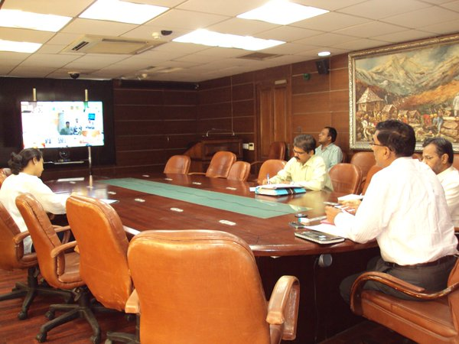
Reviewing Heat wave preparedness through Video Conference with heat prone states

Slide 17
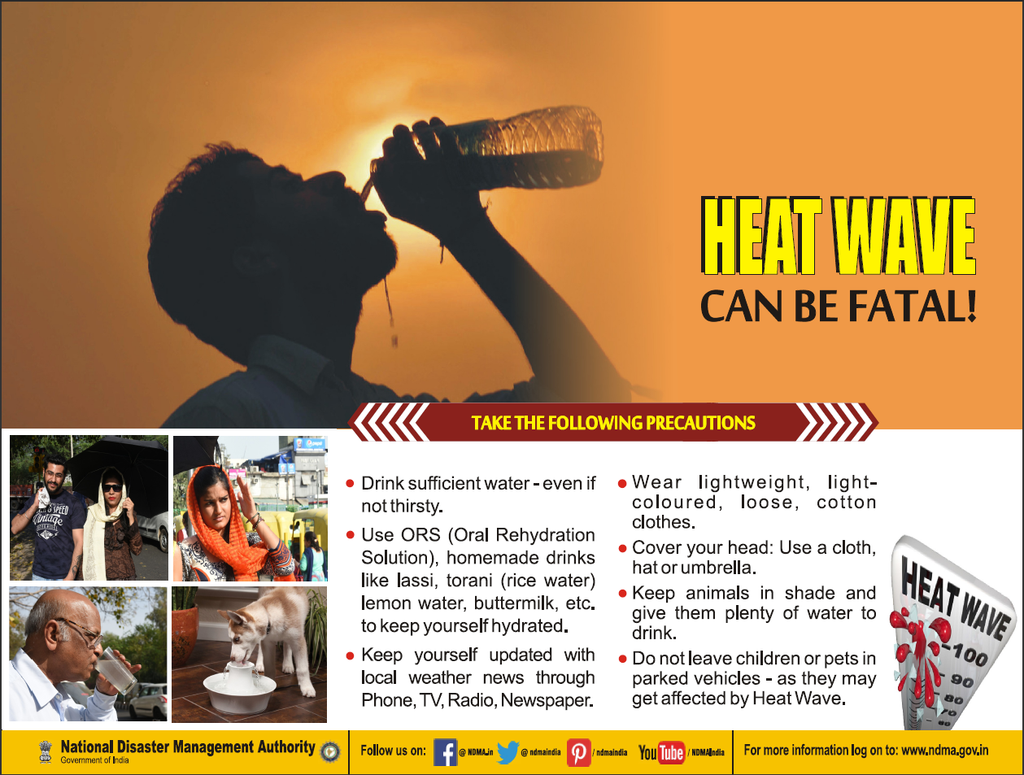
Publicity & Awareness

Slide 18


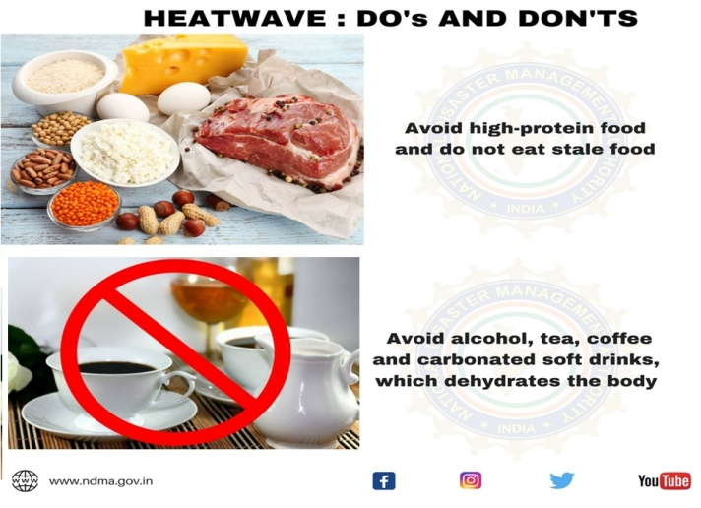
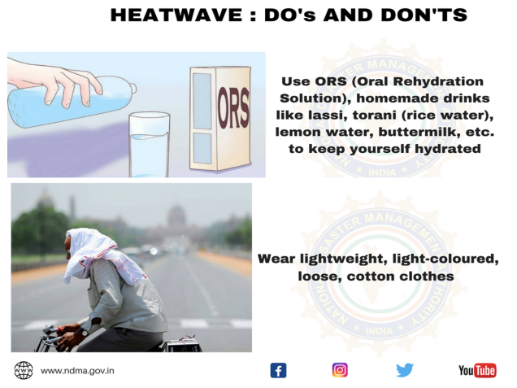
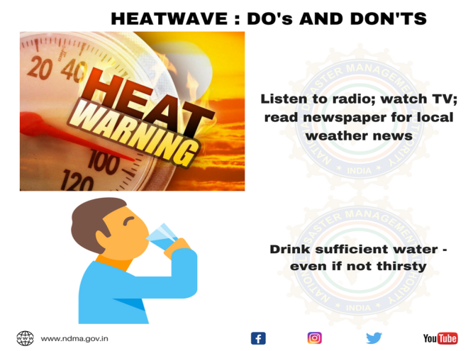
Social media campaigns
Do’s & Don’ts
Facebook
Twitter
LinkedIn
TVCs Commercial
Print & Electronic Media

Slide 19
Actions
State /Local Actions
Early warning dissemination
Issue of daily warning using email, fax, mobiles whatsapp etc.
Warnings published in local media.
Display board of colour coding for heat wave alertness
Advisories for tourists.
Preparedness
Setting up of state/district control room
Prepare and Implementation of Heat Wave Action Plans
Stockpiling of Oral Rehydration Solution (ORS)
Repairing Drinking Water hand pumps
Renovation and deepening of water bodies under MNREGA
Capacity Building of Health personnel

Slide 20
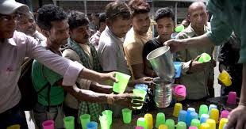
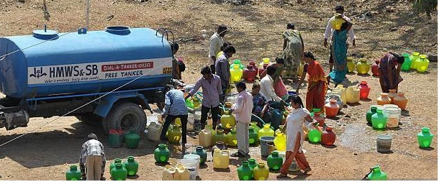
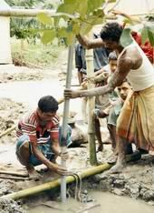
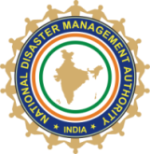
Actions
Mitigation
Early start and early closure of schools/colleges /department
Establish Drinking water kiosk/stall.
Supply of water through tankers.
Setting up special shelters for “Wage Employment programme”
Work timings for outdoor/construction workers are adjusted to avoid exposure to extreme hot weather periods
Construction of Animal shelters with fodder banks
Pre-positioning of adequate veterinary medicines and supplies

Slide 21
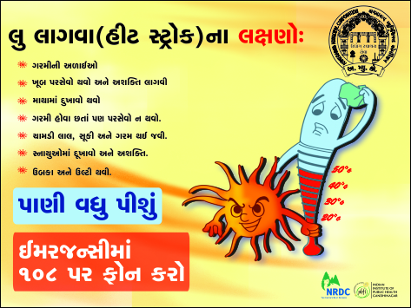
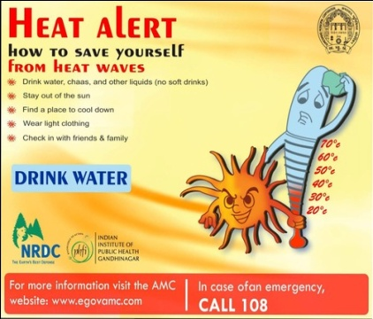
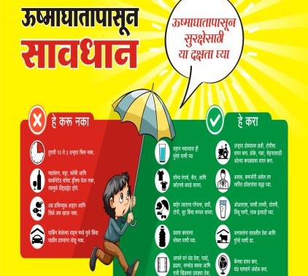

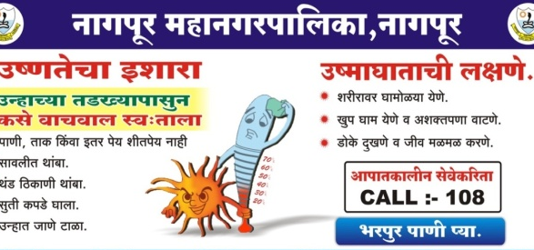
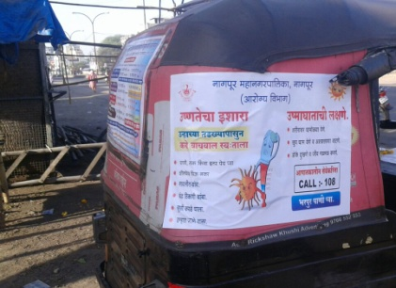
Awareness generation
Disseminations Do’s and Don’ts and IEC material in local languages.
Information dissemination in local newspapers
Radio jingles and TVCs in regional language.
Harnessing Social Media for outreach
Mass mailing and text messages

Slide 22
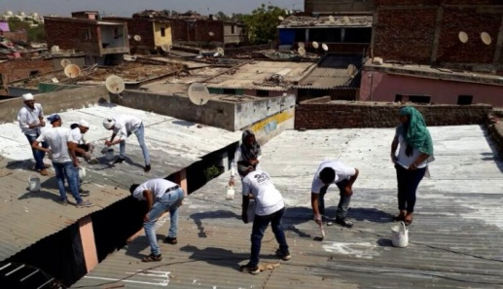
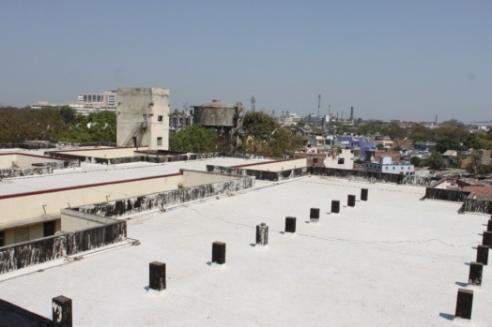
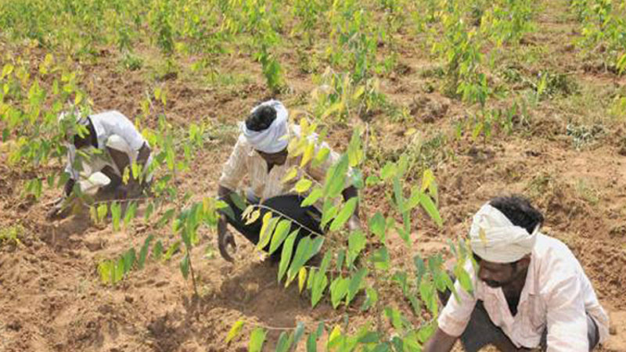
Actions
Long term measures
Adopting Cool roof as a Long term measure (Lime based white wash, white ceramic tiles covering) which can reduce temperature by 3-7 ˚C for indoors
Operational forecast of maximum temperature in short, medium and extended range timescale
Integrate climate variability mitigation and adaptation efforts in HAP.
Improving Forest Coverage and Green areas
Health-harming air pollution apportionment studies, and health impact assessments of ambient and household air pollution

Slide 23
Review and Monitoring
Review of heat wave preparedness and implementation of Heat Action Plans
Review of heat wave preparedness through Video Conferencing at district level
Data collection and Analysis
Documentation

Slide 24
Vulnerability Assessment, Action and Impact
National Actions
Issued a Guidelines for HAP
Organized National Workshop
Reviewed through VC
Expert Group for Tech. inputs
Specific advisory
Monitoring and follow up
Mass awareness Campaign
National Disaster Management Authority, A-1, Safderjung Enclave, New Delhi, India

Slide 25
Impact: Intense and sustained efforts by stakeholders (Increasing heat wave and Reducing Heat wave Impact)
Year | Vulnerable state & districts |  | Mortality and Affected People
 | Vulnerable States | % of Heat affected Districts (under Heat Index) | Heat affected People (Recorded) | No of deaths due to Heat (Recorded) | % of deaths against affected
2015 | 9 | 29.84% | 28500 | 2040 | 7.15%
2016 | 13 | 35.16% | 35121 | 1111 | 3.16%
2017 | 17 | 41.06% | 39563 | 384 | 0.97%
2018 | 19 | 52.37% | 6137 | 25 | 0.40%
2019* | 23* | NA | 14552 | 215** | 1.47%
= Seasonal outlook by IMD (01.03.2019)** = up to 31.07.2019
Source:Heat wave daily update, IMD, 2019, SEOC Weather report and Ministry of Health & Family Welfare, Govt. of India

Slide 26
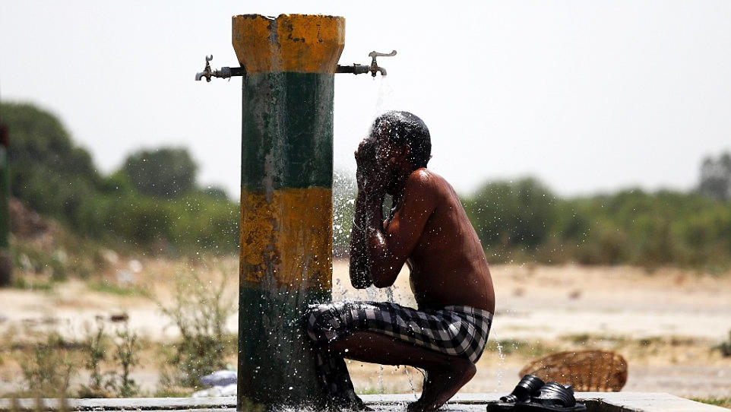

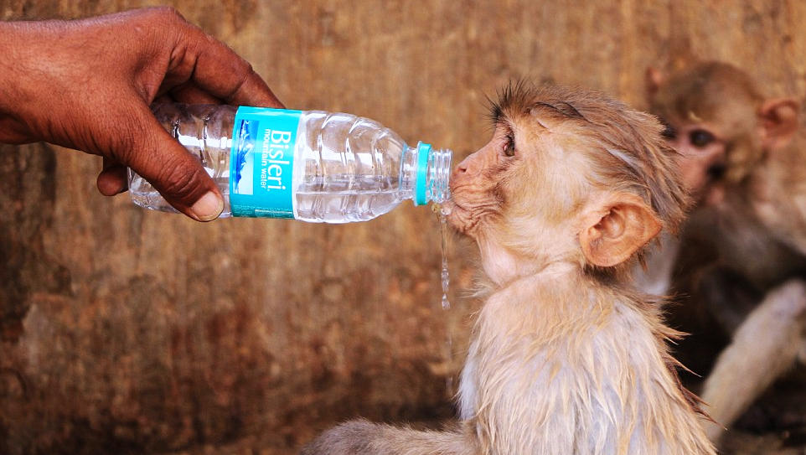
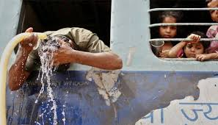
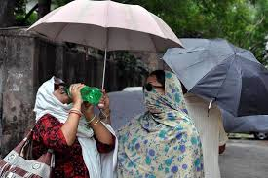
THANK YOU
Actions lead to Risk Reduction

