Slide 1
Extreme Heat Outlook
A developmental product for the health sector
Indian Institute of Tropical Meteorology
Dr. A. K. Sahai

Slide 2
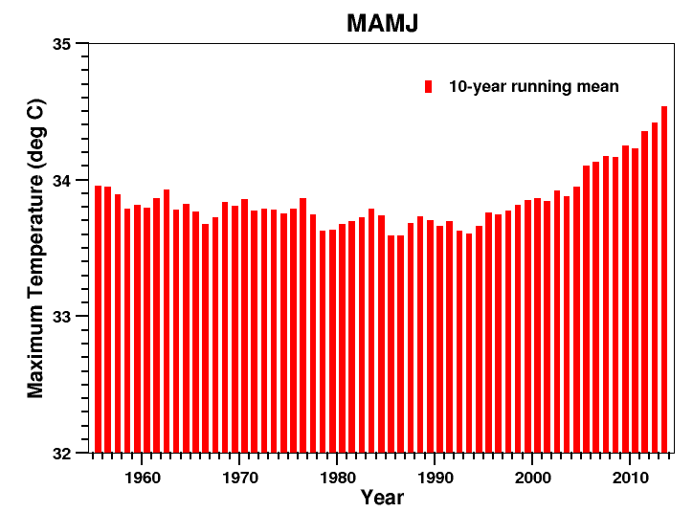
All India averaged Tmax during MAMJ
10 years running mean
In recent decades, the mean maximum temperature has been increased. Thus, the total no. of HW days in recent years has been increased

Slide 3
Heat wave definitions
HEAT WAVE day | T_{max} > 36 °C AND T_{max} ≥ 95th percentile (calculated from daily values during MAMJ) AND T_{max} departure from normal > 3.5 °C OR T_{max} > 44 °C
SEVERE HEAT WAVE day | T_{max} > 36 °C AND T_{max} ≥ 95th percentile (calculated from daily values during MAMJ) AND T_{max} departure from normal > 5.5 °C OR T_{max} > 46 °C

Slide 4
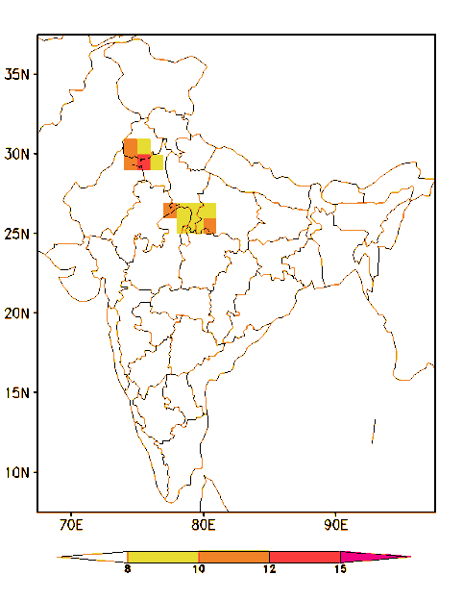
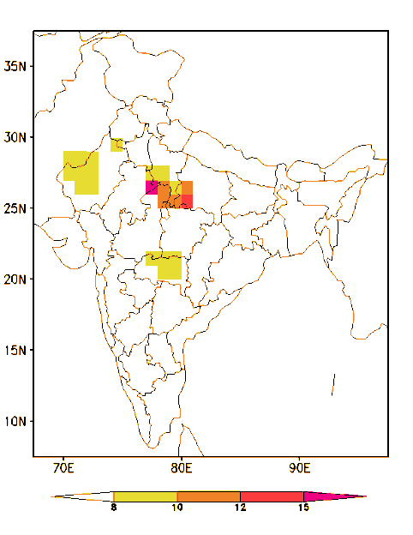
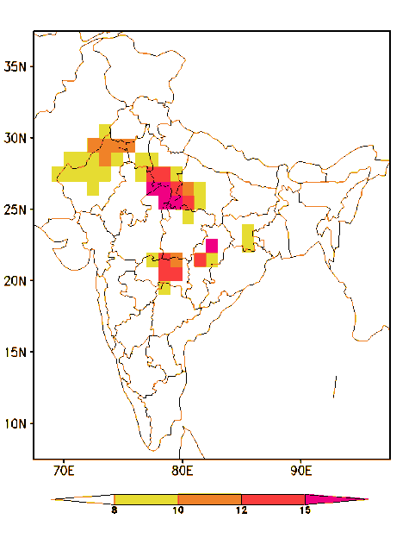
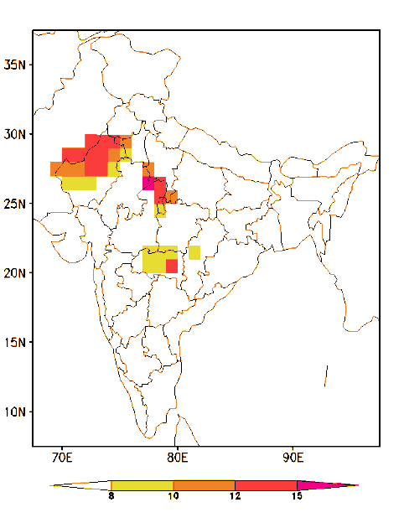
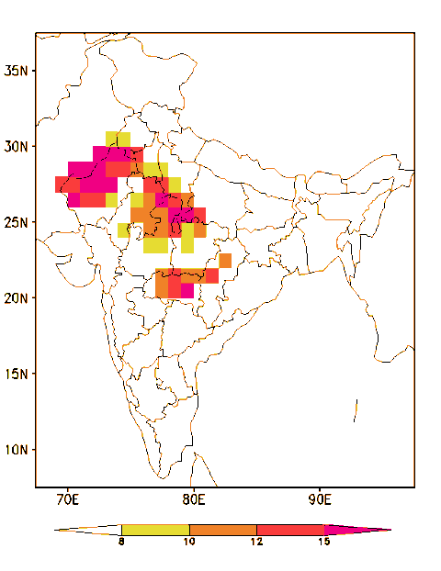
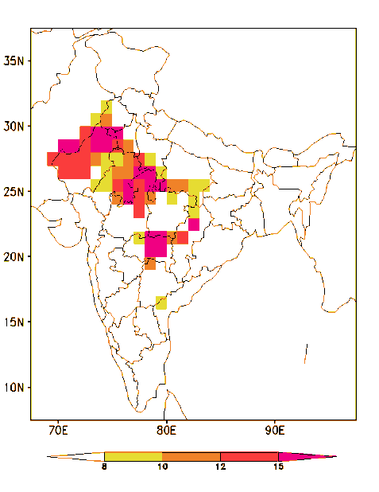
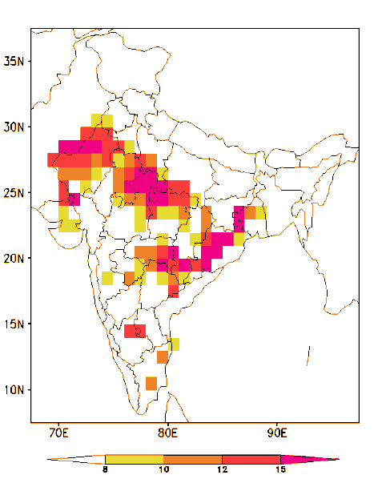

Average Heat Wave days during March-June
1951-1960
1961-1970
1971-1980
1981-1990
1991-2000
2001-2010
2011-2017
A large region of southern parts and east coast regions are mostly affected by HWs in recent decades (no. of HW days also increasing)

Slide 5
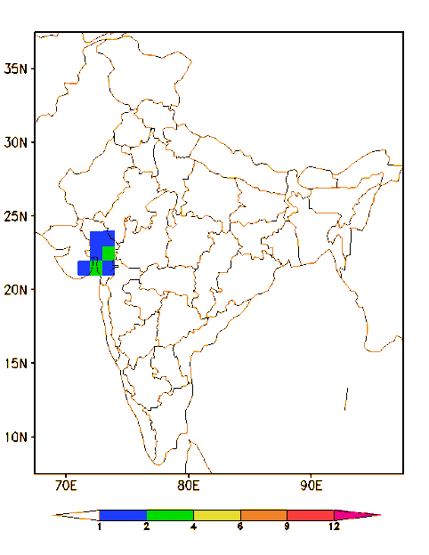
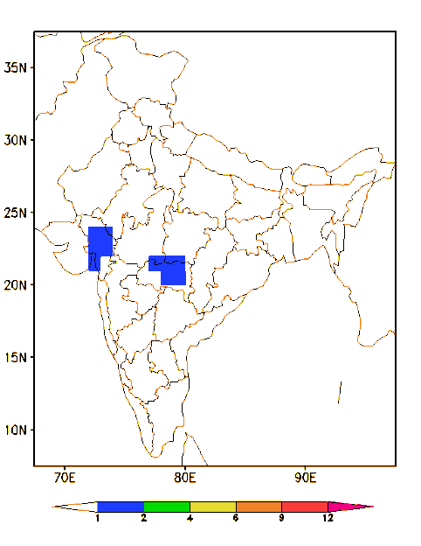
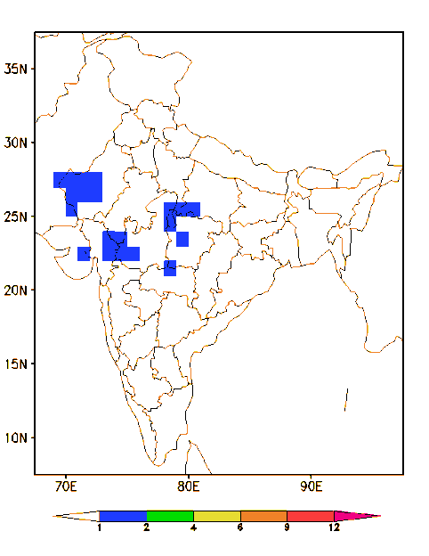
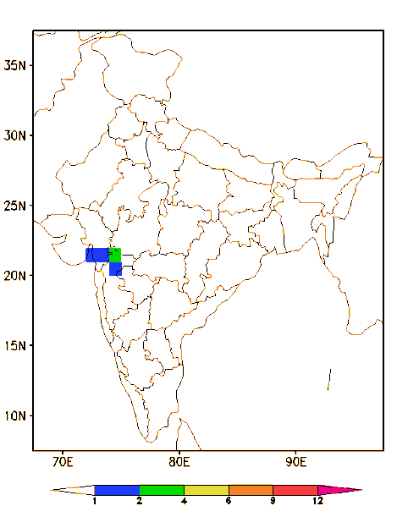
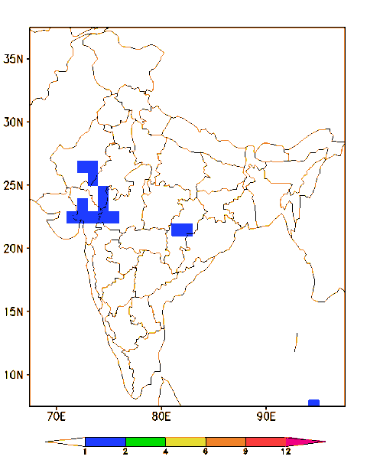
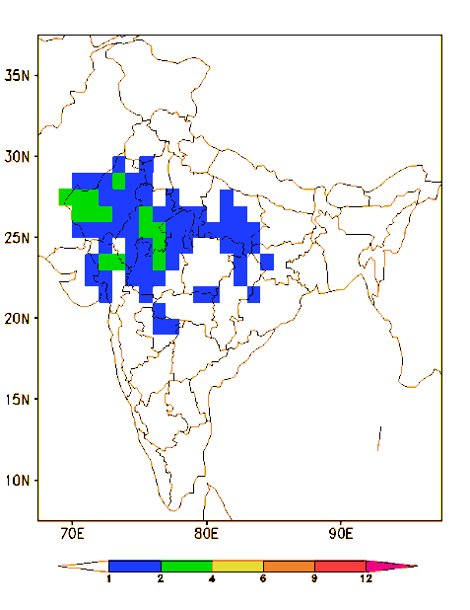
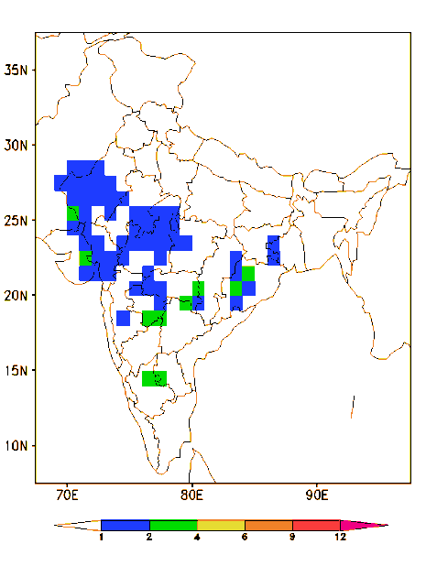
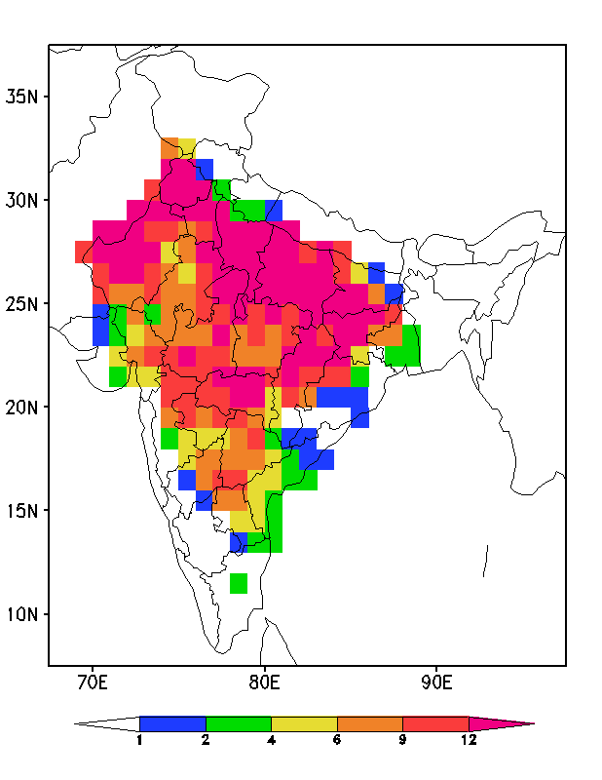
1951-1960
1961-1970
1971-1980
1981-1990
1991-2000
2001-2010
2011-2017
Average Heat Wave days during March

Slide 6
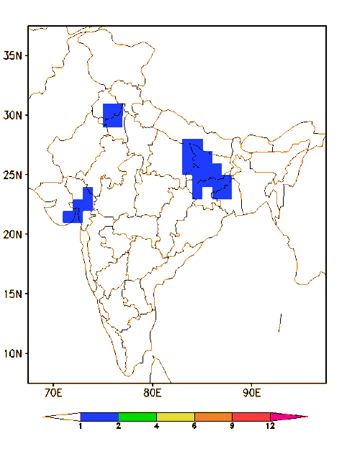
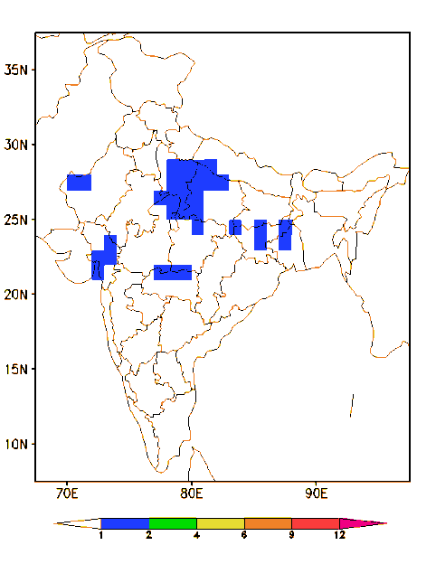
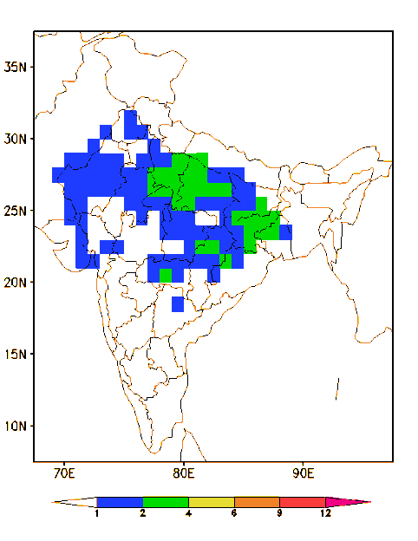
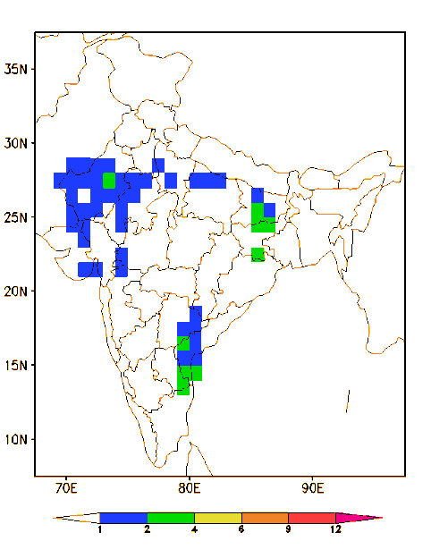
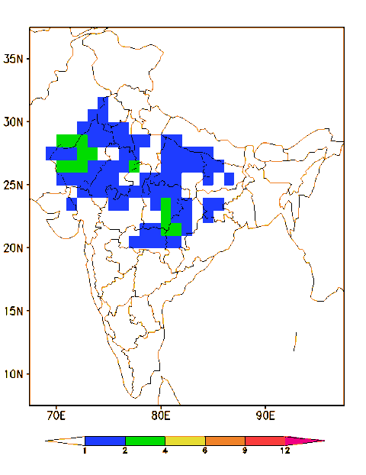
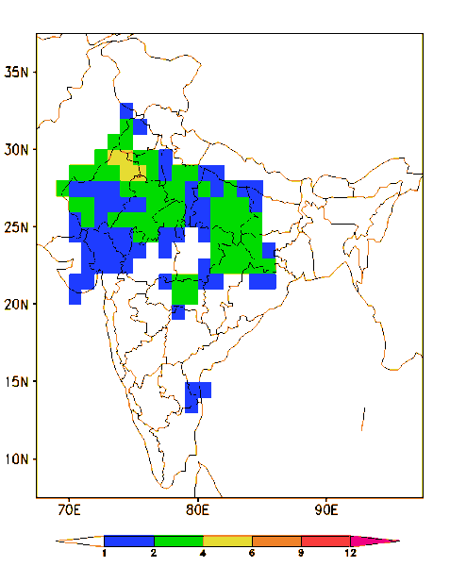
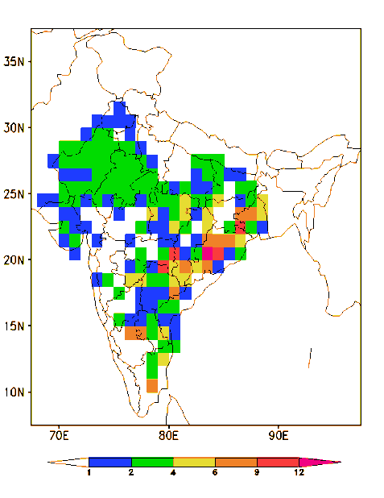
1951-1960
1961-1970
1971-1980
1981-1990
1991-2000
2001-2010
2011-2017
Average Heat Wave days during April

Slide 7
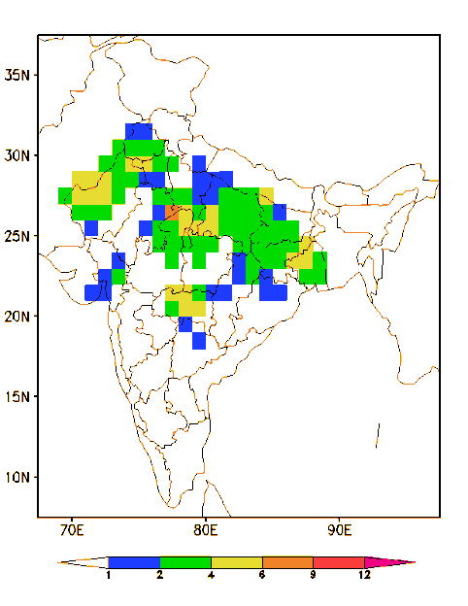
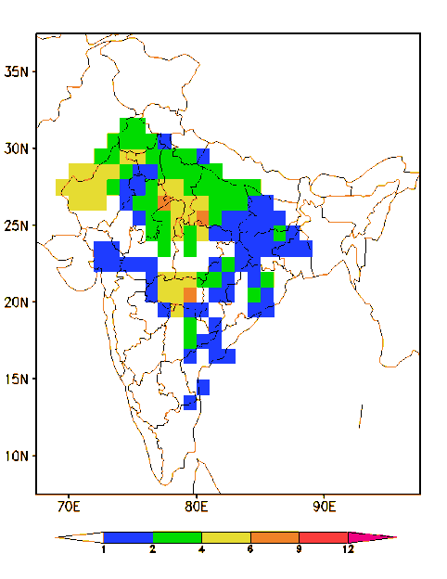
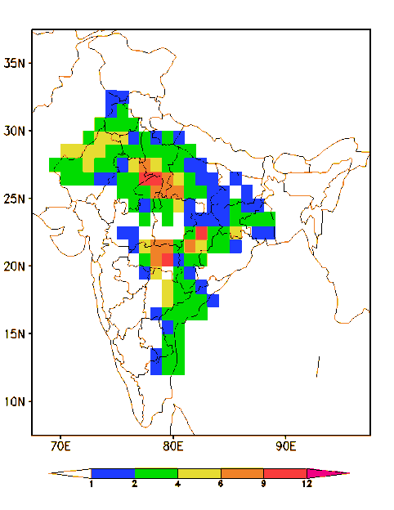
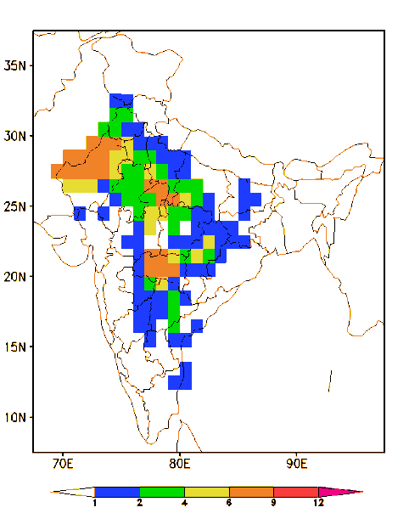
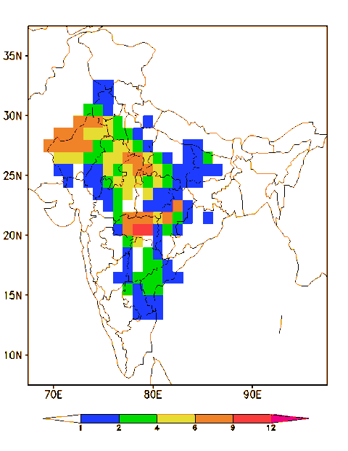
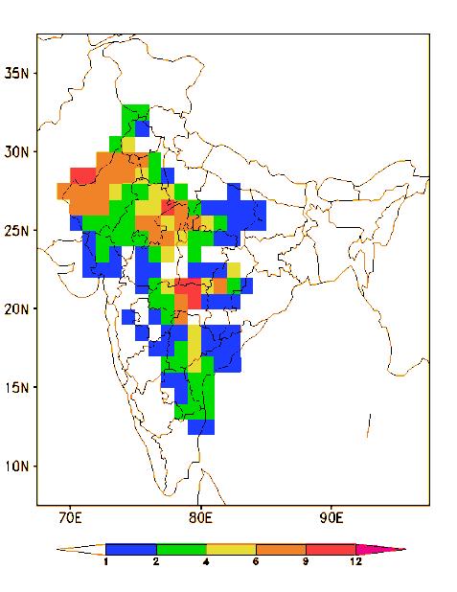
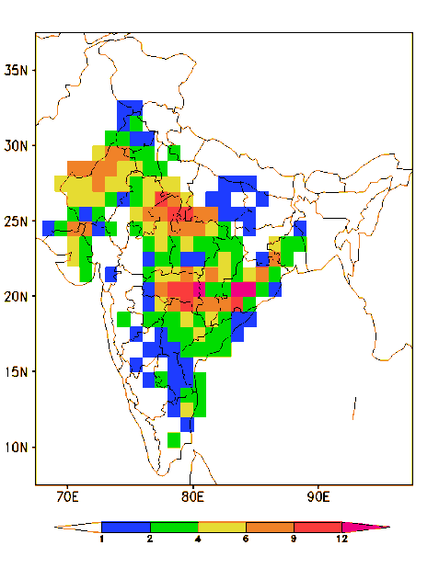
1951-1960
1961-1970
1971-1980
1981-1990
1991-2000
2001-2010
2011-2017
Average Heat Wave days during May

Slide 8
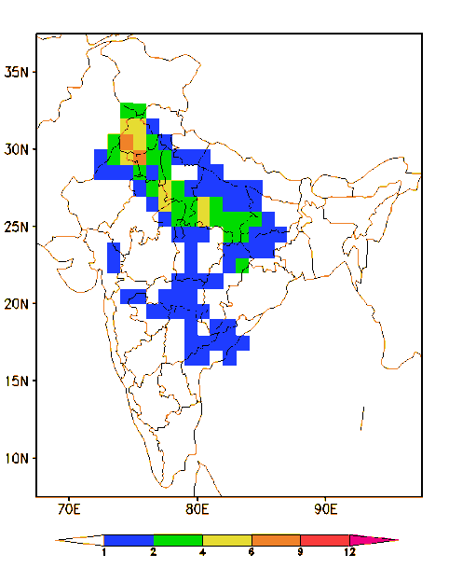
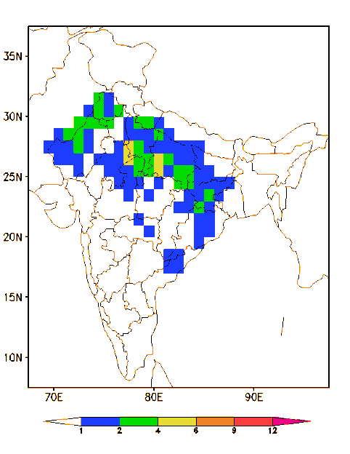
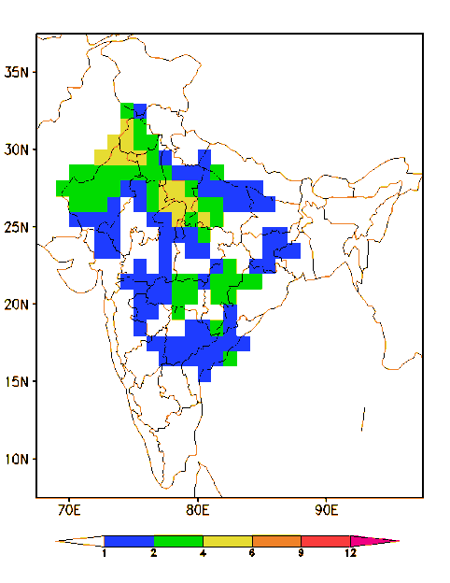
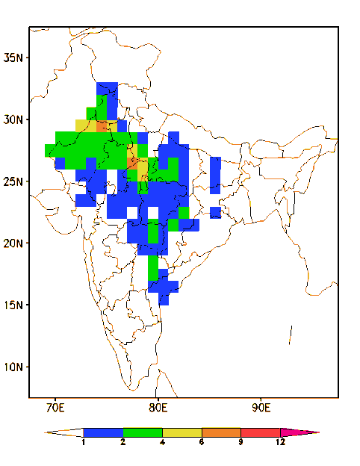
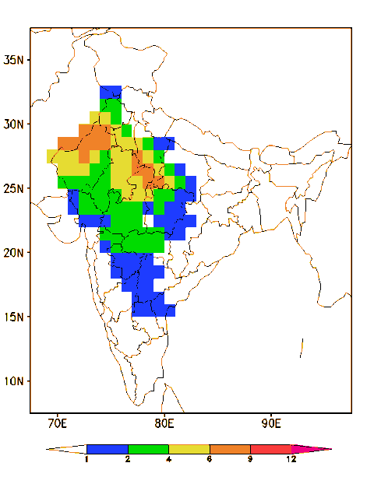
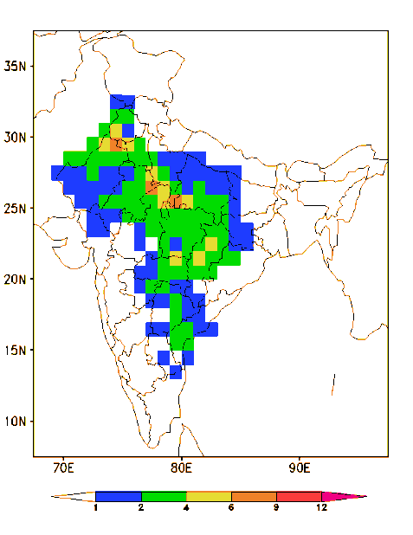
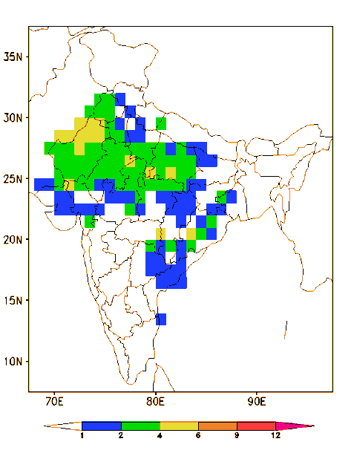
1951-1960
1961-1970
1971-1980
1981-1990
1991-2000
2001-2010
2011-2017
Average Heat Wave days during June

Slide 9
Example -1
Real-time forecast made on 16th May 2018

Slide 10
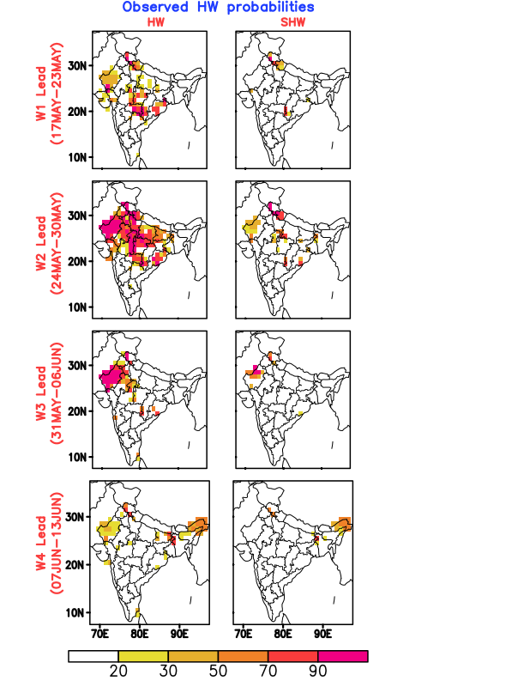
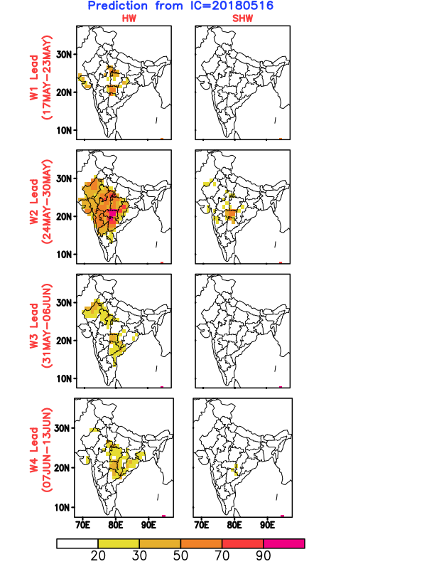
Probabilities of heat waves and severe heat waves : OBS vs MME

Slide 11
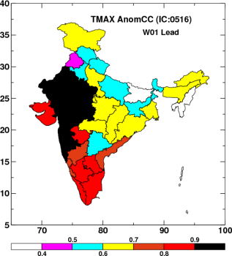
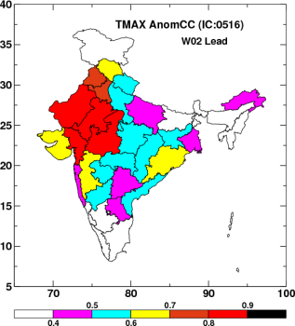
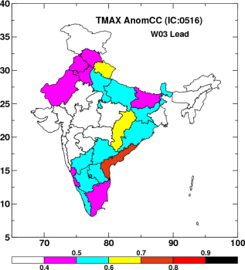
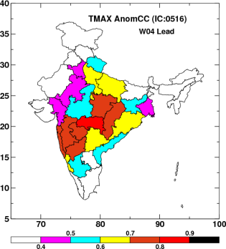
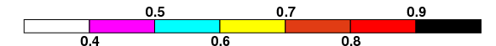
Probabilities of heat waves and severe heat waves : MME
ACC
IC: 16May 2018
17May-23May
24May-30May
Areas of high confidence in the forecast
31May-06Jun
07Jun-13Jun

Slide 12
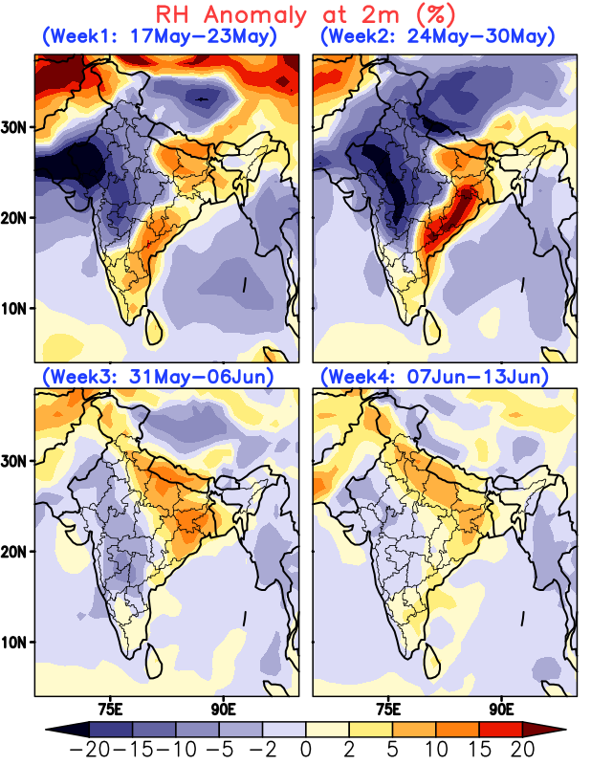
How might humidity influence the effects of heat?
Probability of heat waves and severe heat waves
2m relative humidity forecast (MME)
Regions where humidity may worsen the effects of heat
Relative humidity forecasts are experimental!

Slide 13
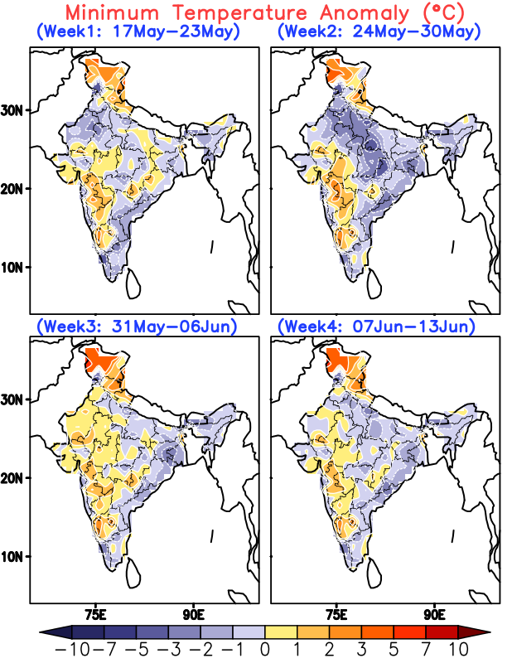
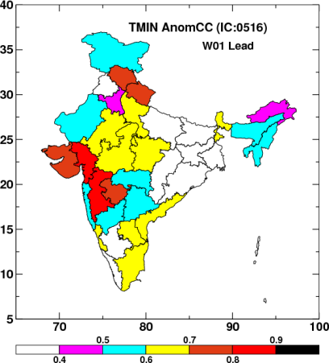
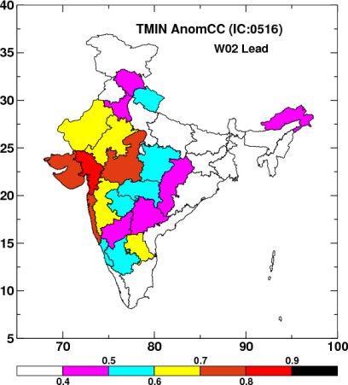
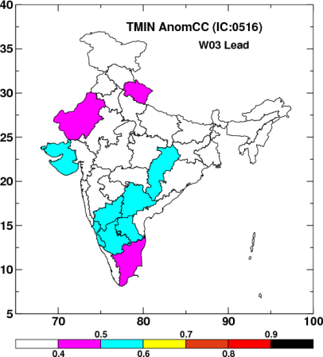
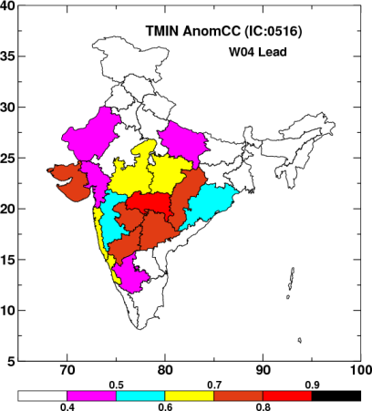
Night time temperature forecasts
Forecast: deviation from normal
Anomaly correlation coefficient
17May-23May
24May-30May
Areas of high confidence in the forecast
31May-06Jun
07Jun-13Jun

Slide 14
SOUTH ASIA REGION

Slide 15

DAY TIME TEMPERATURE FORECAST
Forecast: Temperature difference from normal
Hot days on the west parts of India
Hot days emerging in Southern Myanmar in mid-May and weakening afterwards
High temperatures may develop in Pakistan and Afghanistan in the last week of May and first week of June respectively

Slide 16

RELATIVE HUMIDITY FORECAST
Relative humidity forecasts are experimental!
High humidity may play a major role towards developing the high Tmax in Pakistan and Afghanistan

Slide 17

NIGHT TIME TEMPERATURE FORECAST
Hot nights were forecasted over the west part of India, Myanmar and Sri Lanka by the end of the month
Hot night temperatures are likely to develop in Pakistan, Afghanistan and the west coast of India in the beginning of June

Slide 18
HEAT OUTLOOK STATEMENT
17 May – 13 June
Day-time temperatures
On 16th May, high day-time temperatures were forecast on the west parts of India for next two weeks and then weakening in the subsequent weeks
Hot days emerging in Southern Myanmar in mid-May and weakening afterwards
Hot and humid conditions were forecasted over Pakistan and Afghanistan in the last week of May and first week of June respectively
Night-time temperatures
Hot nights were forecasted over the west part of India, Myanmar and Sri Lanka by the end of the month
Hot night temperatures are likely to develop in Pakistan, Afghanistan and the west coast of India in the beginning of June

Slide 19
LATEST FORECAST
INITIAL CONDITION: 12th February 2020
Working group on Extended Range Prediction
Ministry of Earth Sciences, Govt. of India

Slide 20


Predicted week wise actual temperature (by MME)

Slide 21


Predicted week wise temperature anomaly (by MME)

Slide 22


Daily Departure of minimum and maximum temperature (by MME)

Slide 23

http://www.tropmet.res.in/erpas/index.php
Thank You!!!

