Slide 1


Urban Heat Hotspots-
Case study of Rajkot City, India
Ajit Tyagi, Rohit Magotra, Mohit Kumar, Ananya Bhatia, Yashi Sharma, and Moumita Shaw
Integrated Research and Action for Development

Slide 2
Presentation…….
Urbanisation :
Urban Heat Island
Existing Observation and Warning System
Need for Ward/Sub Ward Level Observations, Vulenrability
Warning and Response Mechanism

Slide 3
Mega Cities in South Asia
S. No. | City | Population (2018) | Growth (2010-18) | Population(2030)
1 | Delhi | 28.5 million | 81.7% | 38.99 million
2 | Mumbai | 20.0 million | 23.7% | 24.47 million
3 | Dhaka | 19.6 million | 90.4% | 28.8% million
4 | Karachi | 15.4 million | 56.7% | 20.43 milllion
5 | Kolkata | 14.7 million | 12.1% | 17.58 million
6 | Lahore | 11.7 million | 110.5% | 16.8 million
7 | Bengaluru | 11.4 million | 105% | 16.23 million
8 | Chennai | 10.5 million | 58.6% | 13.8 million

Slide 4
Fast Developing Cities
Ahmedabad, Hyderabad, Pune,
Kanpur, Lucknow, Nagpur, Jaipur
Patna, Kochi, Bhopal, Coimbatore,
Visakhapatanam, Raipur, Nashik
Guwahati, Bhubaneswar, Rajkot
Vijayawada, Jamshedpur, Mysore
Kozhikode, Tiruchi, Chandigarh
Ghaziabad, Noida, Faridabad

Slide 5
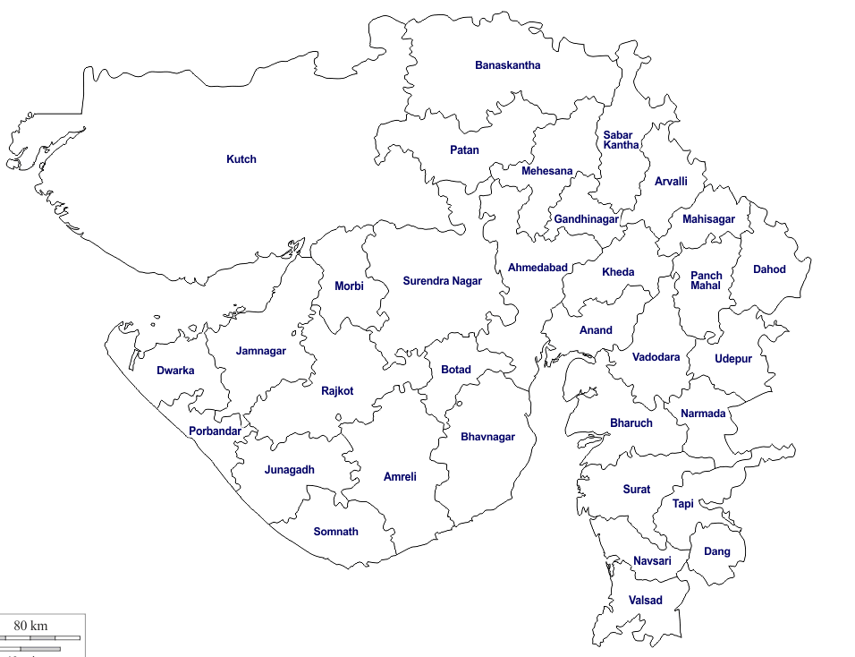
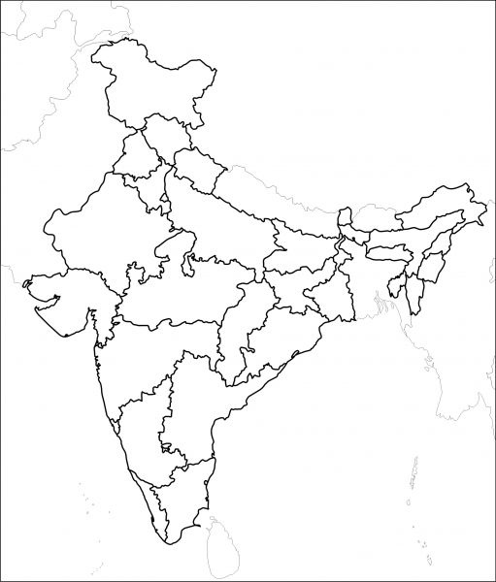
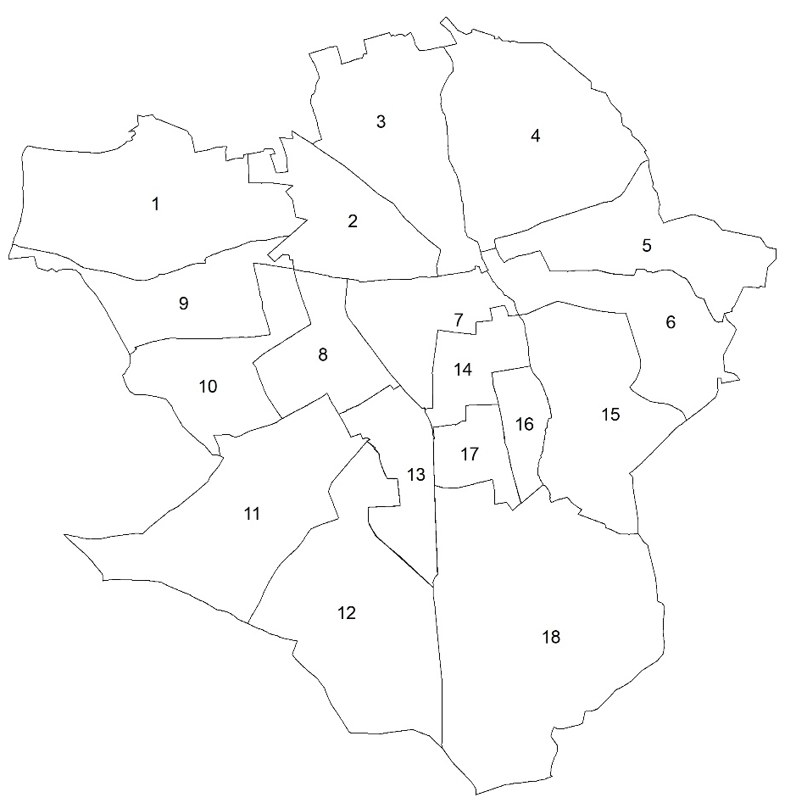



Geographical Location
RAJKOT WITHIN GUJARAT
NOT TO SCALE
NOT TO SCALE
NOT TO SCALE
MAP OF INDIA
RAJKOT MUNICIPAL CORPORATION WARDS

Slide 6
City Details - Demographics
Years | Rajkot City Population | Growth Rate | Density (Sq. Km.) | Area (Sq. Km.)
1981 | 4,45,076 | 48.3 % | 6,450 | 69
1991 | 5,59,407 | 25.69 % | 8,107 | 69
2001 | 10,02,000 | 79.12 % | 9,557 | 104.85
2011 | 12,86,678 | 28.41 % | 12,275 | 104.85
Source : Census of India
Population Projection | Average annual rate of Change (%)
2030 | 2000-2018 | 2018-2030
2,416,000 (Urban Agglomeration) | 3.3 | 2.6
Source : UN World Cities Report , 2018
Years | No. of Notified Slum | No. of Households in Slum Area | Population in Slum Area | Slum Population as % of total population
1971 | 24 | 4,927 | 43210 | 14.39
2001 | 84 | 44,914 | 202371 | 20.20
2011 | 118 | 38,557 | 189360 | 14.7
Source : Poverty Alleviation Plan, RMC, 2008 Census of India

Slide 7
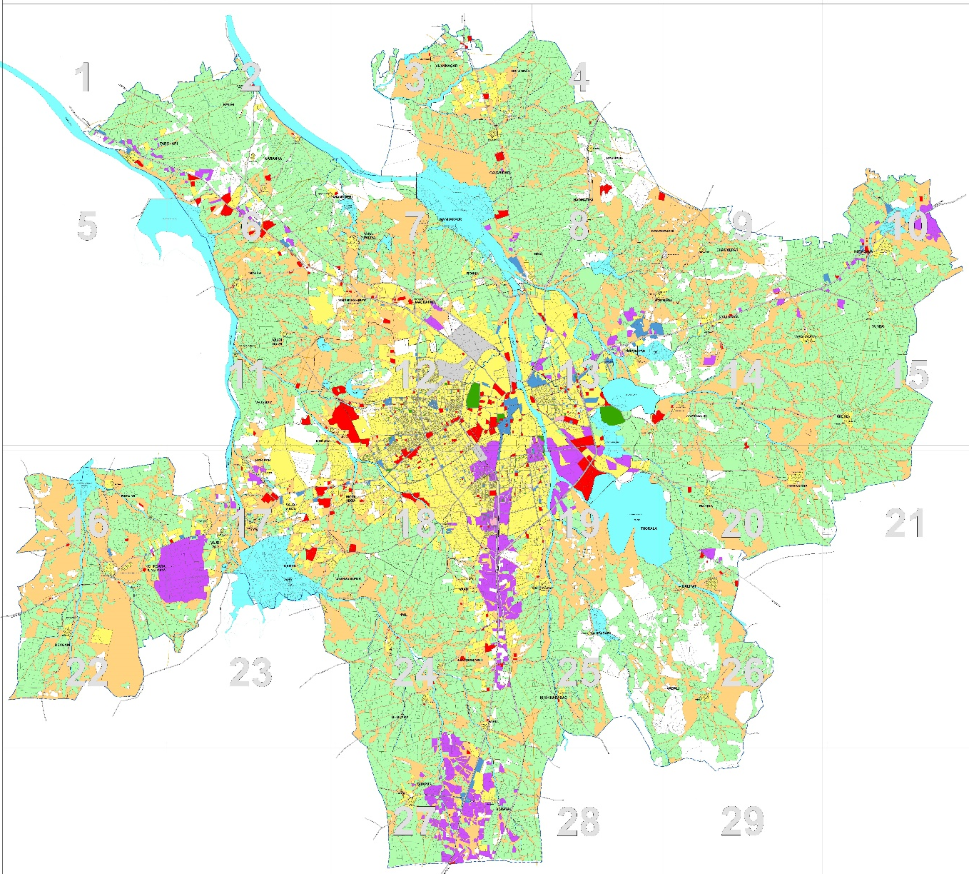

City Details – Existing Land Use 2012 (RUDA)
Existing Land Use 2012
Rajkot Urban Development Authority RUDA
Rajkot is a major Industrial Hub of Saurashtra
More than 43000 industrial units are located in Rajkot
Rajkot has grown to be major center for the production of
  Diesel Engines.
  Engineering and Automobile Industries
  Castor Oil Industries
  Gold & Silver Jewelry
City is a key node on the proposed “Economic Corridor” along the Surendranagar – Rajkot Morbi - Kandla link to it’s growing economic importance
Source: RMC Smart Cities
Source : RUDA

Slide 8
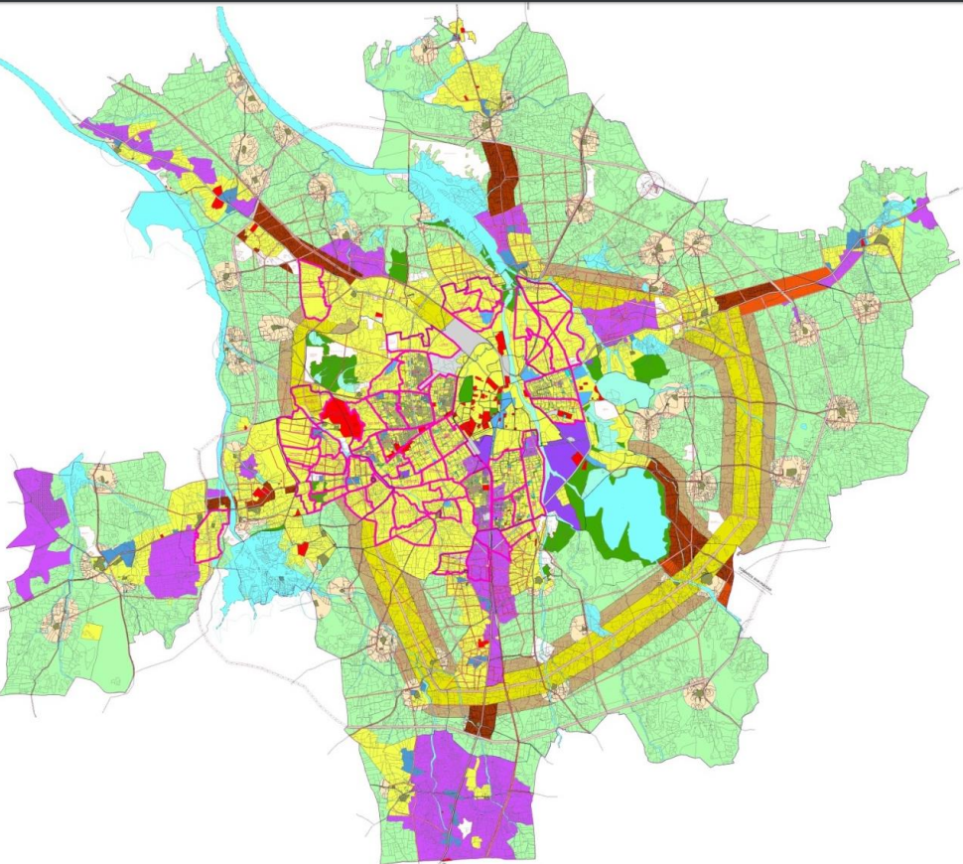
City Details – Proposed Land Use 2031
Proposed Land Use 2031
Rajkot Urban Development Authority RUDA
S.No | PROPOSED LANDUSE | RMC | %AGE
1 | Residential | 6228.16 | 59.40
2 | TOZ | 154.03 | 1.47
3 | Affordable Housing | 46.58 | 0.44
4 | Gen. Commercial | 221.73 | 2.11
5 | Gen. Industrial | 635.24 | 6.06
6 | Public Purpose | 305.37 | 2.91
7 | Recreation | 517.05 | 4.93
8 | Agriculture | 69.34 | 0.66
9 | Other Area | 2307.49 | 22.01
 | Total | 10485 | 100
Source: RUDA DP 2031
Source: RUDA DP 2031

Slide 9
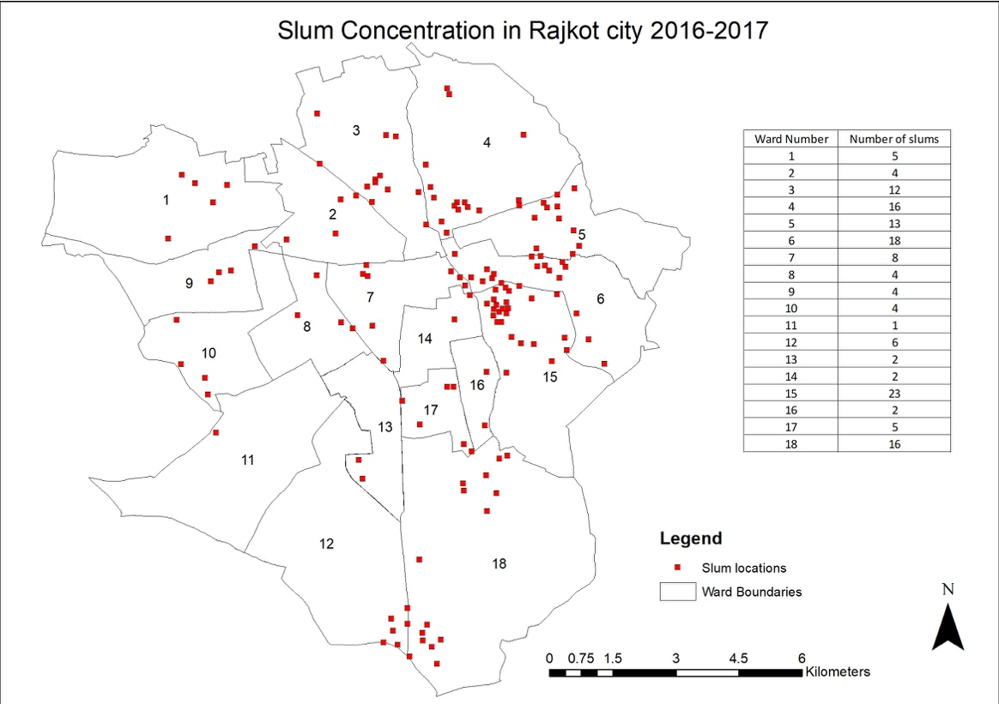
Rajkot Slum Concentration
Source: Rajkot Municipal Corporation

Slide 10
Climatic Conditions
Climate of the city is characterized by Hot and Dry in Summer, wet southwest monsoon season and mild winter with low humidity.
Average annual Maximum Temp | 34.1 °C
Average annual Minimum Temp | 20.9 °C
Mean Maximum Temp. of Hottest Month (May) | 40.5 °C
Mean Minimum Temp. of Hottest Month (May) | 25.4 °C
Mean Maximum Temp. of Coldest Month(Dec) | 28.4 °C
Mean Minimum Temp. of Coldest Month(Dec) | 12.8 °C
Ever Recorded Maximum Temp. was 47.9 °C on 13 May 1977 Ever Recorded Minimum Temp. was -0.6 °C on 16 Jan 1935
Average annual Rainfall | 66.7 cm
Average annual Rainy days | 29
Mean monthly highest rainfall observed in July | 23 cm
Mean monthly lowest rainfall observed in December, January & March | 0.1 cm
Source: IMD Pune

Slide 11
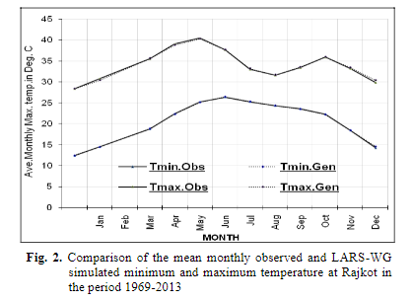
Past Temperature Trends- Rajkot
Source: Sarkar J et al (2017) Future climate change scenario in hot semi-arid climate of Saurashtra, Gujarat by using statistical downscaling by LARS-WG model. MAUSAM, 68, 4 (October 2017), 589-596

Slide 12
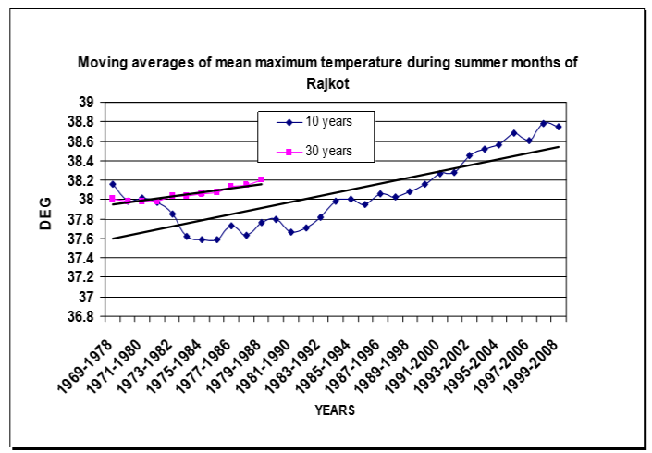
Past Temperature Trends- Rajkot
Source: Ray et al., 2009

Slide 13
Past Temperature Trends- Rajkot
Source: Ray et al., 2012

Slide 14
Urban Heat Island : UHI
Urban and suburban areas experience elevated temperatures compared to their outlying rural surroundings; this difference in temperature is what constitutes an urban heat island. The annual mean air temperature of a city with one million or more people can be 1 to 3°C warmer than its surroundings, and on a clear, calm night, this temperature difference can be as much as 12°C.

Slide 15
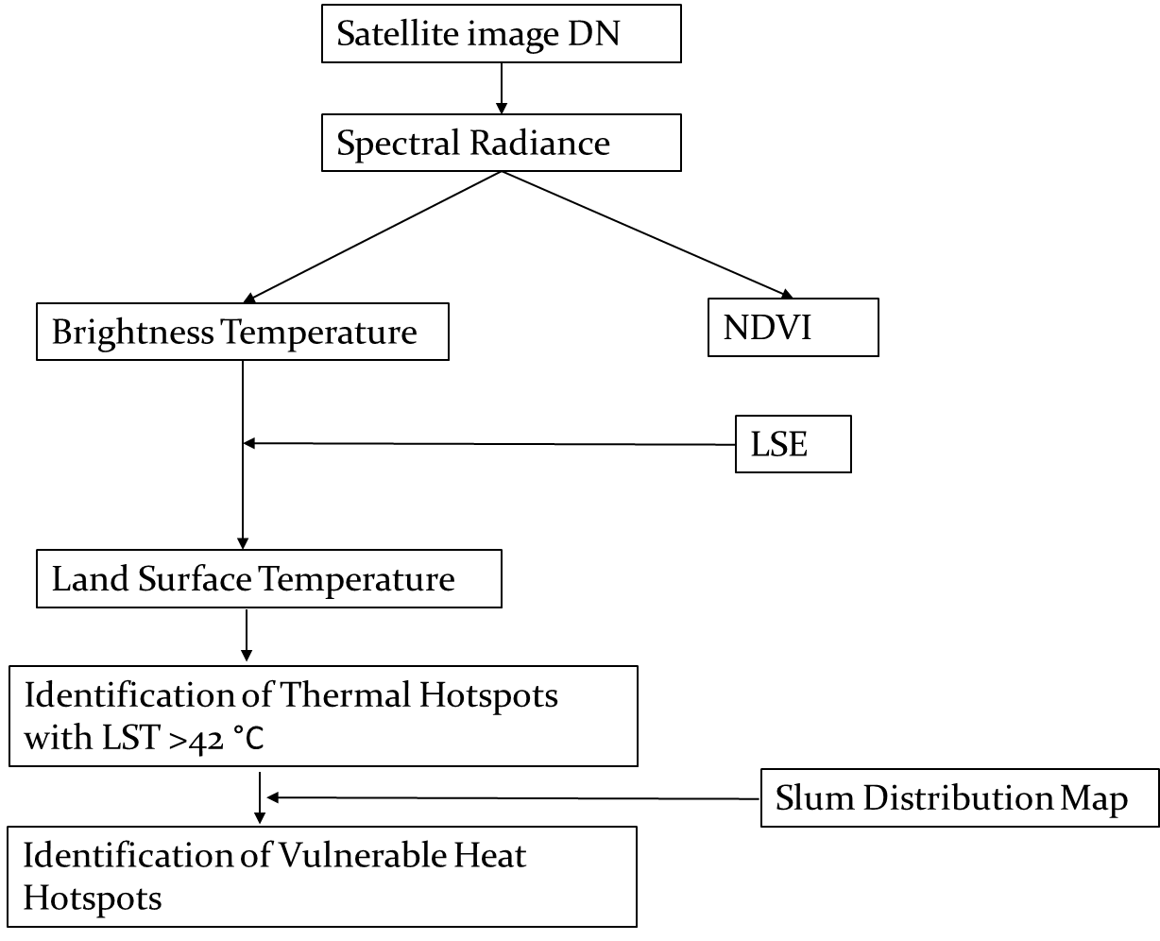
Mapping Methodology

Slide 16
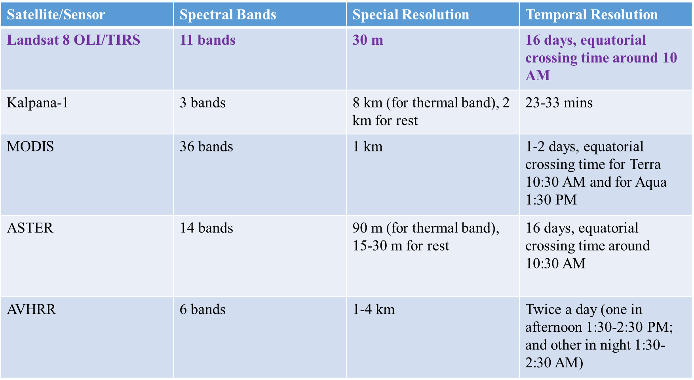
Satellite details
Landsat 8 TIRS data employed

Slide 17
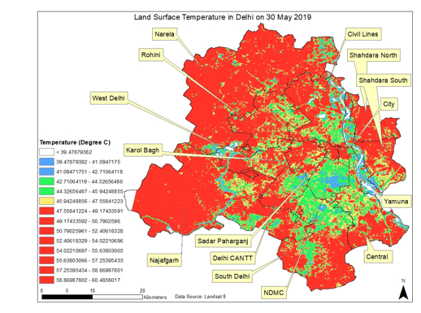
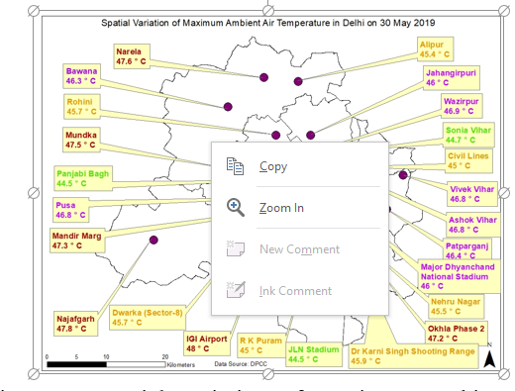
Delhi UHI
Thermal Map
Max Air Temperature
30 May 2019 : 48 degree C

Slide 18
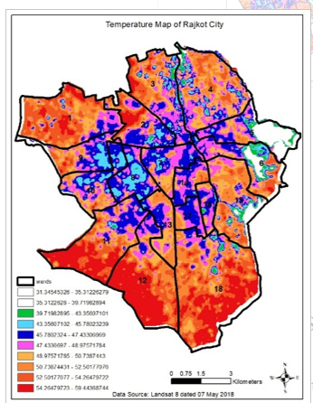
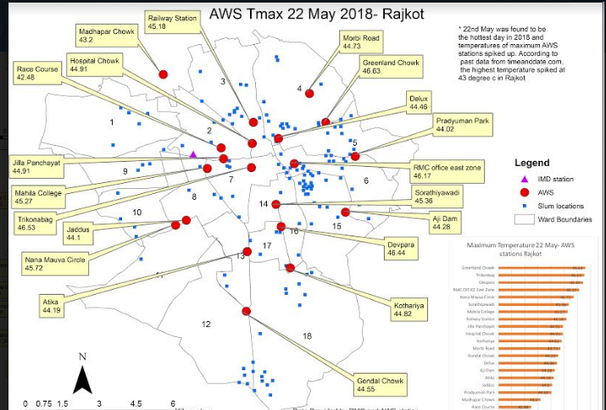
Rajkot : UHI
Thermal Map
Air Temperature

Slide 19
Existing Observation and Warning System
Single IMD Observatory
All India Warning Criteria for Heat Wave used to issue Area Warning
City specific Warning Thresholds are being worked out

Slide 20
Observations – IMD Vs AWS

Slide 21
Observations – IMD Vs AWS

Slide 22
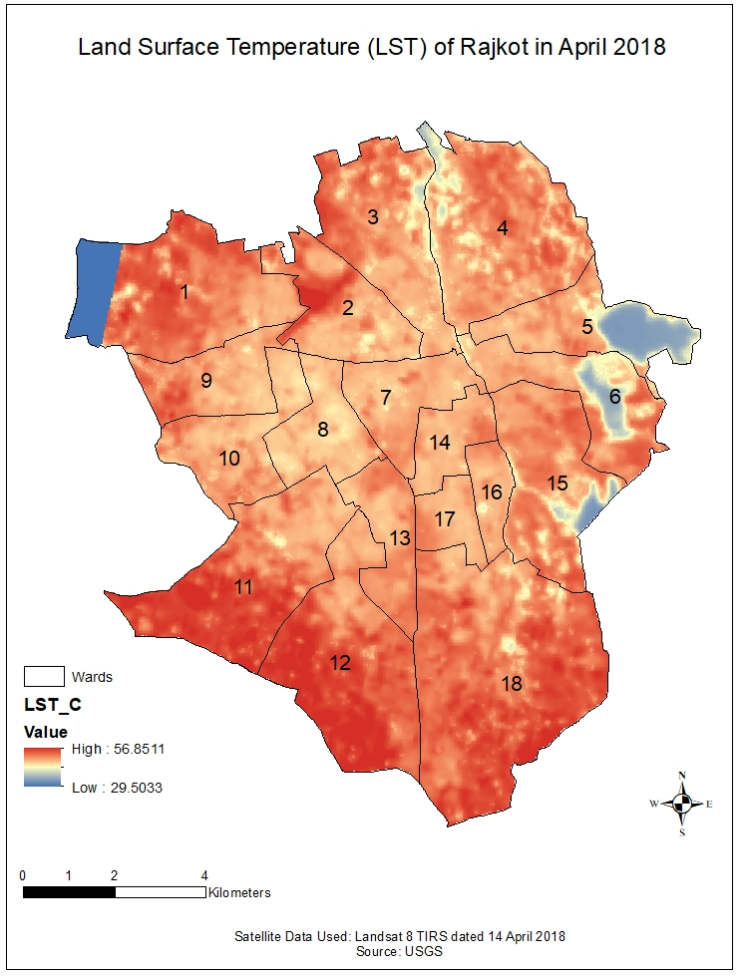
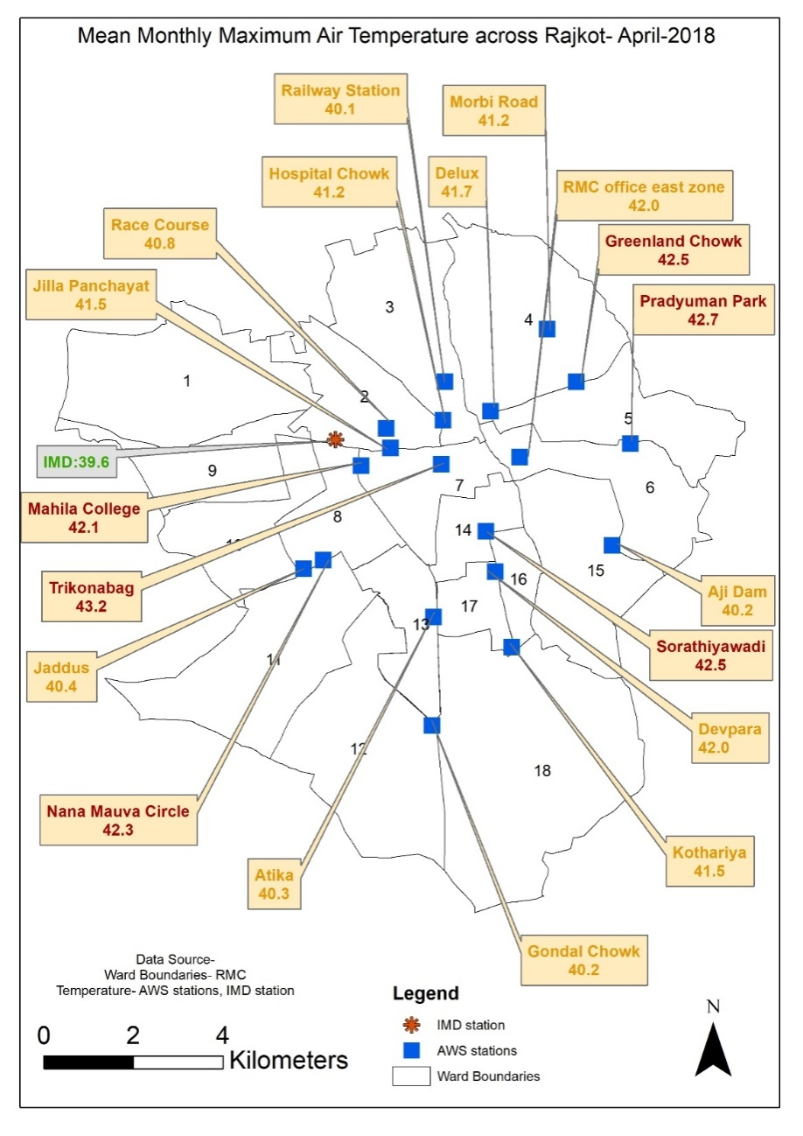
Comparison – LST vs AAT
No Data

Slide 23
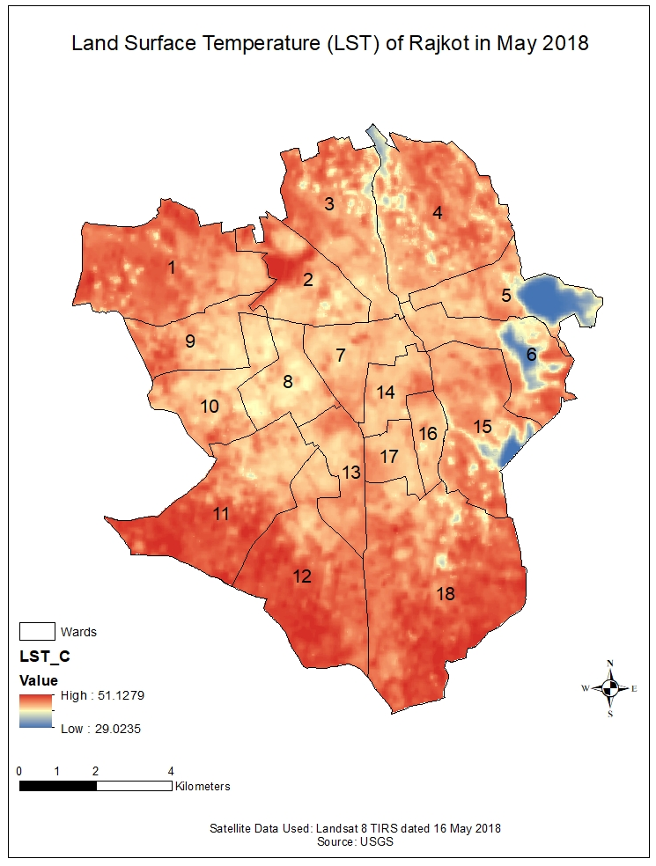
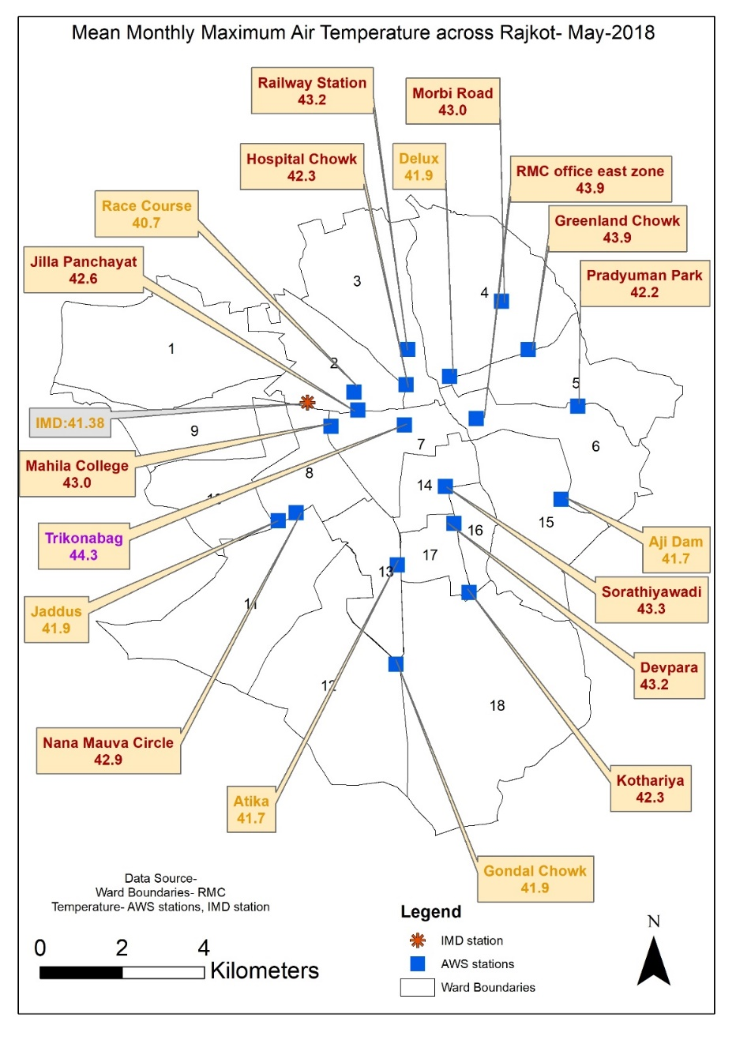
Comparison – LST vs AAT

Slide 24
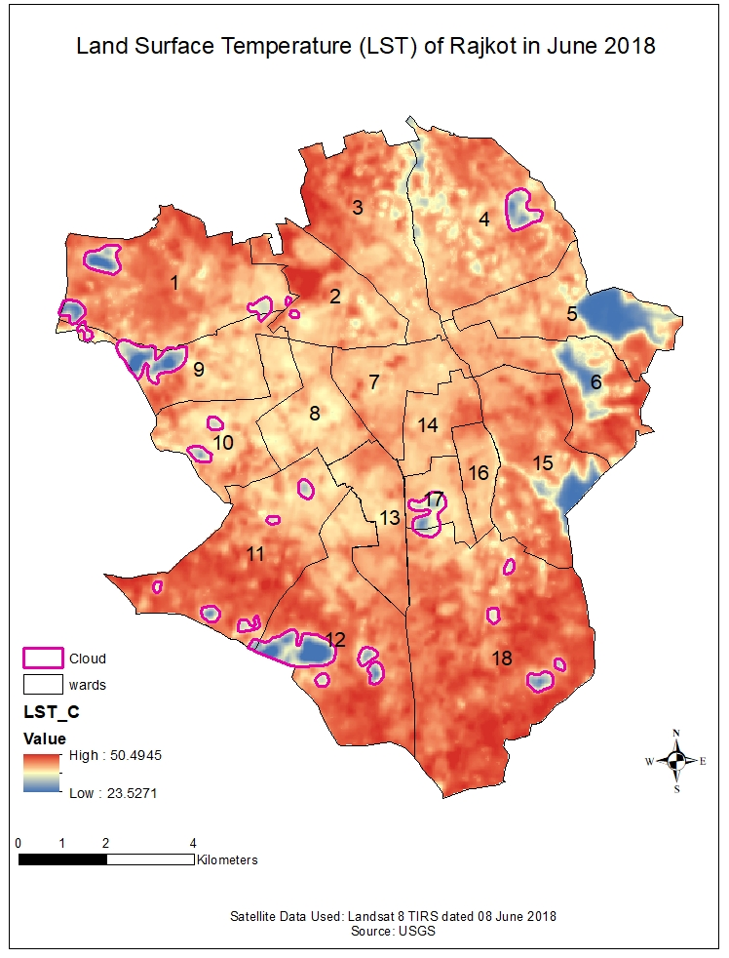
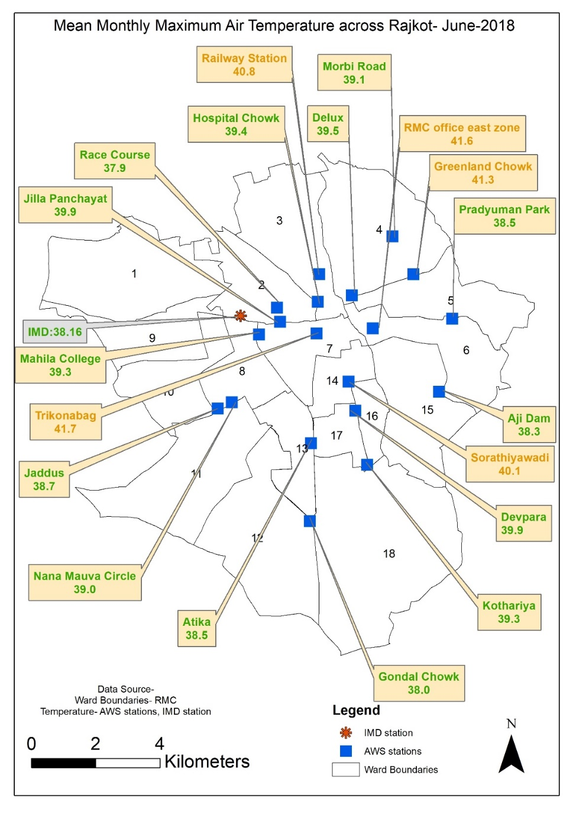
Comparison – LST vs AAT

Slide 25
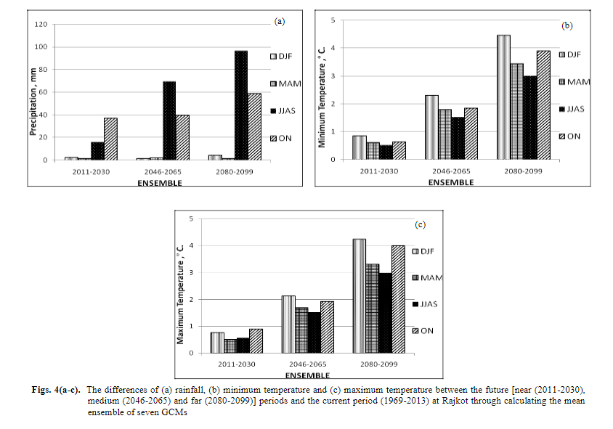
Climate Change Projections- Rajkot
Source: Sarkar J et al (2017) Future climate change scenario in hot semi-arid climate of Saurashtra, Gujarat by using statistical downscaling by LARS-WG model. MAUSAM, 68, 4 (October 2017), 589-596

Slide 26
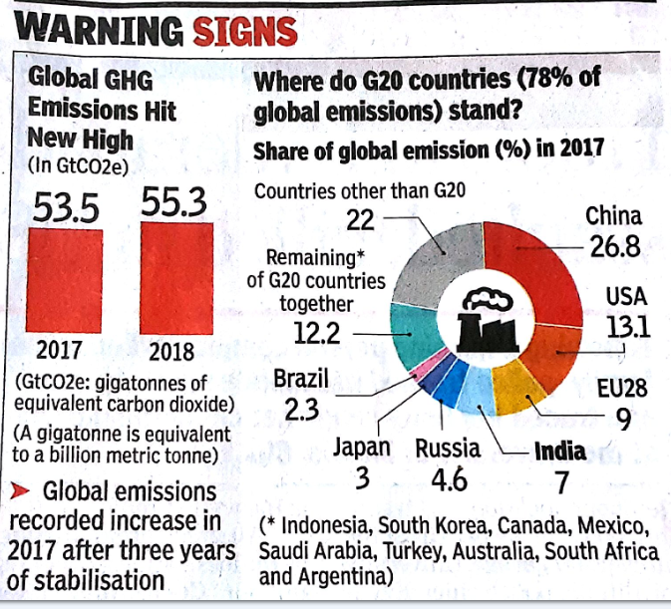
Warning Signs

Slide 27
Current State
GHG Emissions have risen 1.5% per year over last decade, hitting an all time high of 55.3 giga tonnes in 2018.
Unless GHG emissions fell by 7.6% each year between 2020 and 2030, the world can not on track towards the goal of 1.5 degree celisus.
Temperature may increase by 3.5 degree celisus

Slide 28
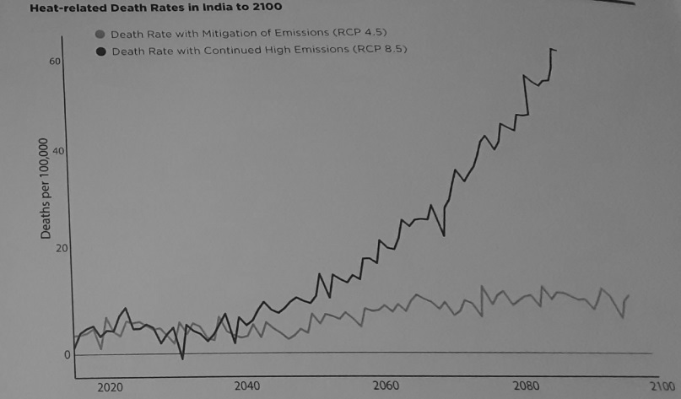
Study by Tata Centre for Development at University of Chicago

Slide 29
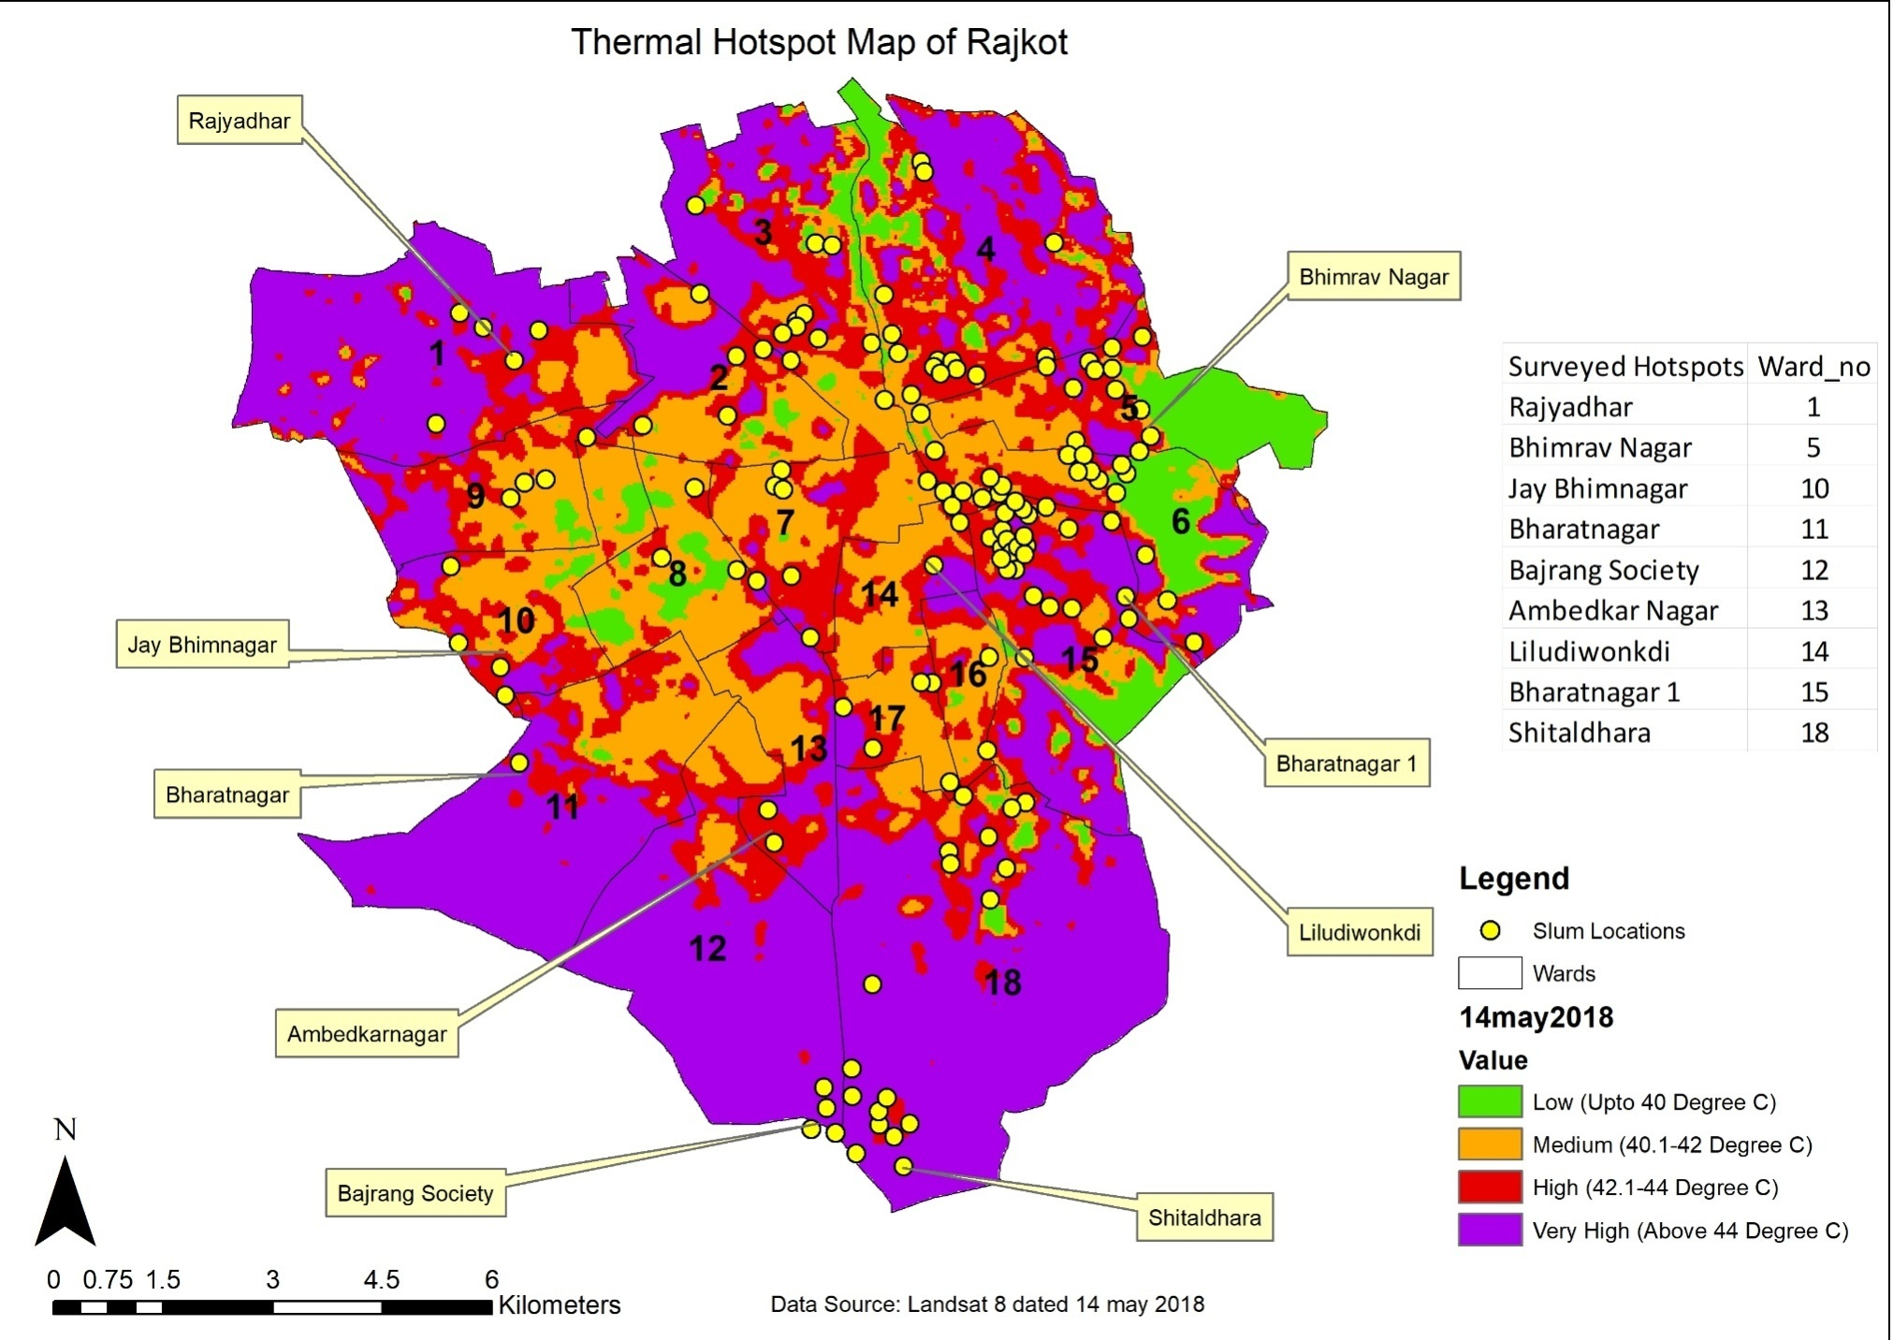
Identification of Hot Spots – Wards
All the 9 surveyed hotspots are falling in high (42.1-44 ֯C) and very high (> 44 ֯C) temperature zones.
The hotspot wards identified are ward numbers 1, 5, 10, 11, 12, 13, 14, 15 and 18.

Slide 30
Way Forward…….
Need to Factor Urbanisation, UHI and Climate Change
Ward Level Observation
Ward/Sub Ward Level Vulnerability Analysis
Temperature, Physical, Socio-Economic
Ward Level Thresholds : Ward Mortality
Ward Level Warning, Preparedness and Mitigation

Slide 31

Thank You
For more details contact: Prof. Ajit Tyagi, atyagi @irade.org

