Slide 1
Seasonal Temperature Forecast over India and South Asia
South Asia Heat Summit
India - 14 February 2020
Pune, India
D. S. Pai
RCC, Pune

Slide 2
Background
Since 2016, India Meteorological Department (IMD), Ministry of Earth Sciences (MoES) has been issuing seasonal forecast outlooks for subdivision scale temperatures over the country for both hot and cold weather seasons based on predictions from the Monsoon Mission Coupled Forecasting System (MMCFS) Model developed under MoES’s monsoon mission project.
Hot weather seasons: MAM & AMJ
Cold Weather Season: DJF

Slide 3
Model Description and Methodology
Model Resolution: 38 KM
Climatology used :1982-2008(28 years)
Bias Correction Method: Quantile‐based mapping method (Panofsky and Brier, 1958) for the bias correction of MMCFS monthly temperature data. This method maps the cumulative distribution function (CDF) or probability distribution functions (PDFs) of monthly gridded model temperatures onto that of gridded observed data.

Slide 4
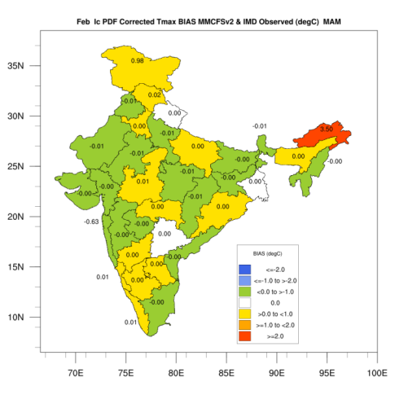
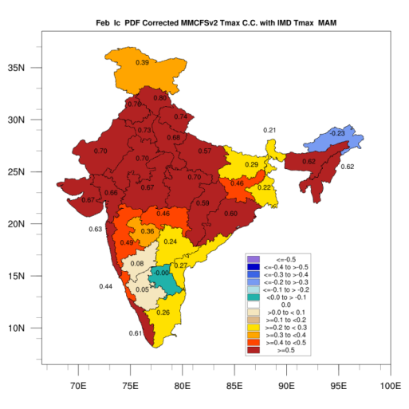
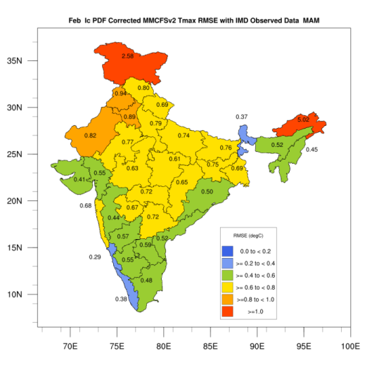
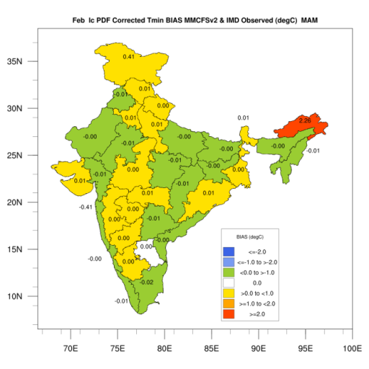
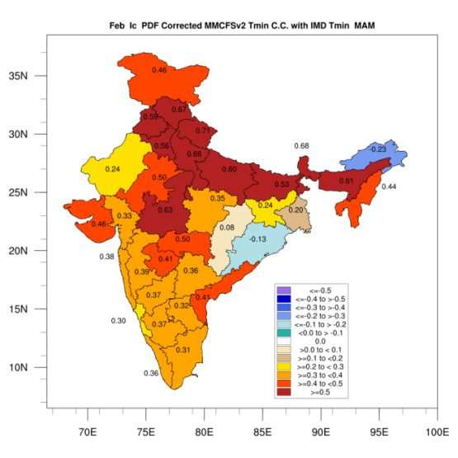
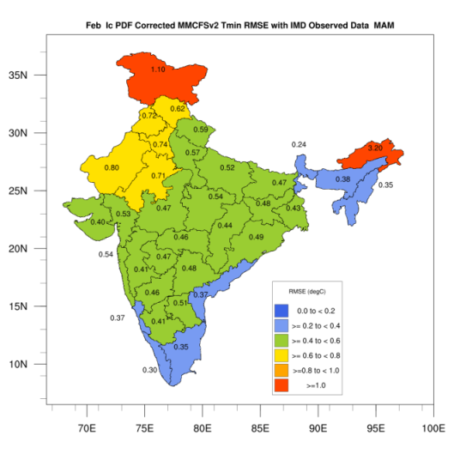
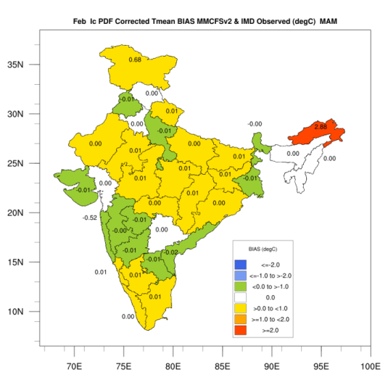
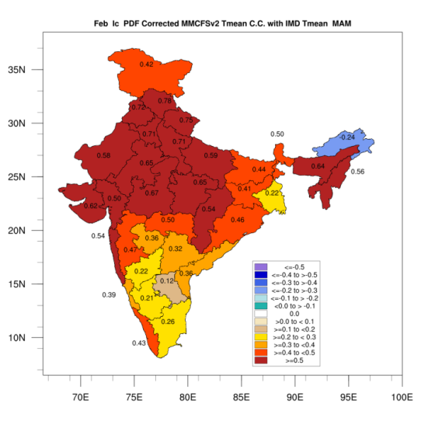
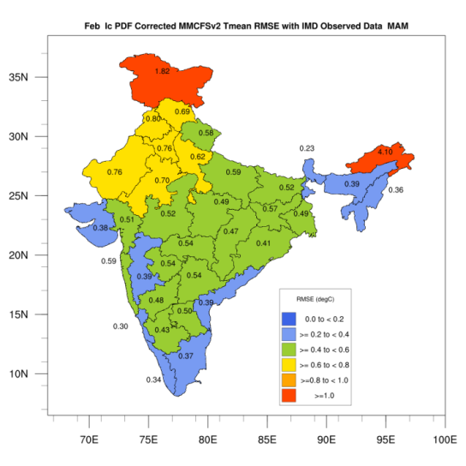
Skill of model
Feb IC for MAM
Bias
CC
RMSE
Tmax
Tmin
Tmean

Slide 5
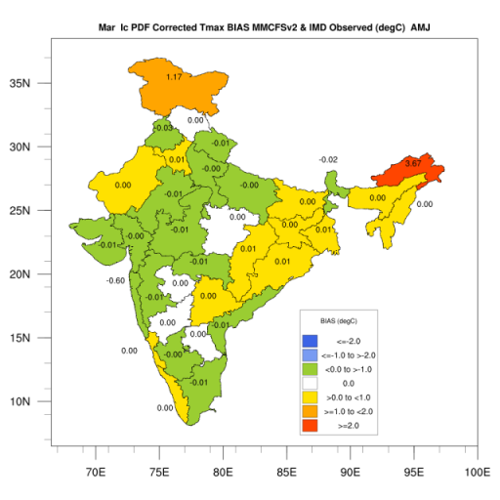
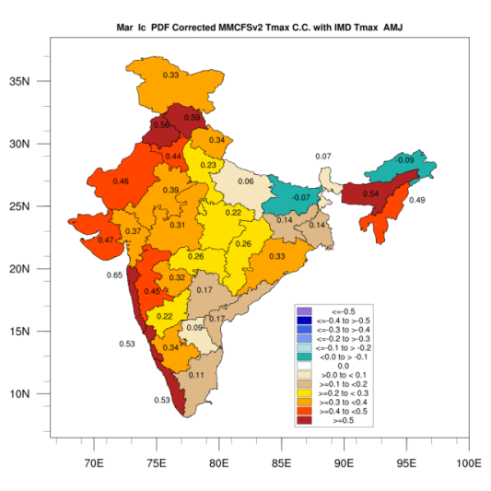
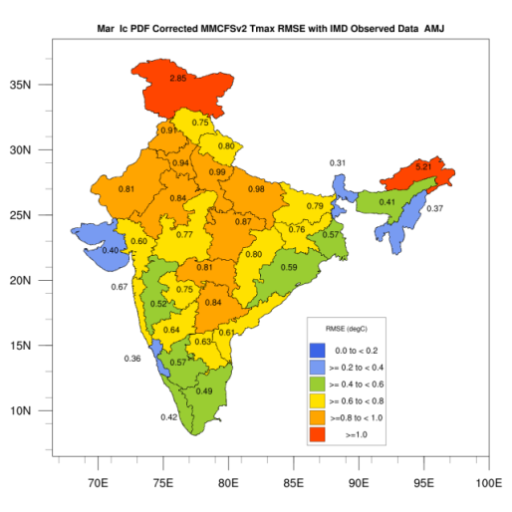

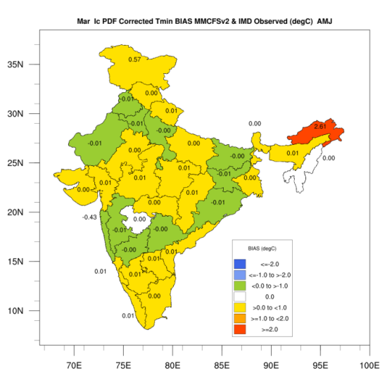
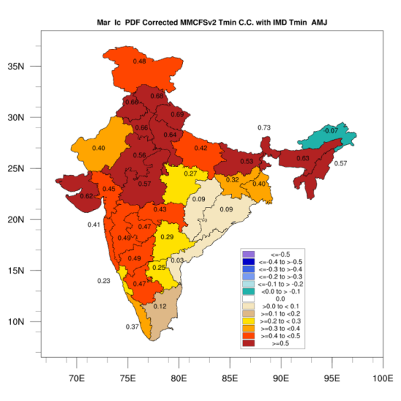
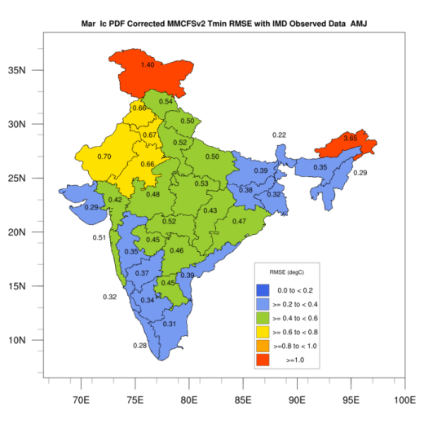
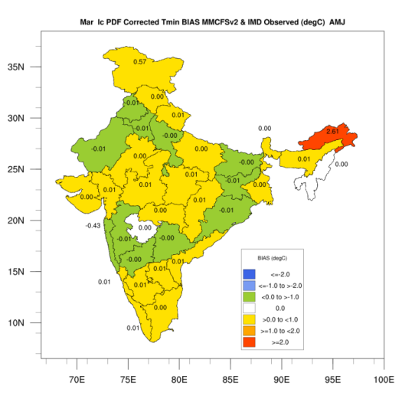
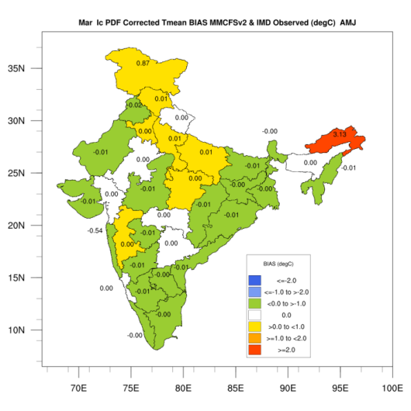
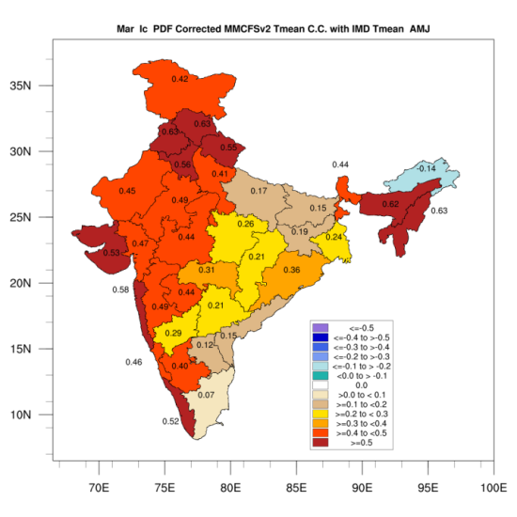
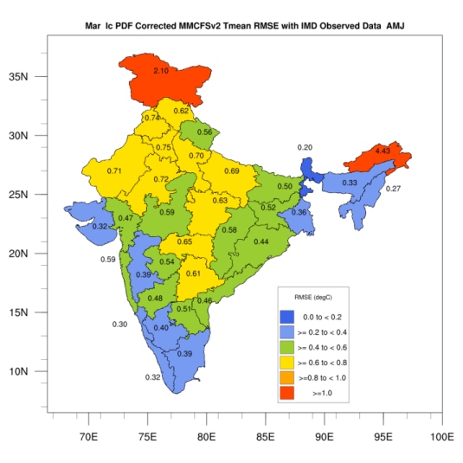
Skill of model
Mar IC for AMJ
Bias
CC
RMSE
Tmax
Tmin
Tmean

Slide 6
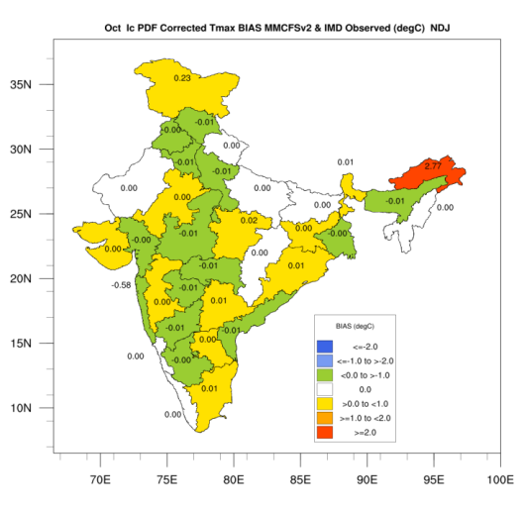
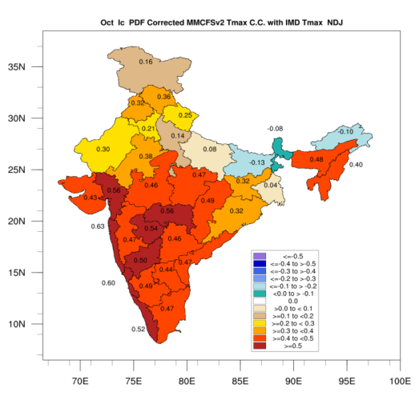
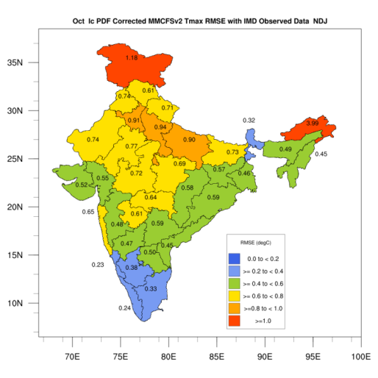
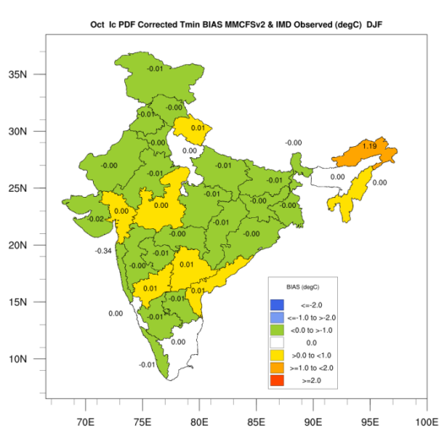
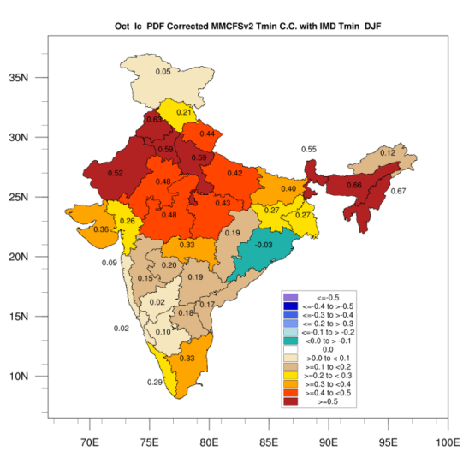
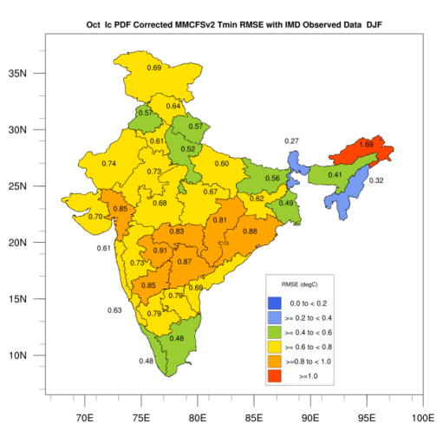
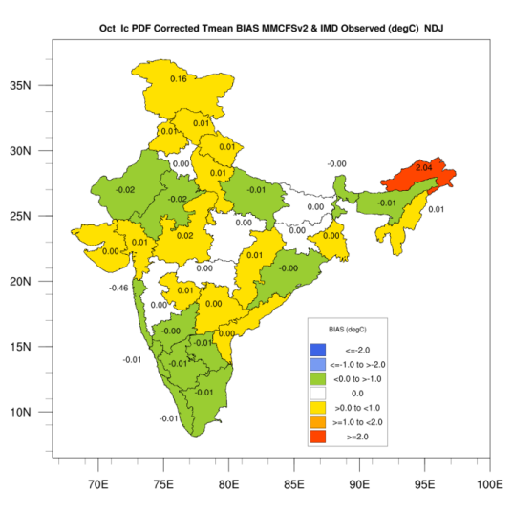
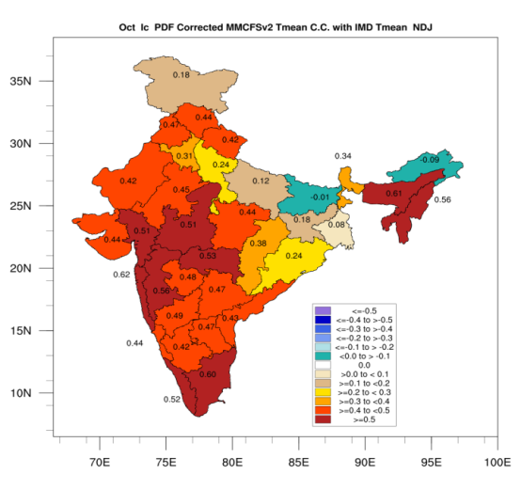
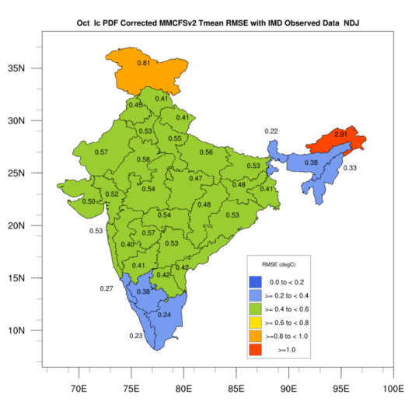
Skill of model
Oct IC for NDJ
Bias
CC
RMSE
Tmax
Tmin
Tmean

Slide 7
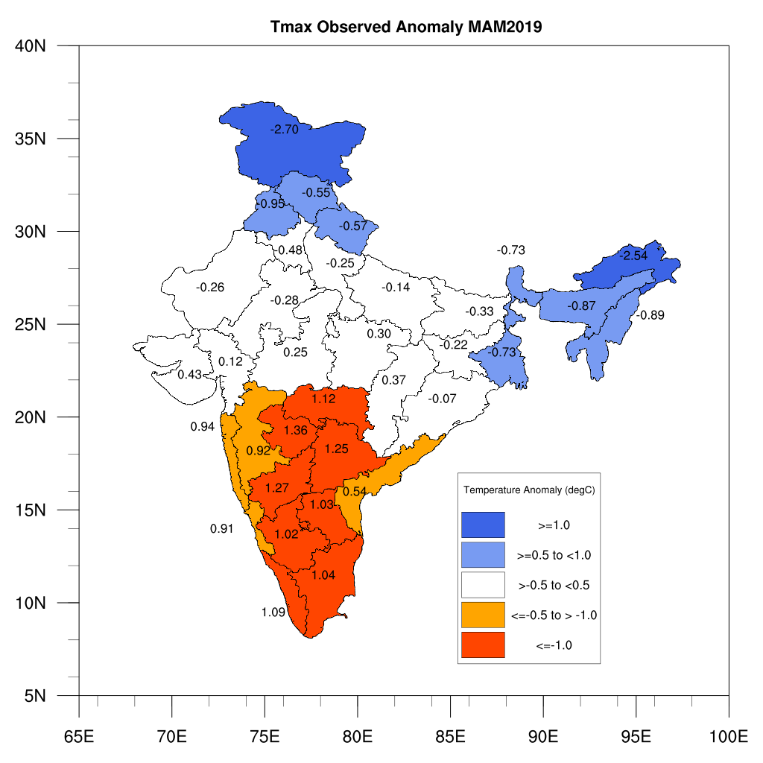
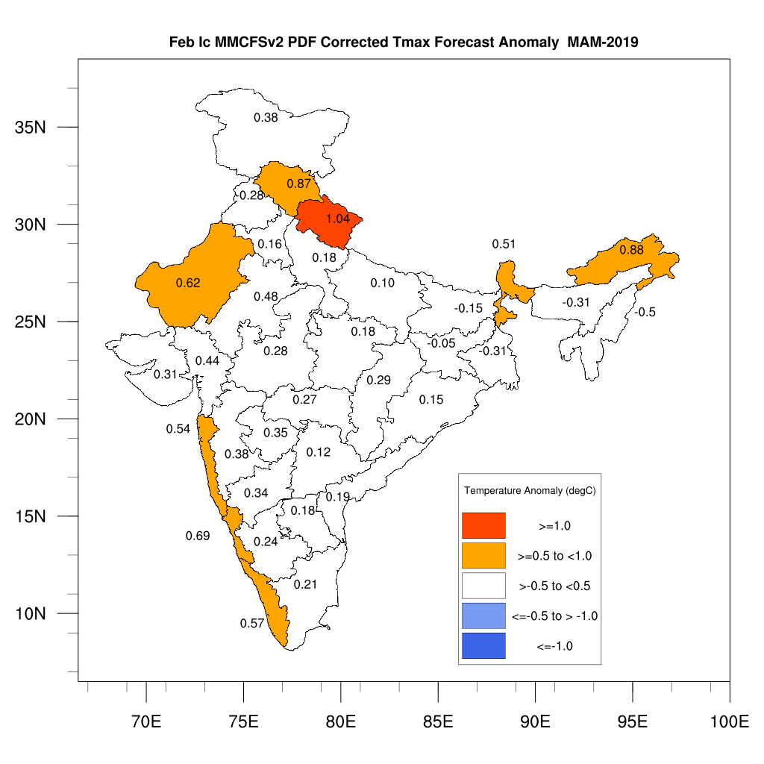
Tmax MAM 2019

Slide 8
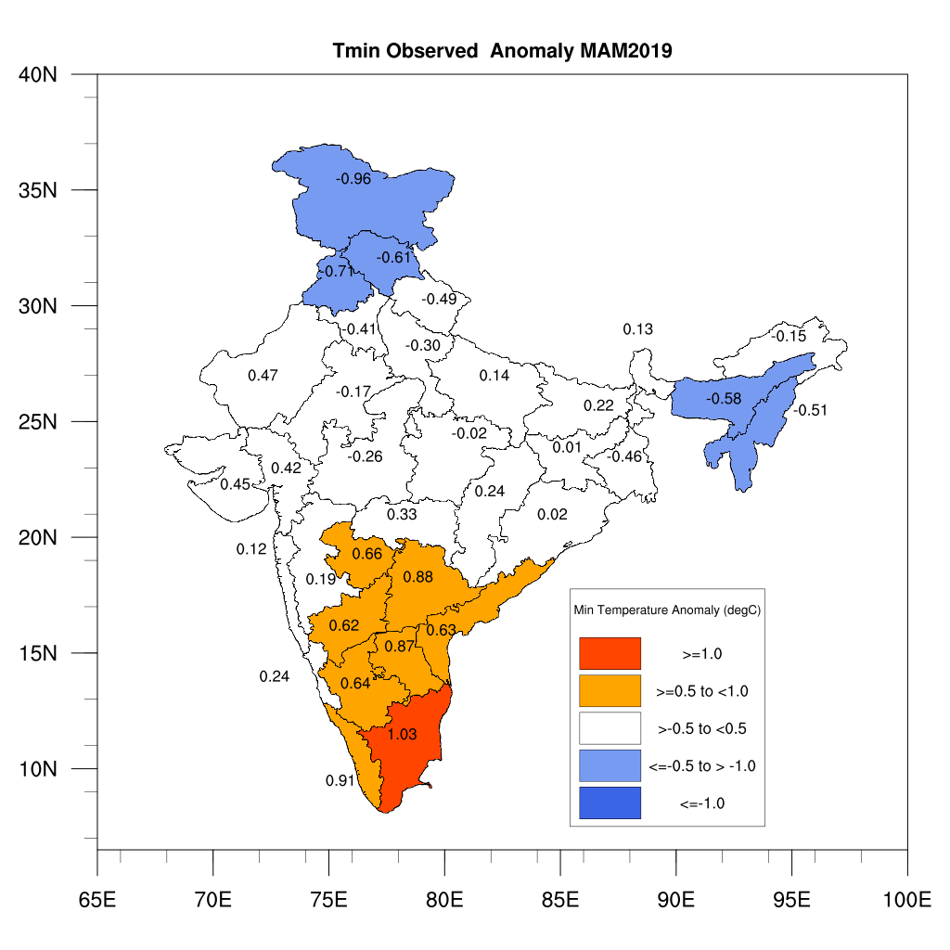
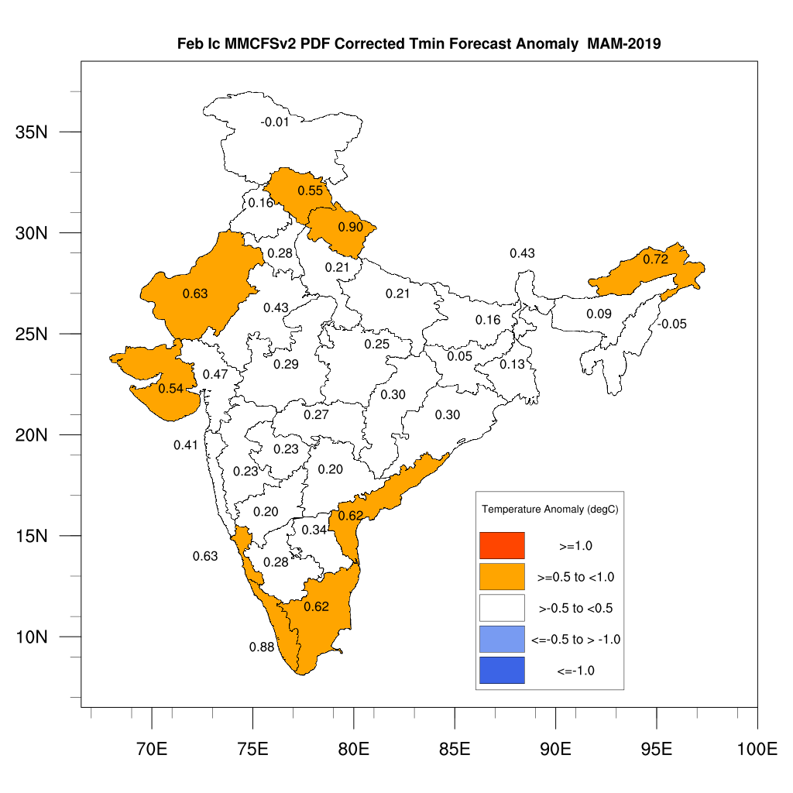
Tmin MAM 2019

Slide 9
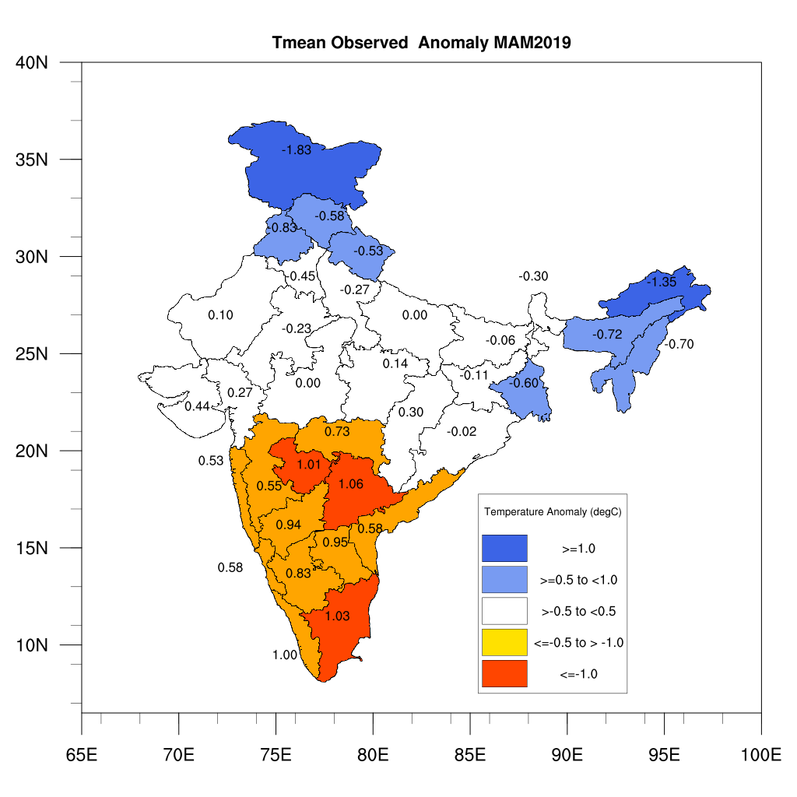
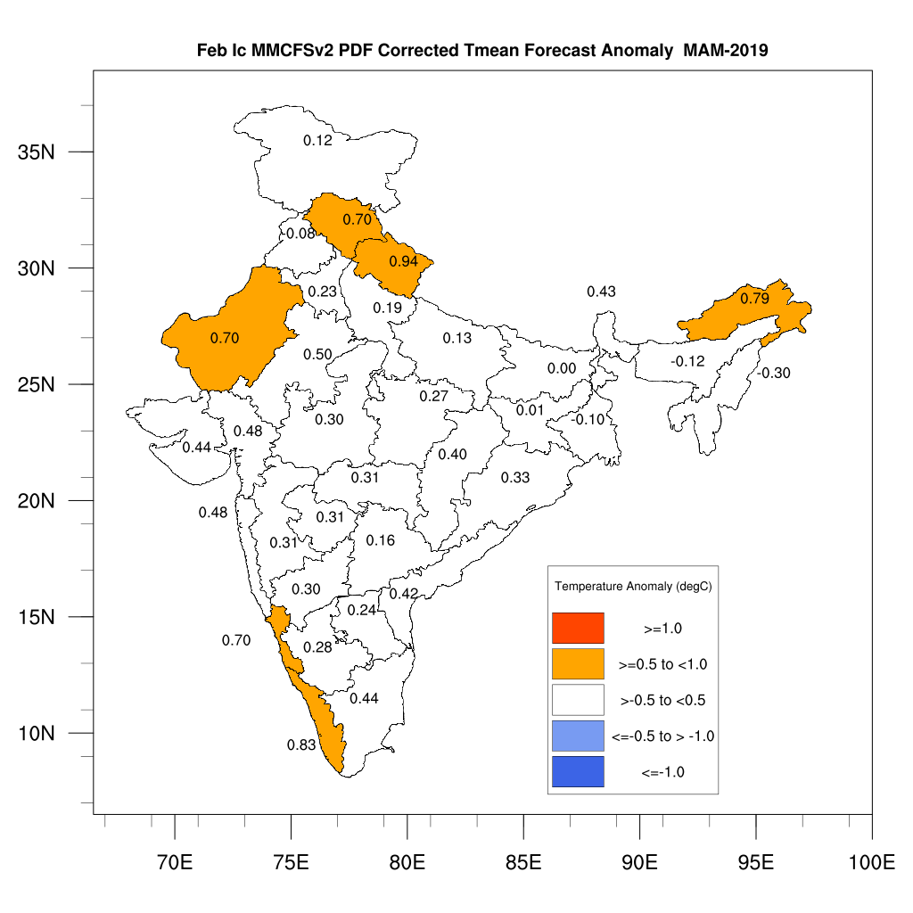
Tmean MAM 2019

Slide 10
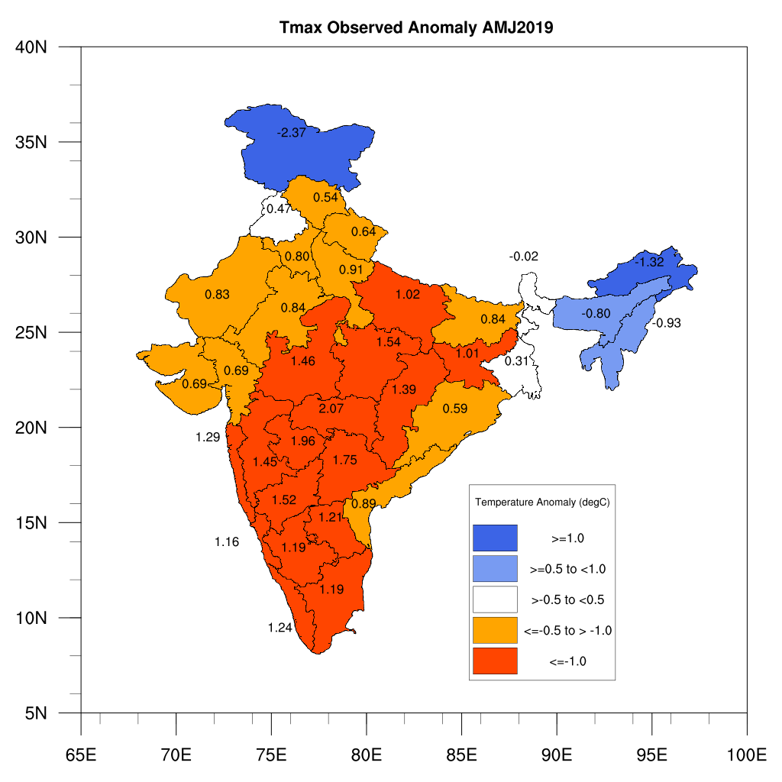
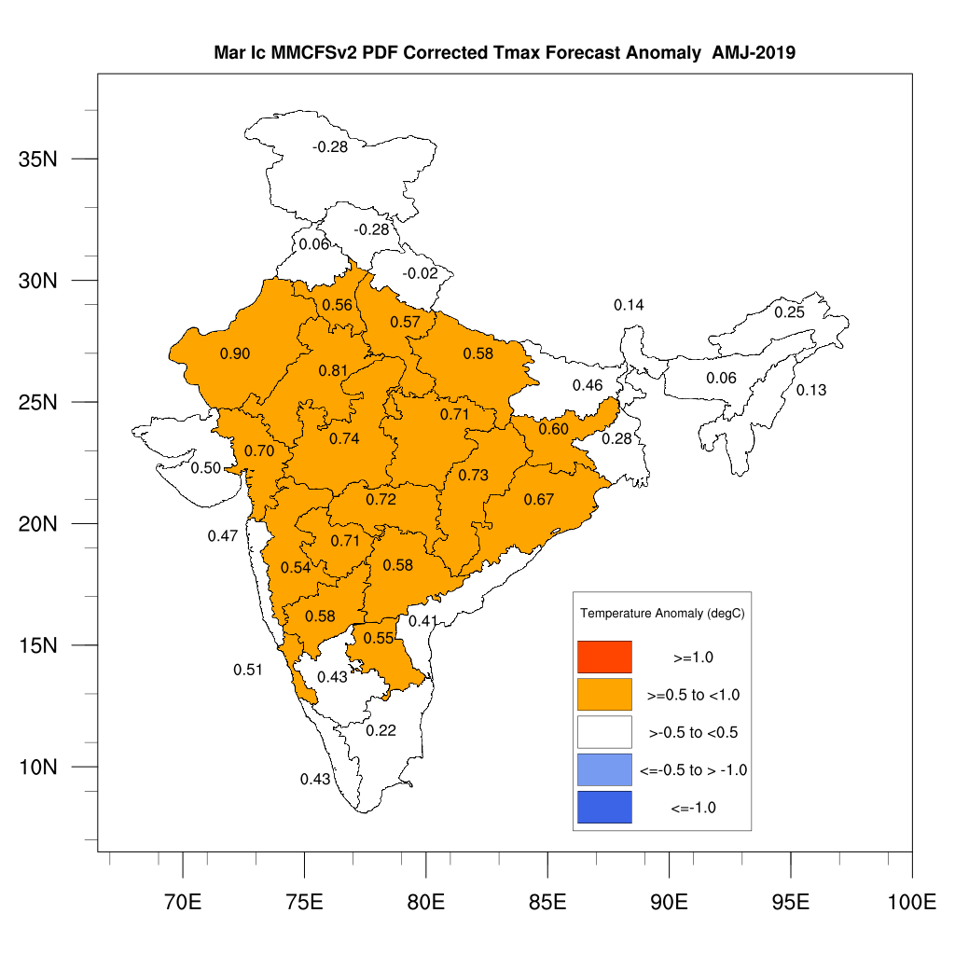
Tmax AMJ 2019

Slide 11
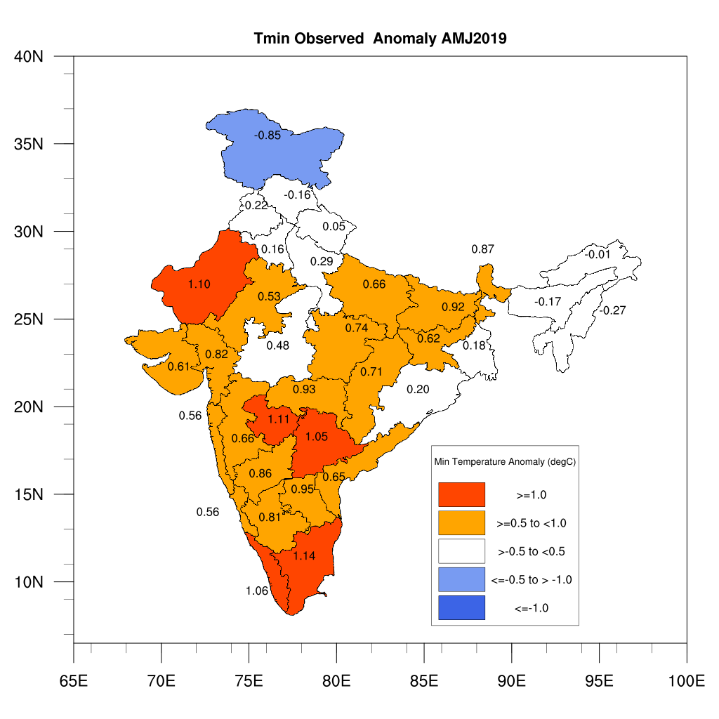
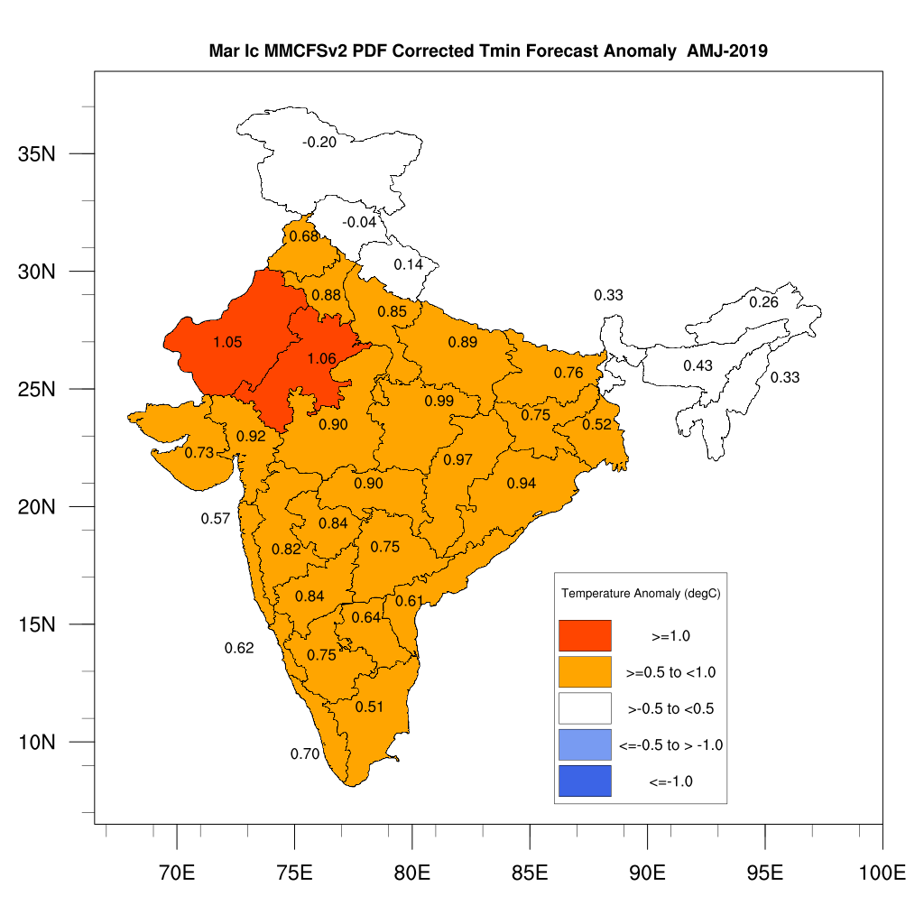
Tmin AMJ 2019

Slide 12
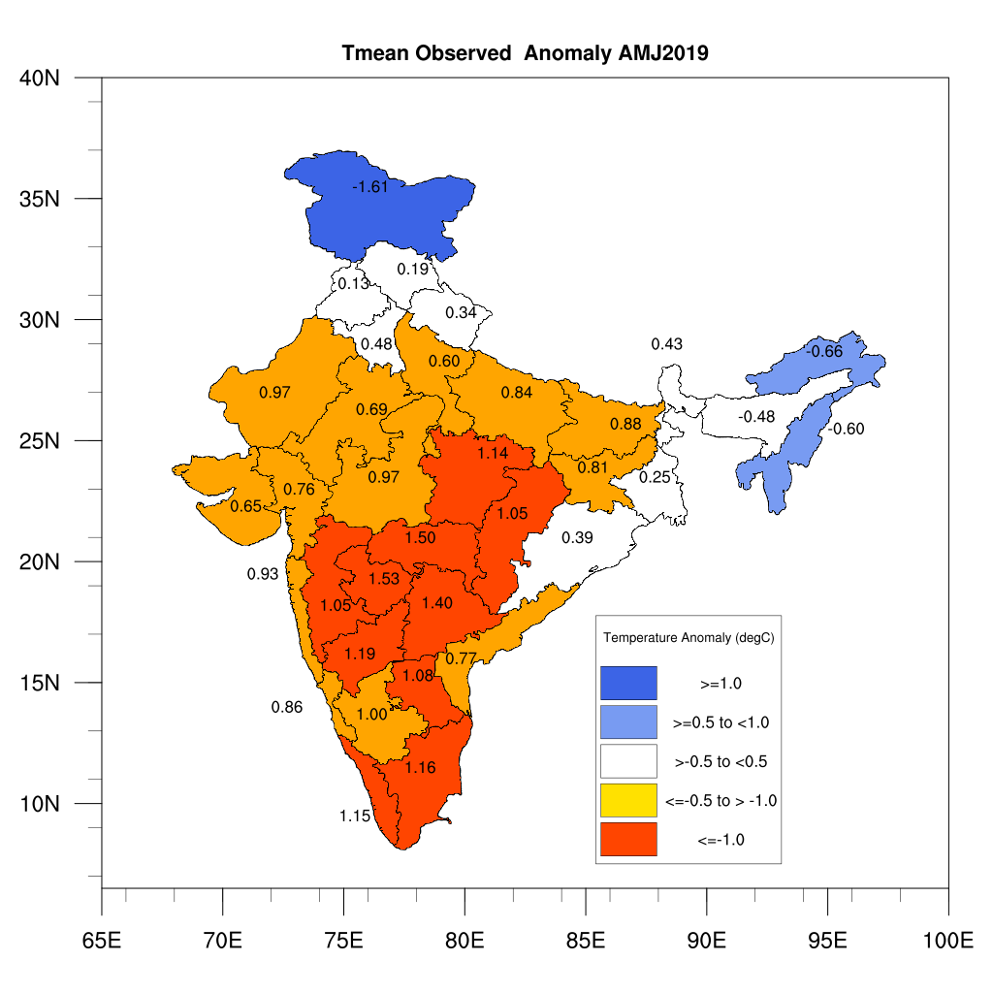
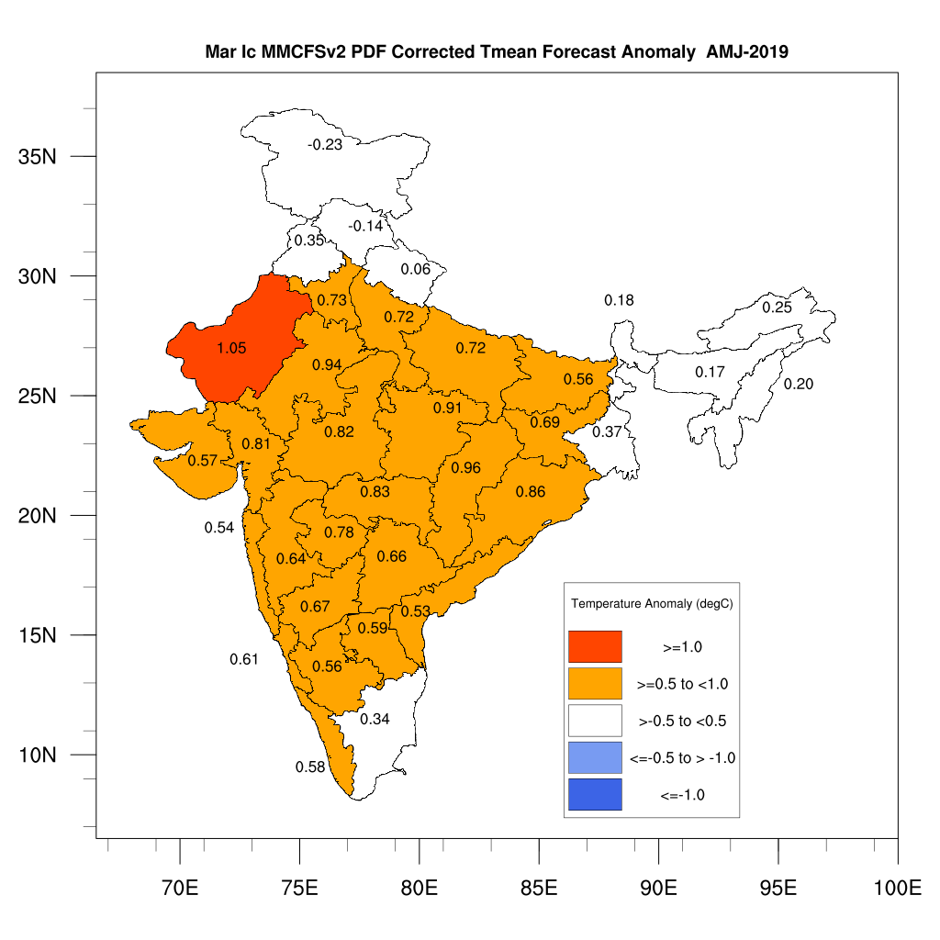
Tmean AMJ 2019

Slide 13
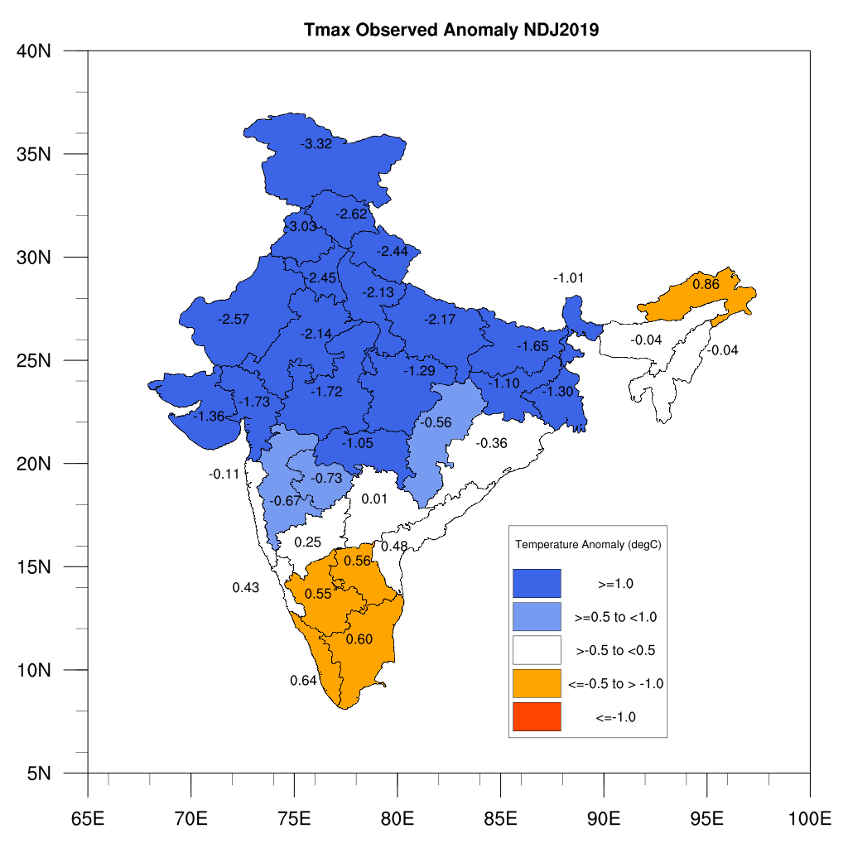
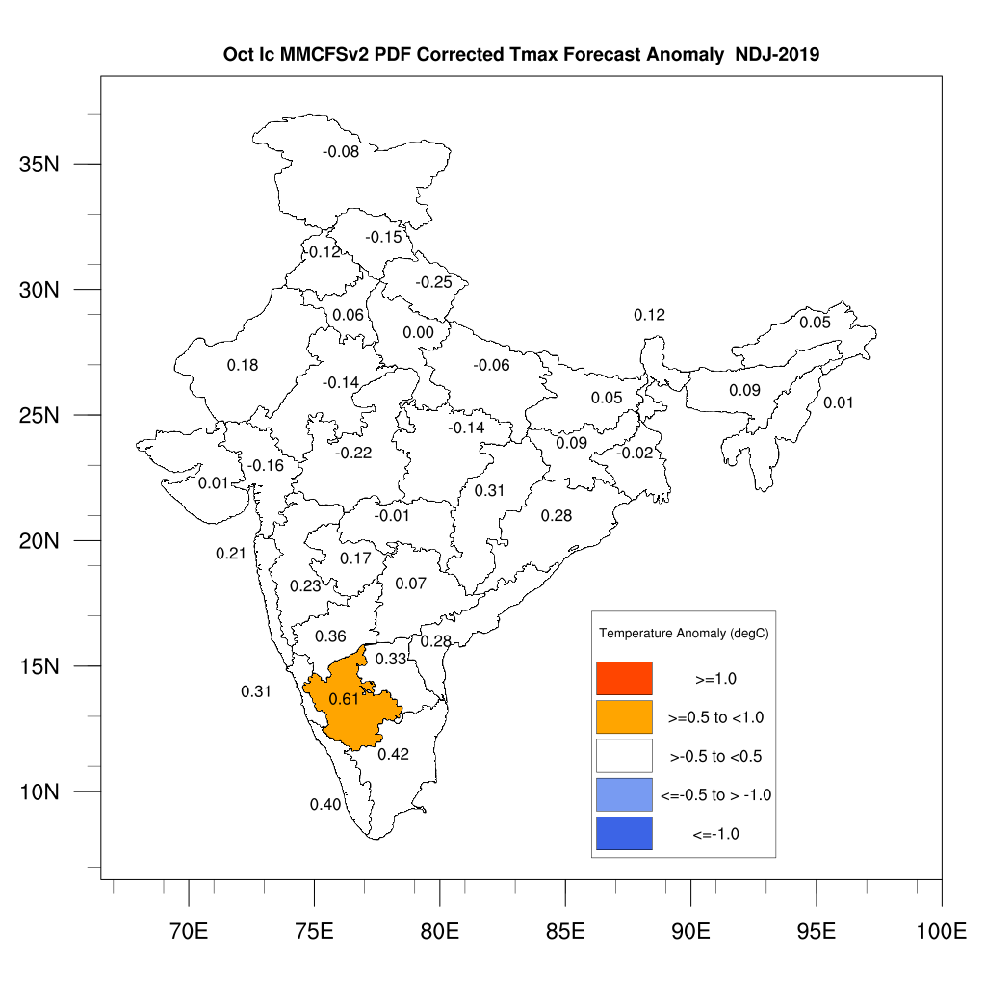
Tmax NDJ 2019

Slide 14
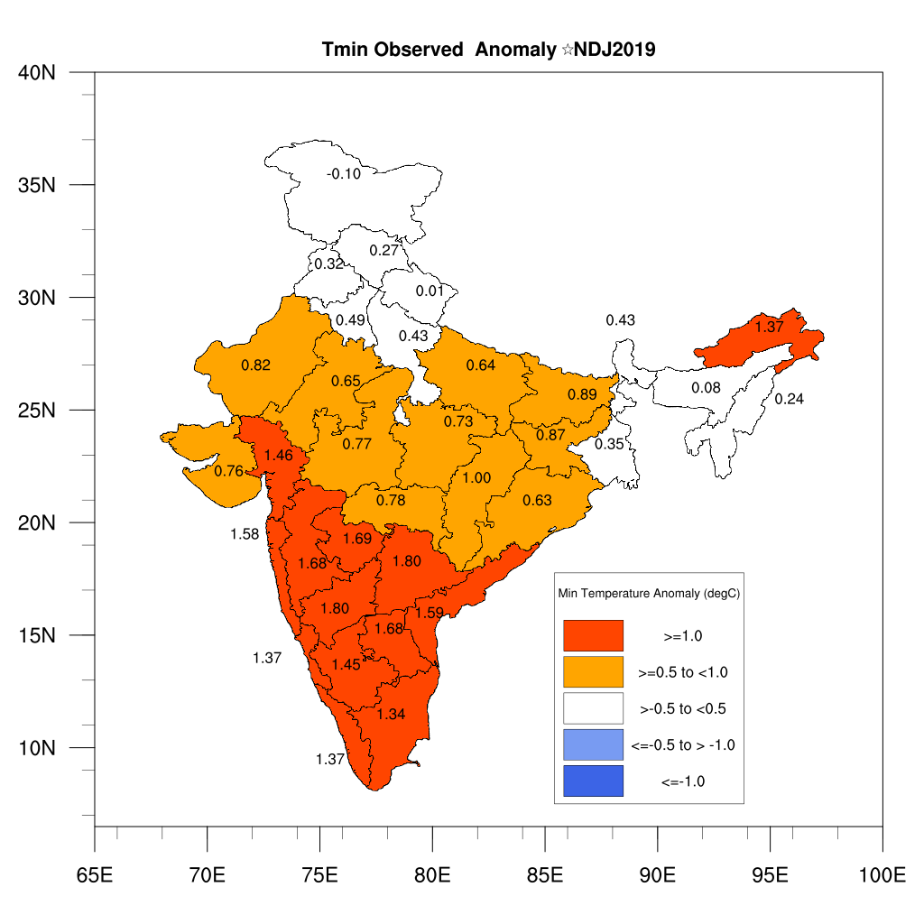
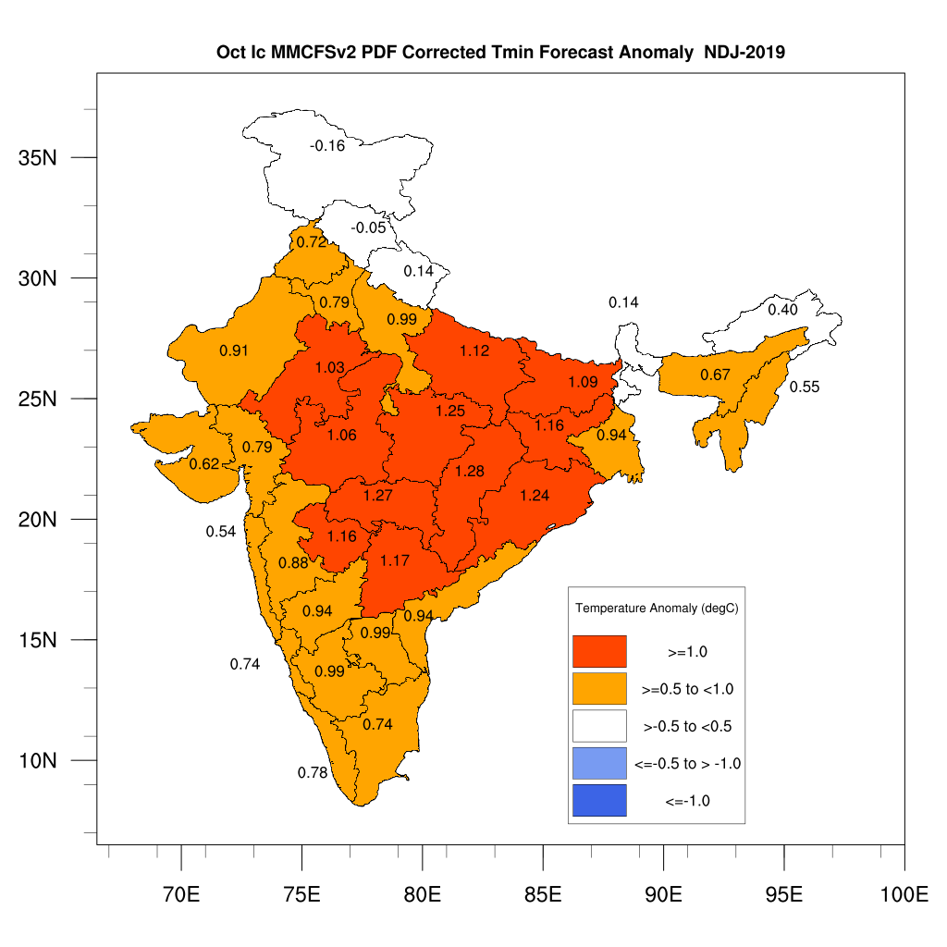
Tmin NDJ 2019

Slide 15
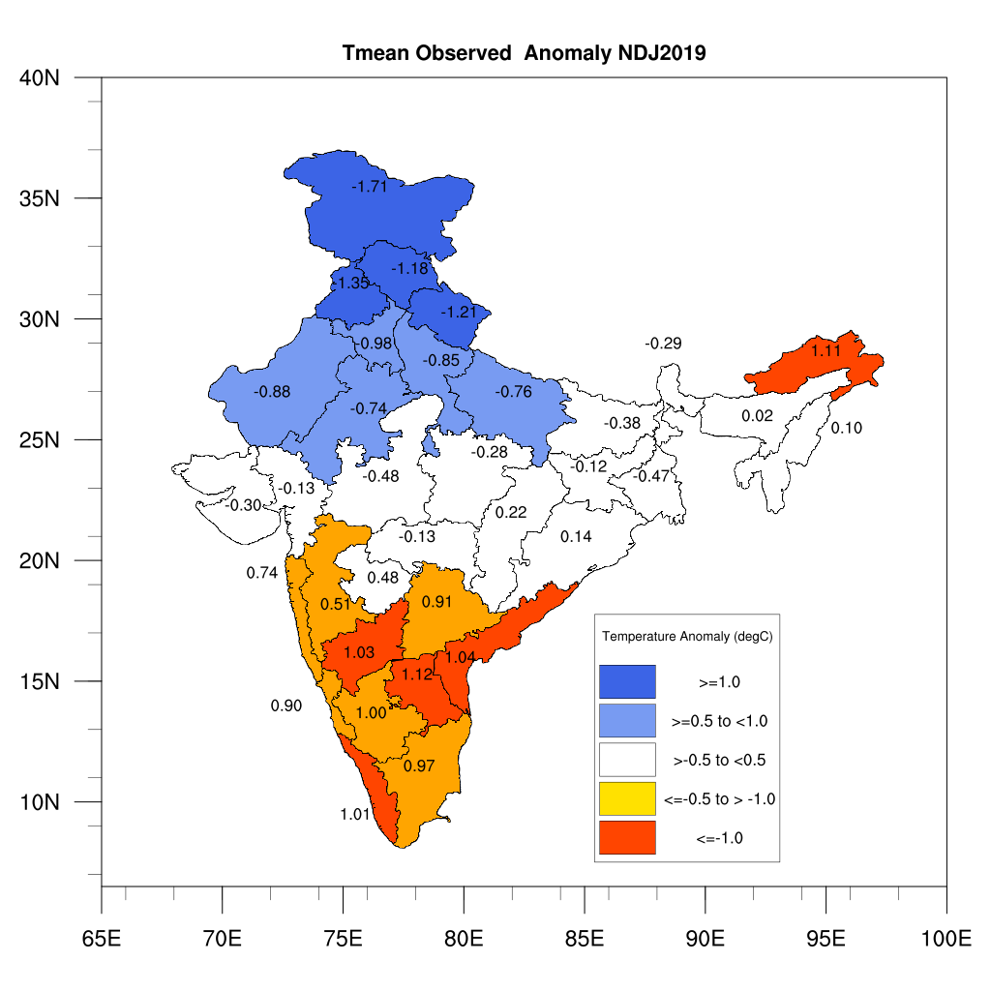
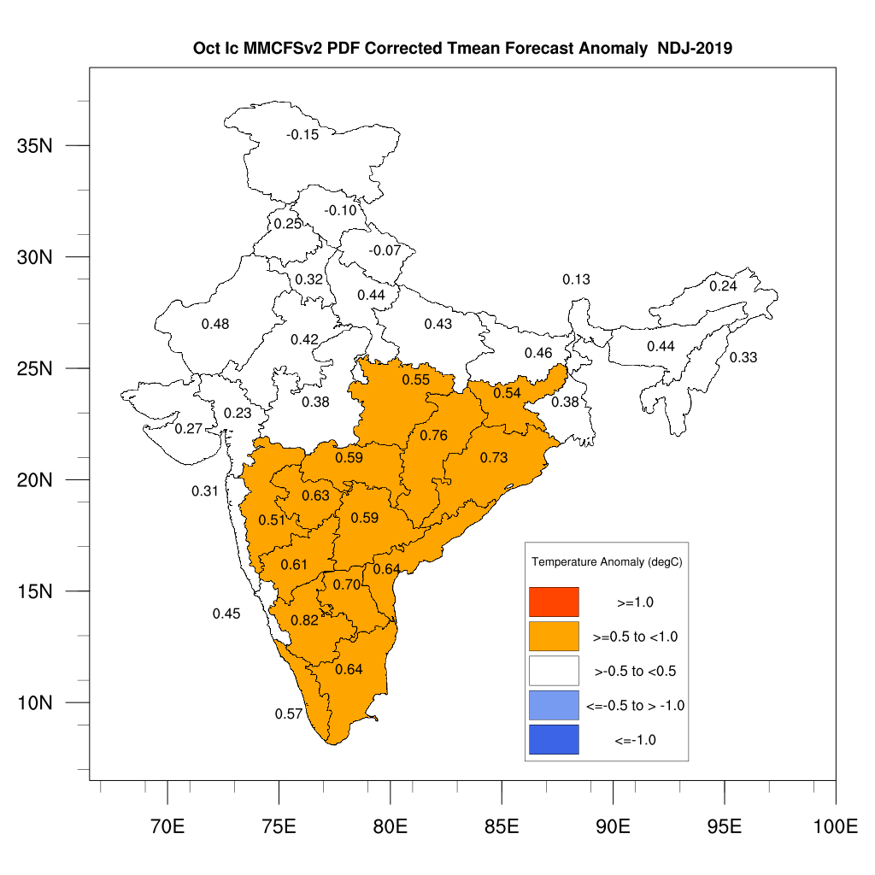
Tmean NDJ 2019

Slide 16
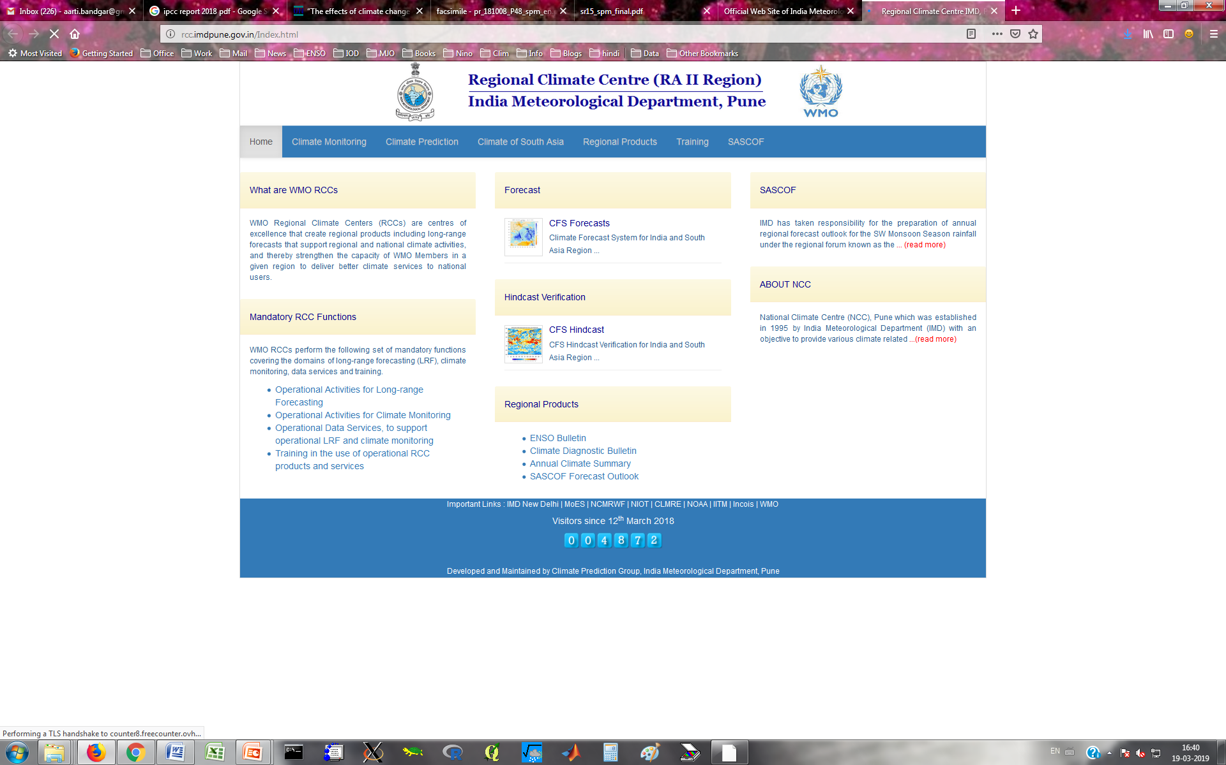
Regional Climate Services Activities:
Regional Climate Centre (RCC)
Long Range Forecast Products Available from RCC, Pune Website Based on Monsoon Mission CFS
Global monthly and seasonal forecast anomaly maps of Rainfall and Temperature for next 4 months & 2 seasons (Every month)
ENSO & IOD Forecast Bulletins (Every month)
Seasonal Forecast Outlook of Rainfall and Temperatures over South Asia (updated every month)
Consensus forecast for South Asia

Slide 18
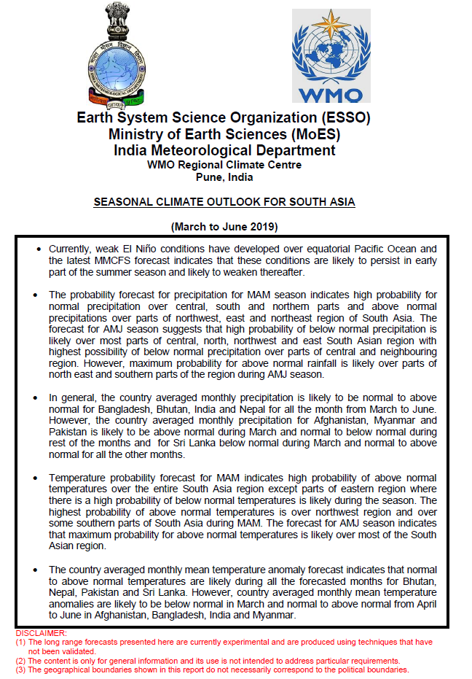
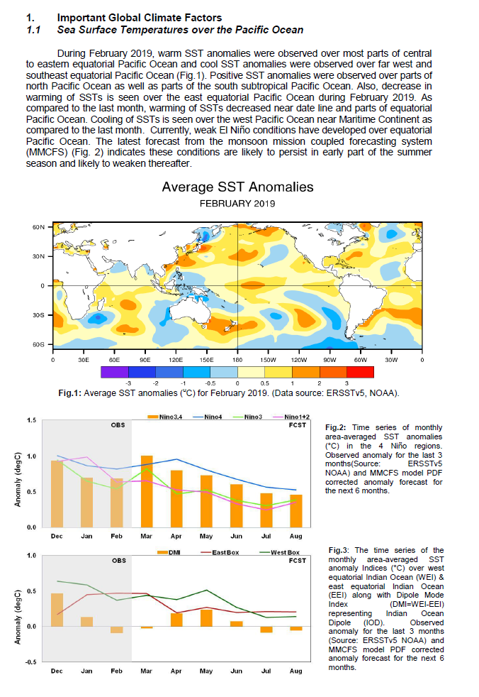
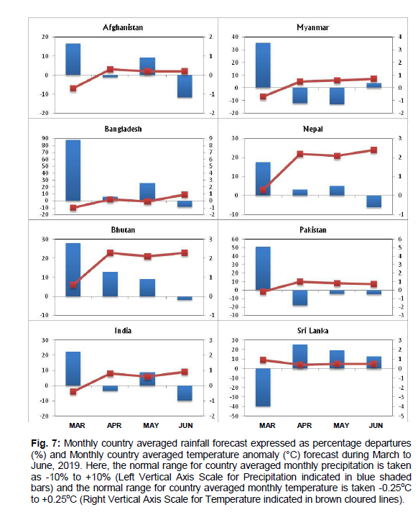
Seasonal Climate Outlook for South Asia

Slide 19

Temperature outlook for South Asia
The probability forecast for temperature for coming seasons for South Asian region

Slide 20


SASCOF Consensus Outlook for the 2018-19 DJF over South Asia

Slide 23

Thank you
23

