Slide 1
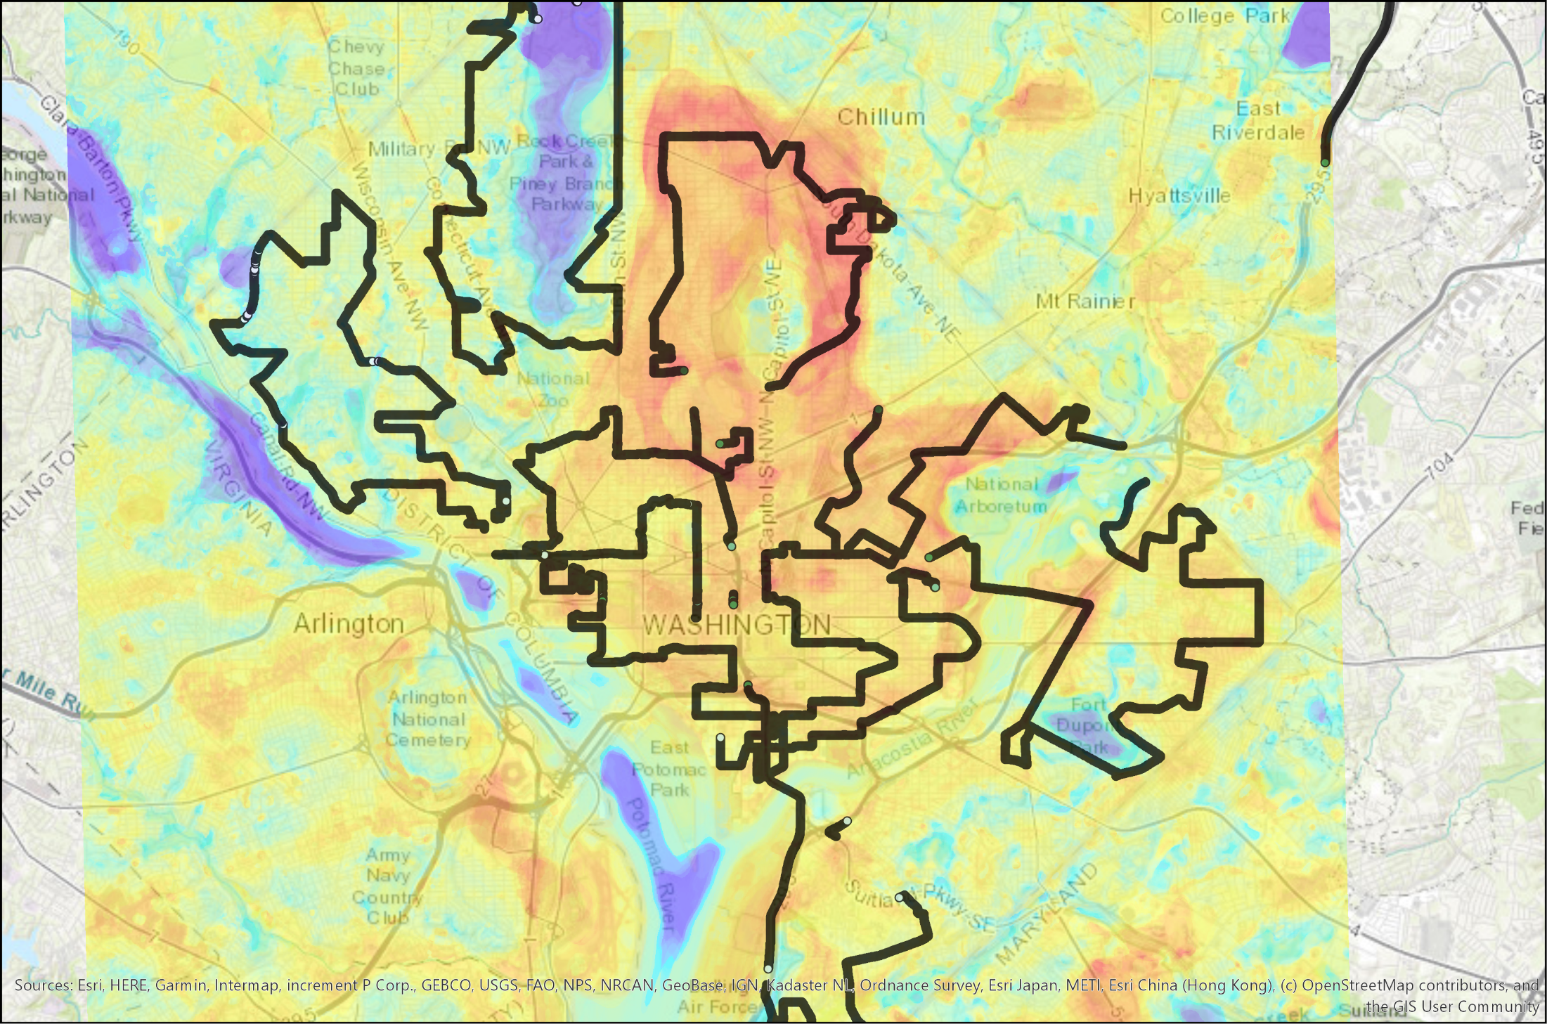



U.S. Heat Health Planning, Preparedness, Response
The National Integrated Heat Health Information System
Hunter Jones
Climate & Health Projects Manager
National Integrated Heat Health Information System (NIHHIS)
NOAA Climate Program Office
Juli Trtanj, NOAA OAR/CPO;
Shubhayu Saha, US CDC;
http://climate.gov/nihhis
Notes:
8-10+ slides
Genesis slide of the context for how NIHHIS came about and what the vision is
Slide on indirect costs of extreme heat - farmer suicides indirect effect of heat?
State Singaporean meeting (in video) could send reps to training session. Highlighting US capacity.

Slide 2
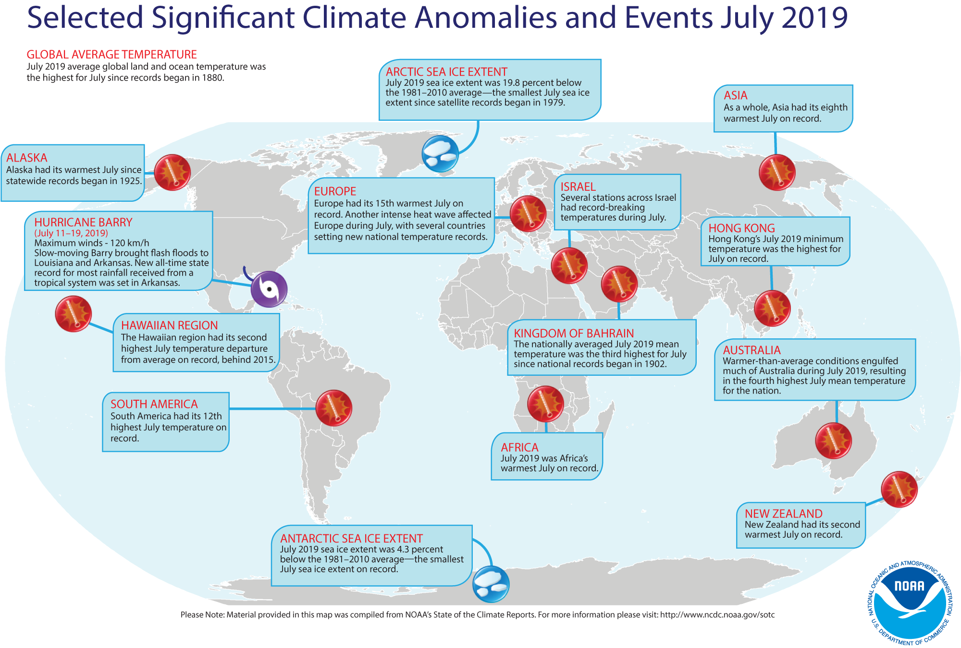
National Centers for Environmental Information

Slide 3
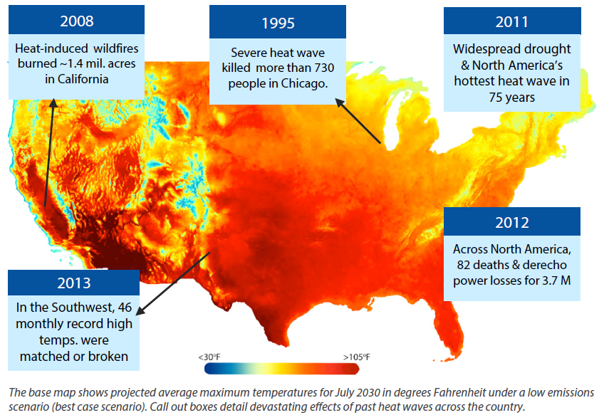
Extreme Heat is a Multidisciplinary Problem
Decisions must be made in many disciplines to protect humans from extreme heat’s health consequences.
Local health departments
Utilities / Energy
Emergency Management
Resilience/Sustainability Offices
Weather Forecast Offices
Hospitals
School districts
They all need information at different timescales, and have different risk tolerances and capacity to respond.
Notes:
Why isn’t what we’re doing now working?
List many reasons
Summarize into: We aren’t meeting people where they are. We don’t understand how they make decisions, and they don’t understand how to use our products.

Slide 4










National Integrated Heat Health Information System
NOAA and CDC launched the National Integrated Heat Health Information System (NIHHIS) in June of 2015 to address heat across timescales
NIHHIS quickly grew to include representation from several agencies (right) in an interagency working group. The group launched the NIHHIS portal and began harmonizing information and guidance.
NIHHIS has also launched regional, trans-boundary pilots to understand local decision-making contexts and needs, and to improve the information.
Ongoing activities include:
Prototyping new integrated climate-health products,
‘Decision calendar’ exercises to understand multi-disciplinary needs in the Northeast,
National projects to improve the utility of information such as Urban Heat Island campaigns.
The National Integrated Heat Health Information System weaves together existing pieces, identifies information needs and helps to develop needed climate services.
NIHHIS will facilitate an integrated approach to providing a suite of
decision support services to reduce heat related illness and death

Slide 5
NIHHIS: an Integrated Information System
Co-develop inter-disciplinary decision calendars, prototypes, requiremnts
Define demand by building relationships to understand local context
Foster inter-agency, NGO, and private sector involvement
Co-learning, sharing best practices, and sharing information
Integrate information across timescales and disciplines
Build Capacity, Inform Decisions, Encourage Risk-Reducing Actions
Notes:
Seamless timescales [Build Capacity, Inform Choices, and Encourage Resilient Actions]
Regional-local pilots and International
Interagency, w/ NGOs and private sector
Linking Science and Proven Interventions to Outcomes, not Outputs
Interdisciplinary, for Decision-makers
Interagency w/ NGOs and private sector involvement
Translating science to evidence-based interventions to outcomes

Slide 6
NIHHIS Core Questions
All NIHHIS engagements are used to understand the answers to these core questions – as well as how and why those answers change given local context.
Institutional Capacity & Partnerships
What institutional partners have you engaged to help define the needs (esp. bridging disciplines: health, env. science, emergency management); is that sustainable and if so, how and why?
Heat Parameters & Health Outcomes
What heat parameters (tmax, tmin, heat index, etc) are most important for which specific population and in what geographic conditions?
Data and Forecast Products
What data and forecast products, indicators, surveillance, and monitoring is needed (at what spatial and temporal resolution & lead time) and what is currently being used by practitioners to make decisions?
Engagement and Communication Strategies
What communication strategies are most effective both during an event and for long lead time planning (seasonal outlooks)?
Interventions and Effectiveness
What health interventions are currently being employed in managing heat risk and at what timescales?
Are these interventions successful, and to what extent to they depend on local context & capacity?
Notes:
The NIHHIS framework intends that each domestic pilot and member of the international network address these core questions. This facilitates inter-comparison of approaches to heat-health.
<Briefly step through the 4 main theme areas for questions>
These questions are not necessarily mutually exclusive nor collectively exhaustive, but rather are a starting point. Each pilot will implement these questions slightly differently, but will still be able to relate to other pilots and partners through the questions.

Slide 7
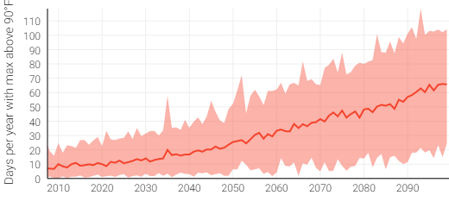
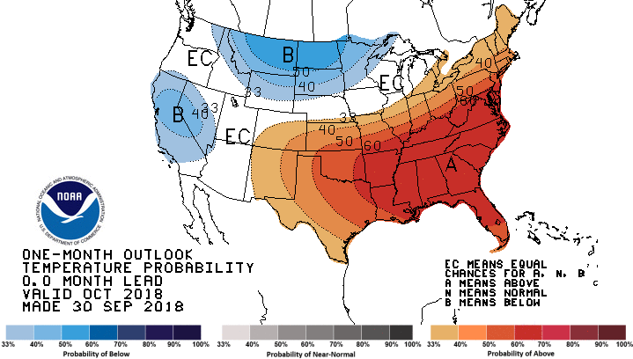
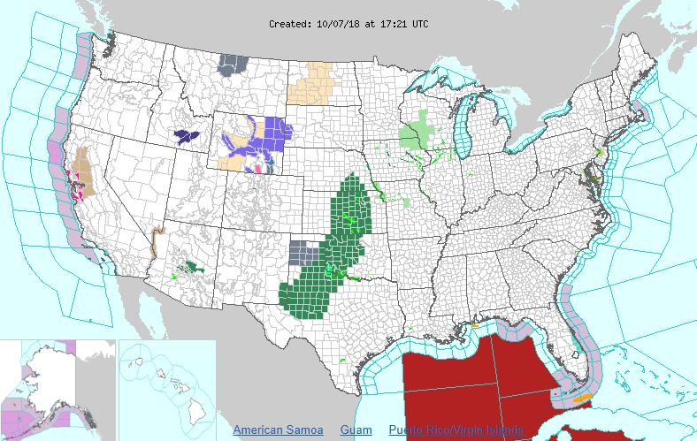
Climate and Weather Information Available at Many Timescales
Climate Projections from the Climate Explorer
Seasonal Prediction from NOAA
Seasonal Prediction from NOAA
Heat Health Action Plans and Heat Early Warning Systems
Heat Season
Intervention Lead Time
Heat Event
Heat Event
Heat Event
Years to Decades Out
Pre-Heat Season
Planning
Preparedness
Response & Recovery
Emergency Management Cycle
Learn from heat events and climate projections to update HHAPs and HEWS
Consideration of long-term interventions are often missing from HHAPS and HEWS, but could be more cost effective in the long-run
Heat Health Action Plans often include interventions for pre-heat season preparedness
Heat Early Warning Systems are typically engaged when a heat alert is issued

Slide 8
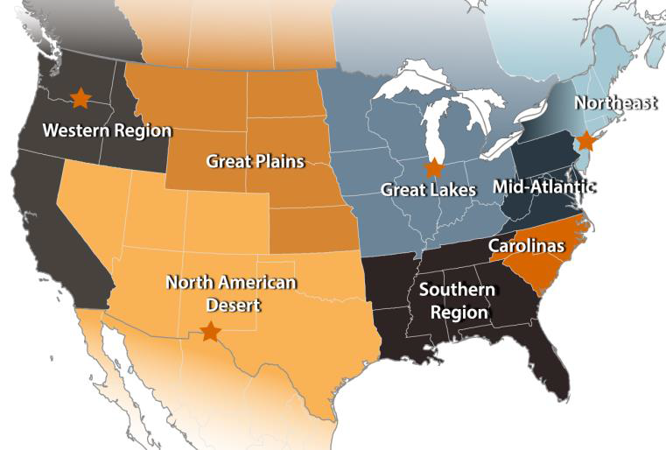
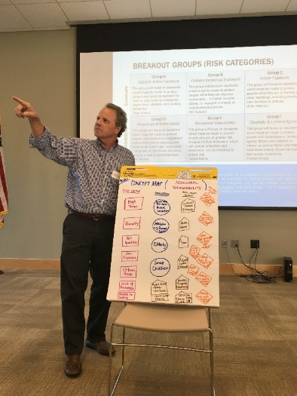
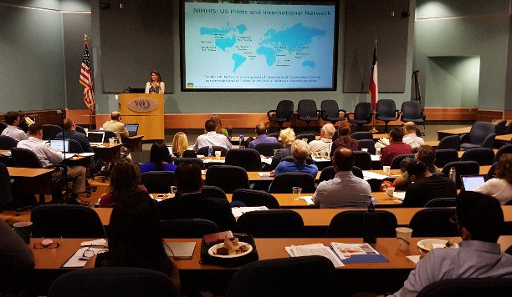
Defining Local Context and
Understanding Sector-based Decisions
Engagement with other agencies
  Activity Modification Guidelines
Engagement through Pilots & Decision Calendars
  Interviews with experts in many disciplines
  Documentation and refinement
  Compare across pilots
Attend Interdisciplinary Meetings
  American Institute of Architects NYC
  National Association of County and City Health Officials
  Army Public Health Center
  Harris County Public Health
  One Health Conference
Invite other disciplines to
climate meetings
  AMS 2020 in Boston
  AGU GeoHealth

Slide 9
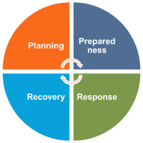
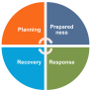
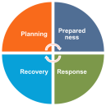
Heat Health
Risk Management Annual Cycle
Planning
Prepared-ness
Response
Recovery
Analysis of historical impacts & climate observations
Scenario-based planning & climate predictions
Previous Years
Future Years
What can we learn from past experiences to improve heat health planning and preparedness?
How might our current approach fail under future climate stressors, and how can we prevent such failure?
Notes:
Elaborate on activities at each timescale, information needs, other dependencies, and downstream activities.

Slide 10
Decision Calendars
Decision calendars are a framework to organize information about user context in decision-making. They document what needs to be known when, by whom, and with what certainty in order to take actions to reduce heat health risk.
Planning and Preparedness Lead Times
1-2 Weeks
< 1 Week
Active Heat Wave
3-4 Weeks
Pre-Heat Season
Inter-annual
Long Term
Emergency Manager
Selecting New Sites
Launch Heat
Awareness Campaign
Targeted Outreach to
Pops of Concern?
Open Cooling
Centers?
Urban
Planner
Plant
Trees?
Rooftop Albedo
Modifications
Environmental Decision-Support Information
Where will the Urban Heat Island Effect be the greatest?
Where is the UHI effect currently the greatest?
Characterize the heat season relative to previous or analog years
Detect likely heat event in the coming few weeks
Weather service issues heat advisory
For more information see:
Ray, A. J., & Webb, R. S. (2016).
Understanding the user context: decision calendars as frameworks for linking climate to policy, planning, and decision-making.
Climate in Context, 27–50. doi:10.1002/9781118474785.ch2

Slide 11
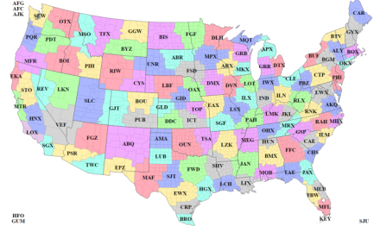
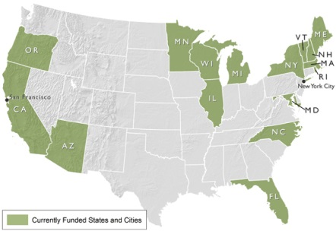
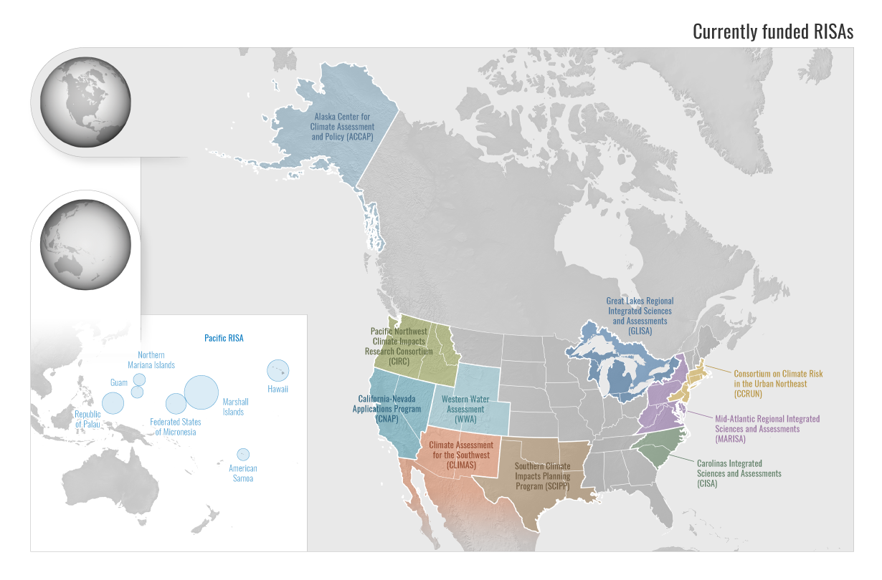
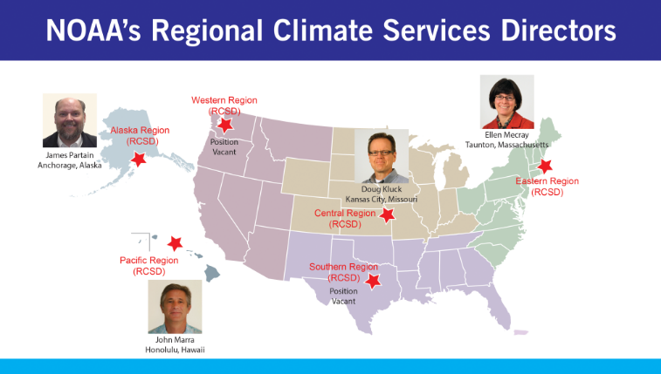
Building user engagement via other networks
NWS WFOs
& Weather Ready Nation Health Ambassadors
CDC BRACE Grantees
CPO-supported RISAs
Notes:
It’s important to make use of existing communities, networks, and That’s why GHHIN is linked into CSRD and GFCS, and it’s why NIHHIS utilizes these existing networks and many more.

Slide 12
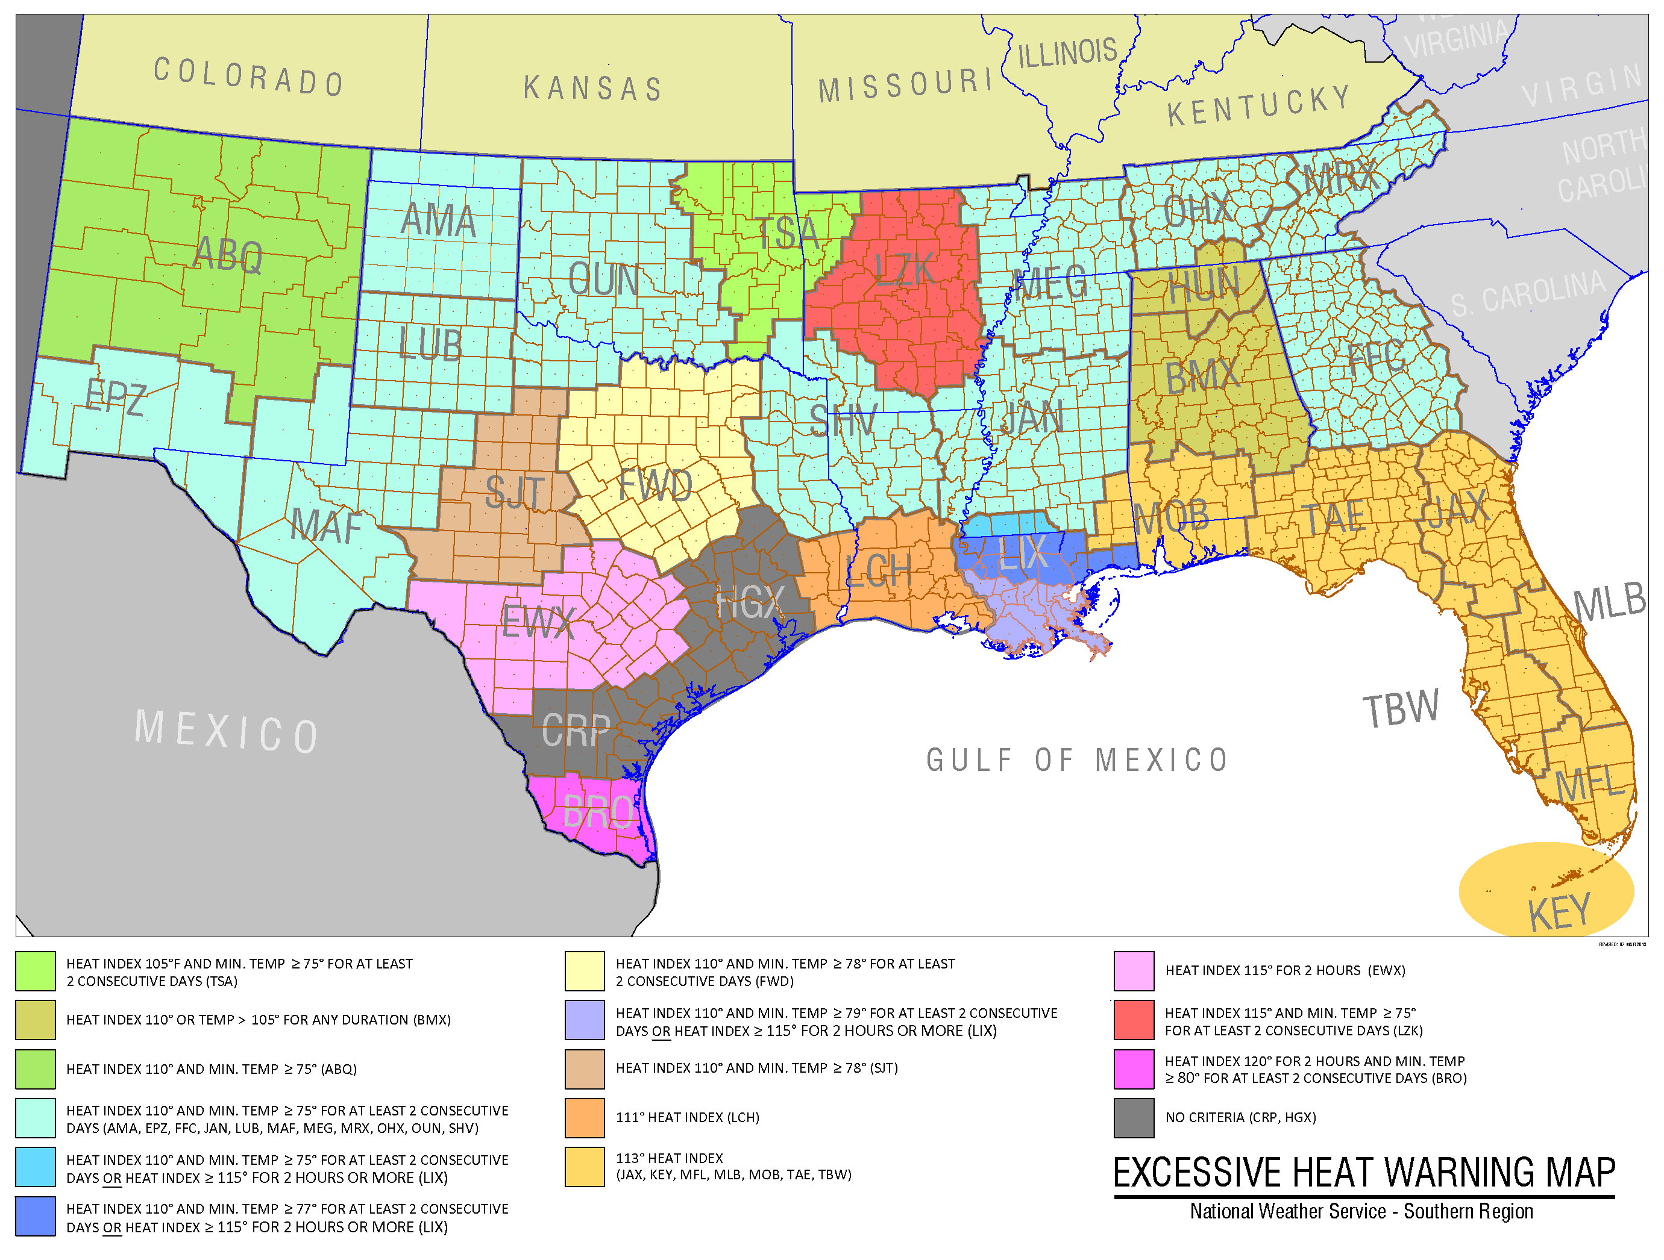
Notes:
Extreme heat is a global challenge that will only increase with a changing climate. It is an often overlooked problem, described by many as a ‘silent killer’, but its effects on human health, animal health, and infrastructure can be just as crippling as an earthquake or tsunami. A variety of approaches to managing the risk associated with extreme heat have been employed around the world, using different information sources, and serving different vulnerable populations. Yet, extreme heat continues to kill tens to hundreds of thousands per year. the heat wave of summer 2003 in Europe for example, more than 70 000 excess deaths were recorded ^{(WHO)} The National Integrated Heat Health Information System seeks to integrate these approaches by providing a framework for understanding the risk, information needs, and potential interventions that reduce risk on timescales from early warning (when a heat wave is imminent) to long-term planning.

Slide 13
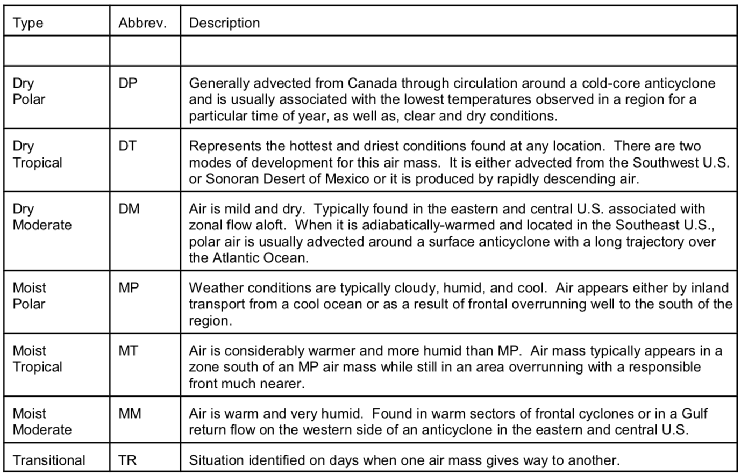
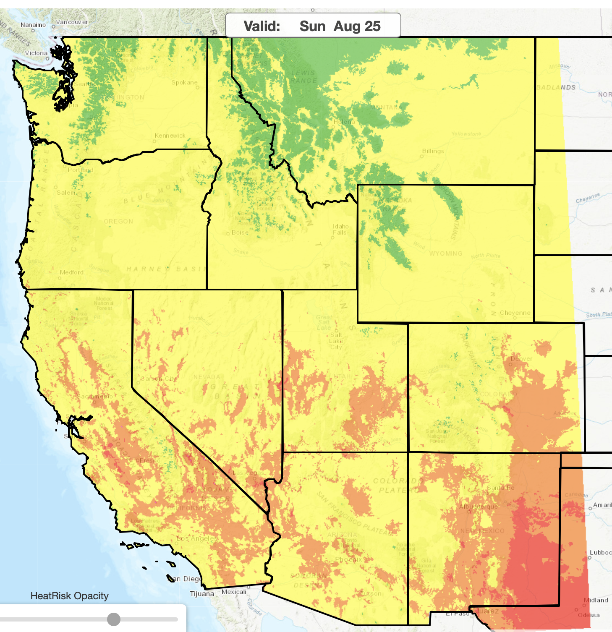
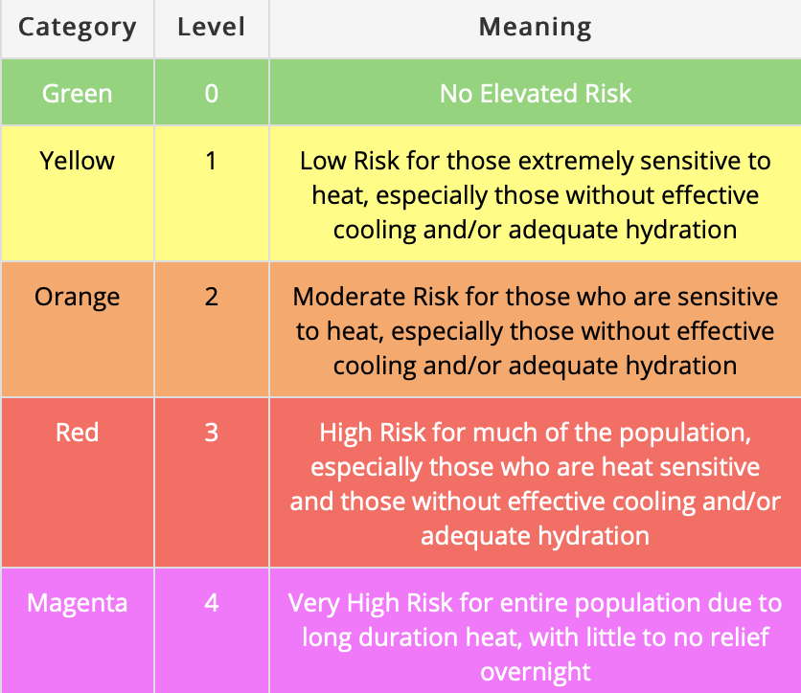
Current Heat Wave Products
NOAA issues Heat Advisories, Watches, and Warnings.
  Advisory: Take action, excessive heat is expected.
  Watch: Be prepared for a prolonged period of extreme heat within 48 hours.
  Warning: Take action, a prolonged period of extreme heat is expected in < 24 hours.
These communications are issued by WFOs and derived from:
Temperature & Wet Bulb Globe Temperature
Kalkstein Procedures
  Classify air as “oppressive” based on temperature and humidity.
HeatRisk
  Developed and used primarily in the western region, but has been codified as a requirement and will be available as a national option soon. Level 3 or 4 of the NWS Heat Risk scale is the threshold for issuing an Excessive Heat Warning.

Slide 14
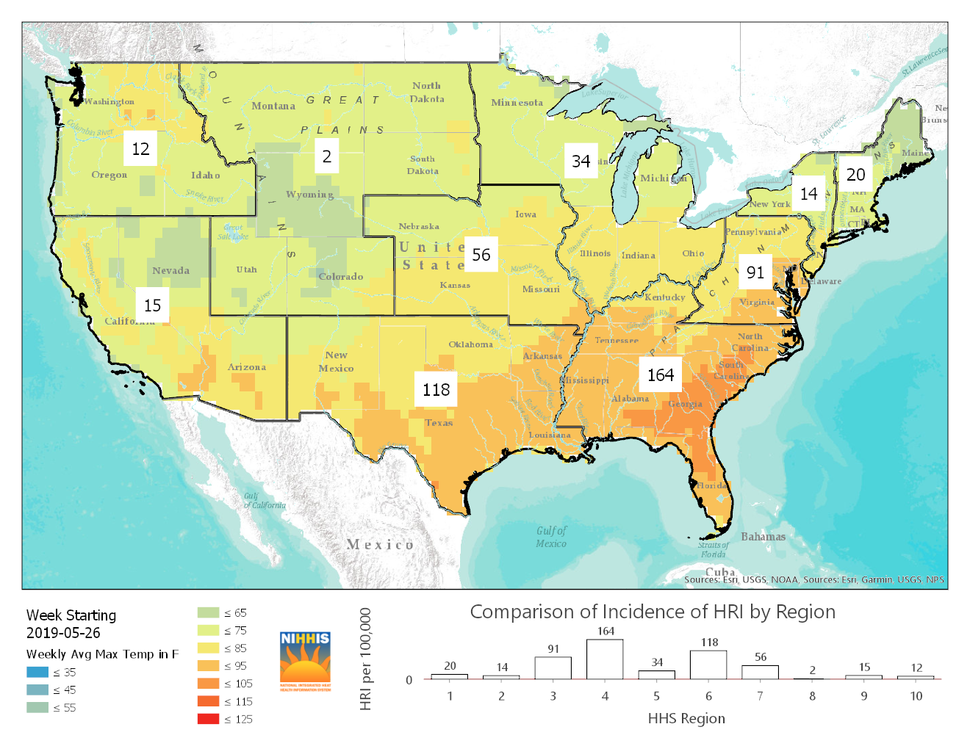
Early Summer 2019 NIHHIS Monitor Showing The Southeastern Heat Wave’s Impacts

Slide 15
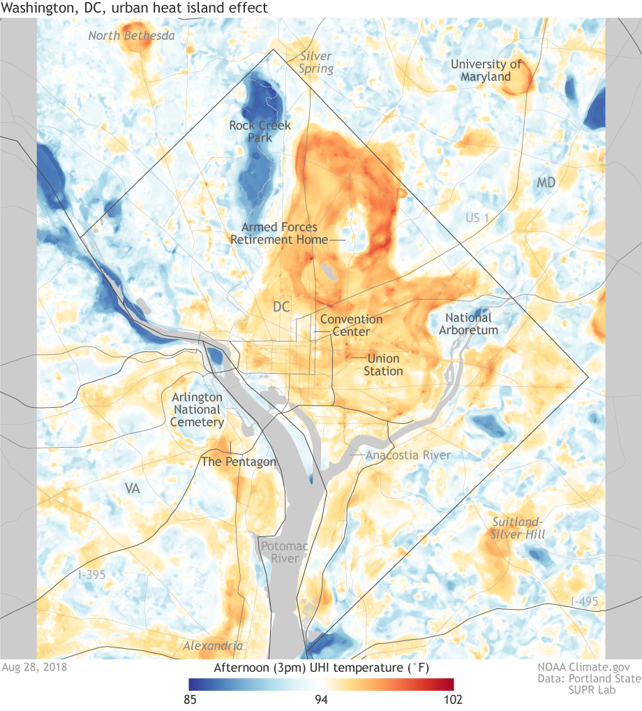
UHI Map of DC
Produced in summer 2018. Also created maps of Baltimore. Richmond was mapped by the same PIs previously.
Temperature readings collected in-situ via vehicle transects using mounted thermometers every second.
Satellite imagery and other data fed into machine learning process with transect data to create maps.
https://doi.org/10.3390/cli7010005

Slide 16
Thank you for listening
Contact Me
Learn More
Hunter Jones
hunter.jones@noaa.gov
+1 301-734-1215
NIHHIS
nihhis.cpo.noaa.gov
NIHHIS NE Materials
https://github.com/
hunterjonesm/
NIHHIS-Northeast
GHHIN
https://ghhin.org
BAMS
meeting summary
dx.doi.org/10.1175/
BAMS-D-19-0042.1

Slide 17
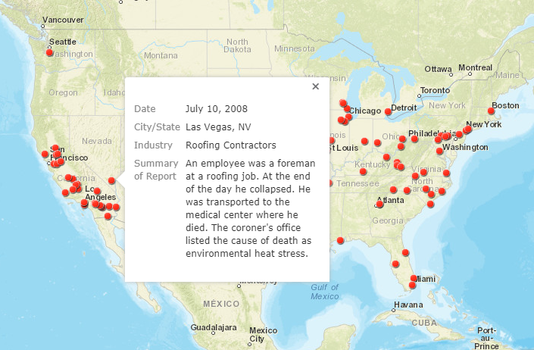
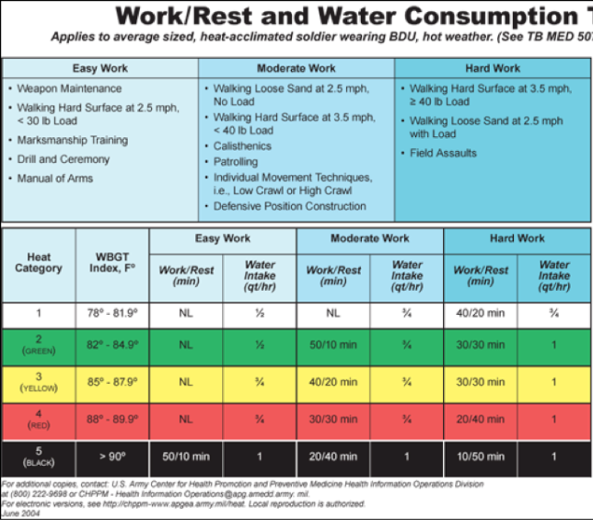
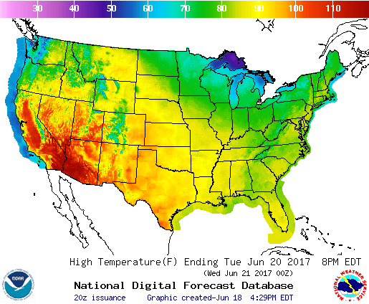
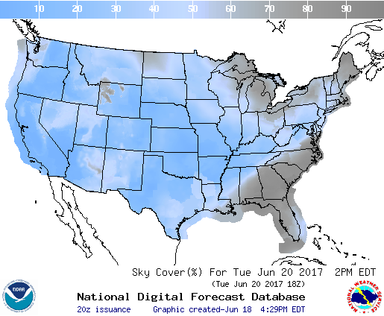
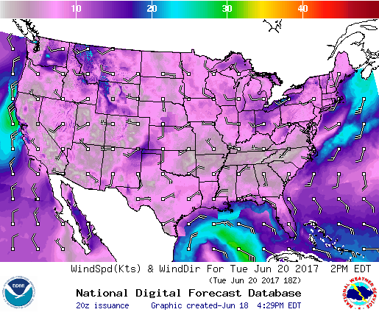
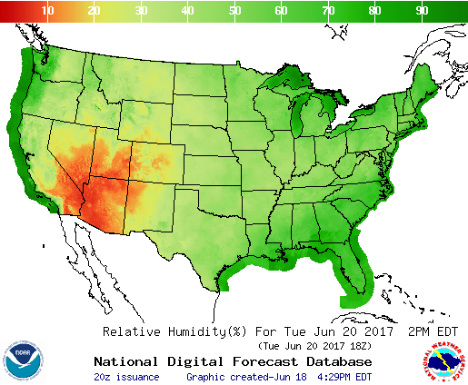

Forecasting WBGT for Occupational Health
Activity Modification Guidelines, often based on wet-bulb globe temperature (WBGT) are used for occupational, athletic, and the military heat exposure to advise on work/rest ratios and hydration.
WBGT can be approximated from temp., insolation, humidity, and wind.

Slide 18
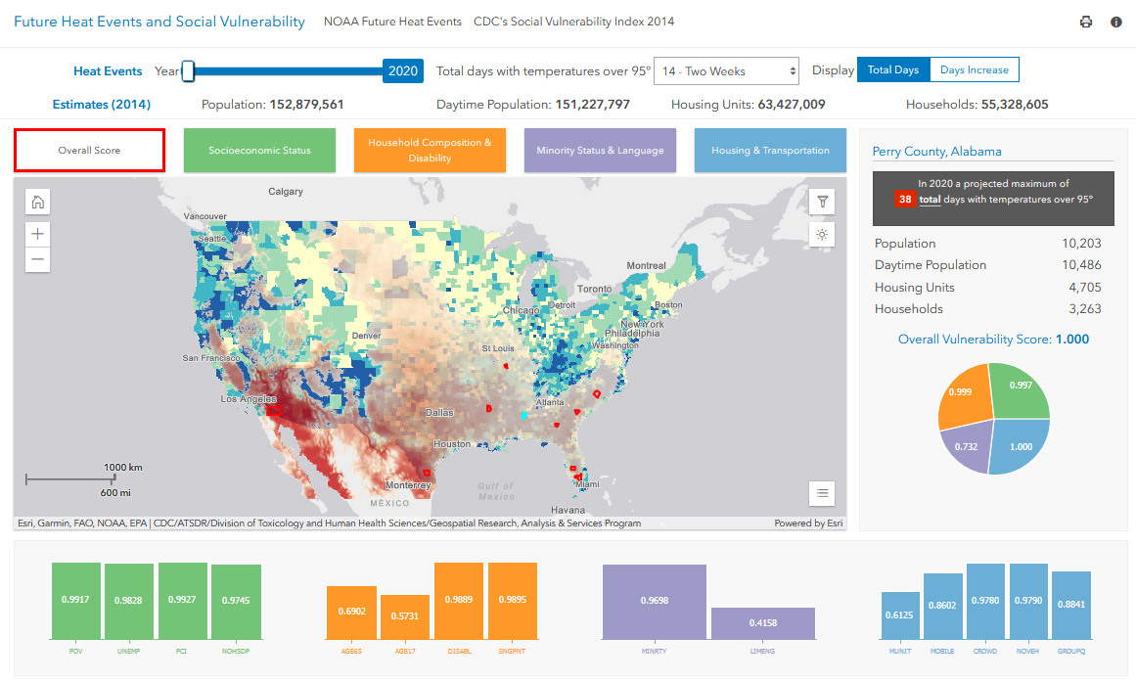
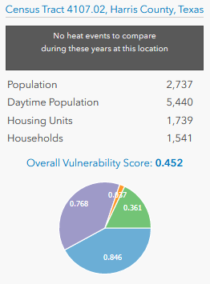
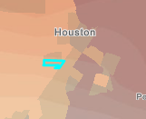
Co-developed with Esri, this tool on NIHHIS combines CDC’s Social Vulnerability Index with Heat Projections – and allows for census-tract level analysis. The next step is to introduce a heat-specific vulnerability layer.

Slide 19
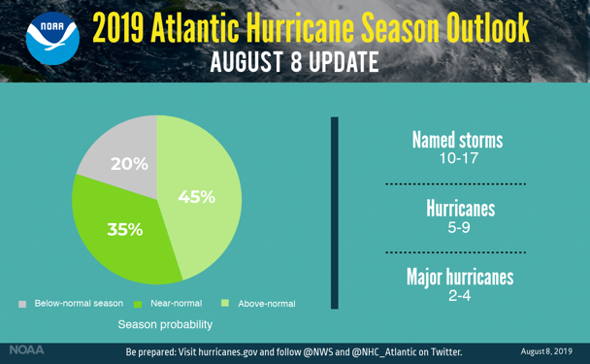
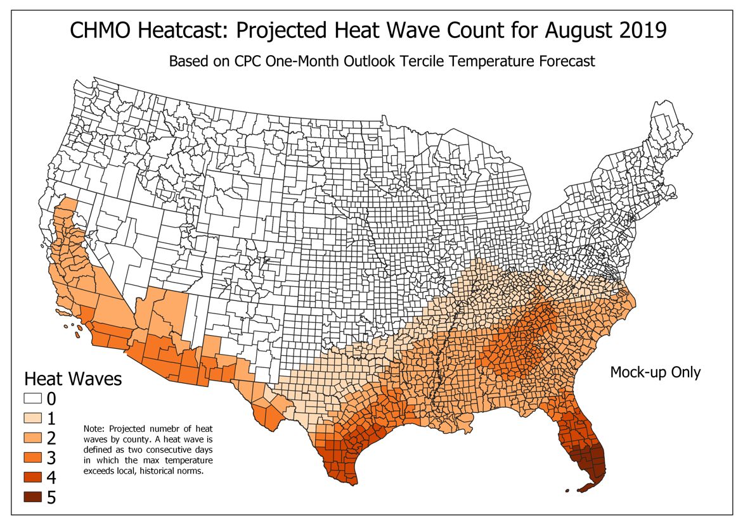
CHMO First Prototype: Historical Heatwave Analysis & Heat Season Prediction (like Hurricane Outlooks)
Can we provide an enhanced interpretation of NOAA’s Climate Predictions for Health Users?
https://www.climate.gov/news-features/understanding-climate/where-are-highest-chances-hot-summer-2017
Notes:
https://www.climate.gov/news-features/understanding-climate/where-are-highest-chances-hot-summer-2017

Slide 20
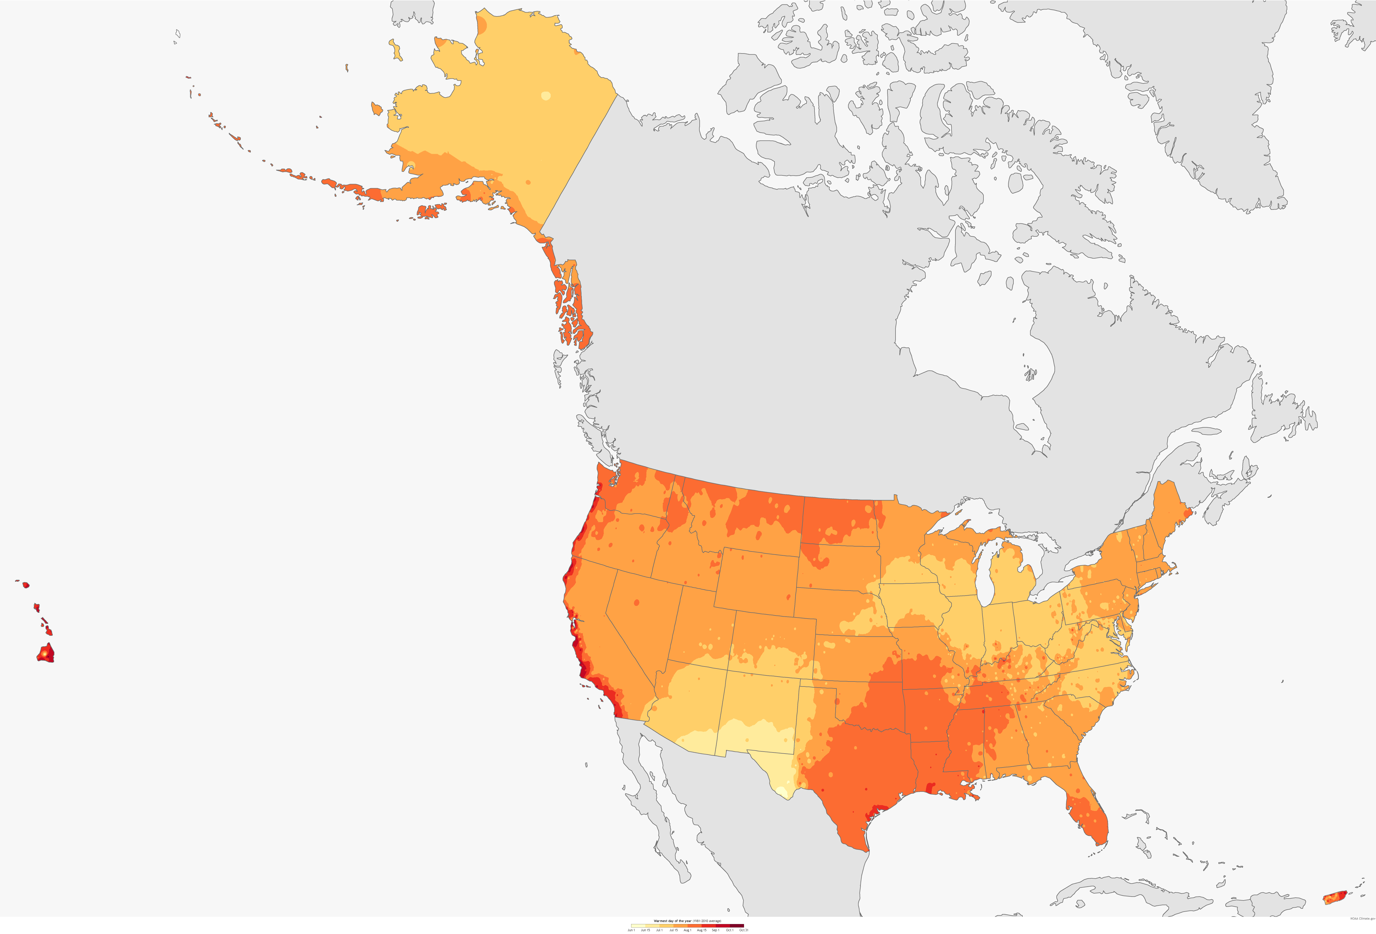
Seattle, WA
Portland, OR
Boston, MA
Worcester, MA
Yonkers, NY
Baltimore, MD
Washington, DC
Richmond, VA
Honolulu, HI
West Palm Beach, FL
Ft. Lauderdale, FL
Miami, FL
climate.gov
This map shows the locations of the previous Urban Heat Island mapping campaigns superimposed upon a map of the climatological (19810-2010) average hottest day of the year. Historical climate information as well as weather and climate predictions from NOAA are used to plan the campaigns in cities across the U.S.
Notes:
This map shows the locations of the previous Urban Heat Island mapping campaigns superimposed upon a map of the climatological (19810-2010) average hottest day of the year. Historical climate information as well as weather and climate predictions from NOAA are used to plan the campaigns in cities across the U.S.

Slide 21



Launched in June 2016 by experts from over a dozen founding institutions, spearheaded by WMO/WHO Joint Office for Climate and Health, and NOAA.
GHHIN is an independent, voluntary, and member-driven forum of scientists, practitioners, and policy makers focused on improving capacity to protect populations from the avoidable health risks of extreme heat in a changing climate.
GHHIN activities include the bi-annual Global Forum on Heat and Health, the GHHIN.org portal and newsletter, national and regional technical consultations on HEWS, learning exchanges (eg. CPC-ANACIM).
2nd Global Forum on Heat and Health
28-31 July 2020 / Copenhagen, Denmark

Slide 22
NOAA’s Line Offices & Activities
NMFS
National Marine Fisheries Service
Productive and sustainable fisheries, safe sources of seafood, the recovery and conservation of protected resources, and healthy ecosystems.
NOS
National Ocean Service
Provides data, tools, and services for safe & efficient transportation & commerce, preparedness & risk reduction, stewardship, recreation, and tourism.
NESDIS
National Env. Satellite Data and Information Service
Manages NOAA’s satellites (GOES, Jason-3, Suomi NPP, DSCOVR, COSMIC-2, etc…) & climate data center – the National Center for Env. Information
OAR
Oceanic and Atmospheric Research
NWS
National Weather Service
OMAO
Office of Marine and Aviation Operations
One of 7 US Uniformed Services (like US Public Health Service Commissioned Corps)
Labs & Cooperative Institutes nationwide, research grant programs, & international research activities
Weather and climate prediction, early warning, engagement across US Weather Forecast Offices, partnership with Weather Ready Nation Ambassadors

Slide 23
NOAA Heat Predictions at Seasonal and Sub-seasonal Scales
NOAA 3-4 Week Outlook
NOAA 3-Month Seasonal Outlook

Slide 24
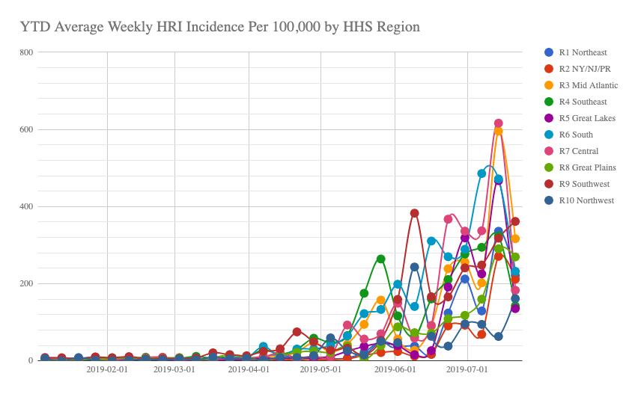
Data from CDC Essence Syndromic Surveillance
Notes:
Data from CDC Essence Syndromic Surveillance

Slide 25
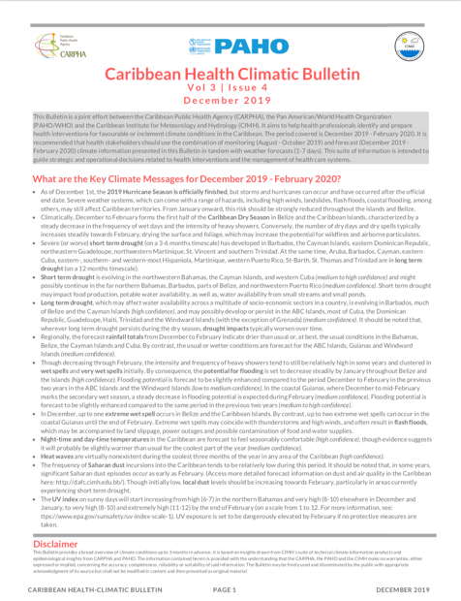
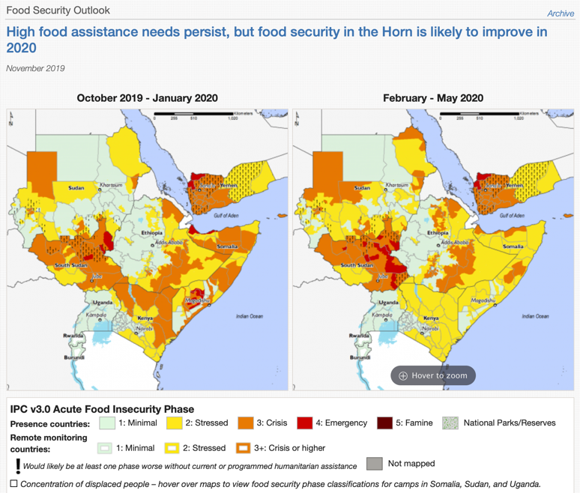
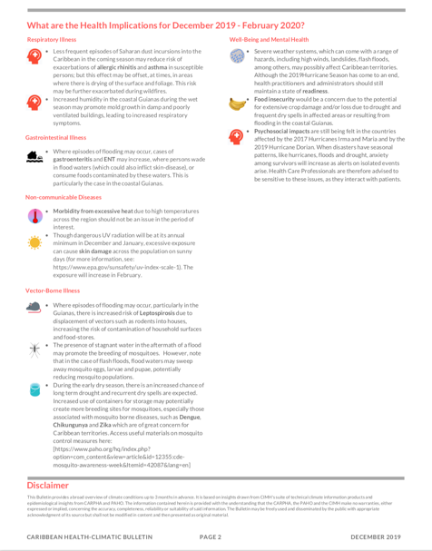
Inspiration for Integrated Climate Information
Left: Caribbean Health Climatic Bulletin
Right: FEWS NET Famine Early Warning System

Slide 26

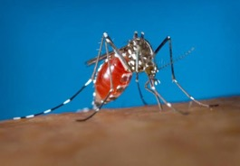
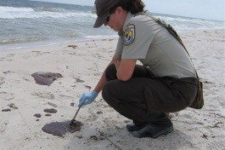
The Climate and Health Monitor and Outlook
Integrating Health, Climate, and Weather Info at all Timescales
Co-everything. Iterative Prototyping (agile). Build on existing data and products, but iteratively refine through engagement with users.
The CHMO: A set of integrated climate, weather, and health information prototypes intended to enhance the use of environmental information in health decision-making.
Heat-related morbidity and mortality
Helping decision makers answer questions:
How bad will this heat season be compared to last year?
Should public health offices need to step up communication and surveillance?
When will mosquito season start and how bad will it be?
Is there an increased risk of local transmission of imported tropical diseases?
When is additional screening of seafood warranted, or beach closures?
Arboviral (arthropod-transmitted) diseases
Waterborne diseases (Vibriosis)
Important Caveat:
We are producing PROTOTYPES not functional products. The prototypes are meant to explore the problem and solution domains by generating discussion, ideas, and research and operational opportunities – not to be operational products.
Initial Health Targets

Slide 27
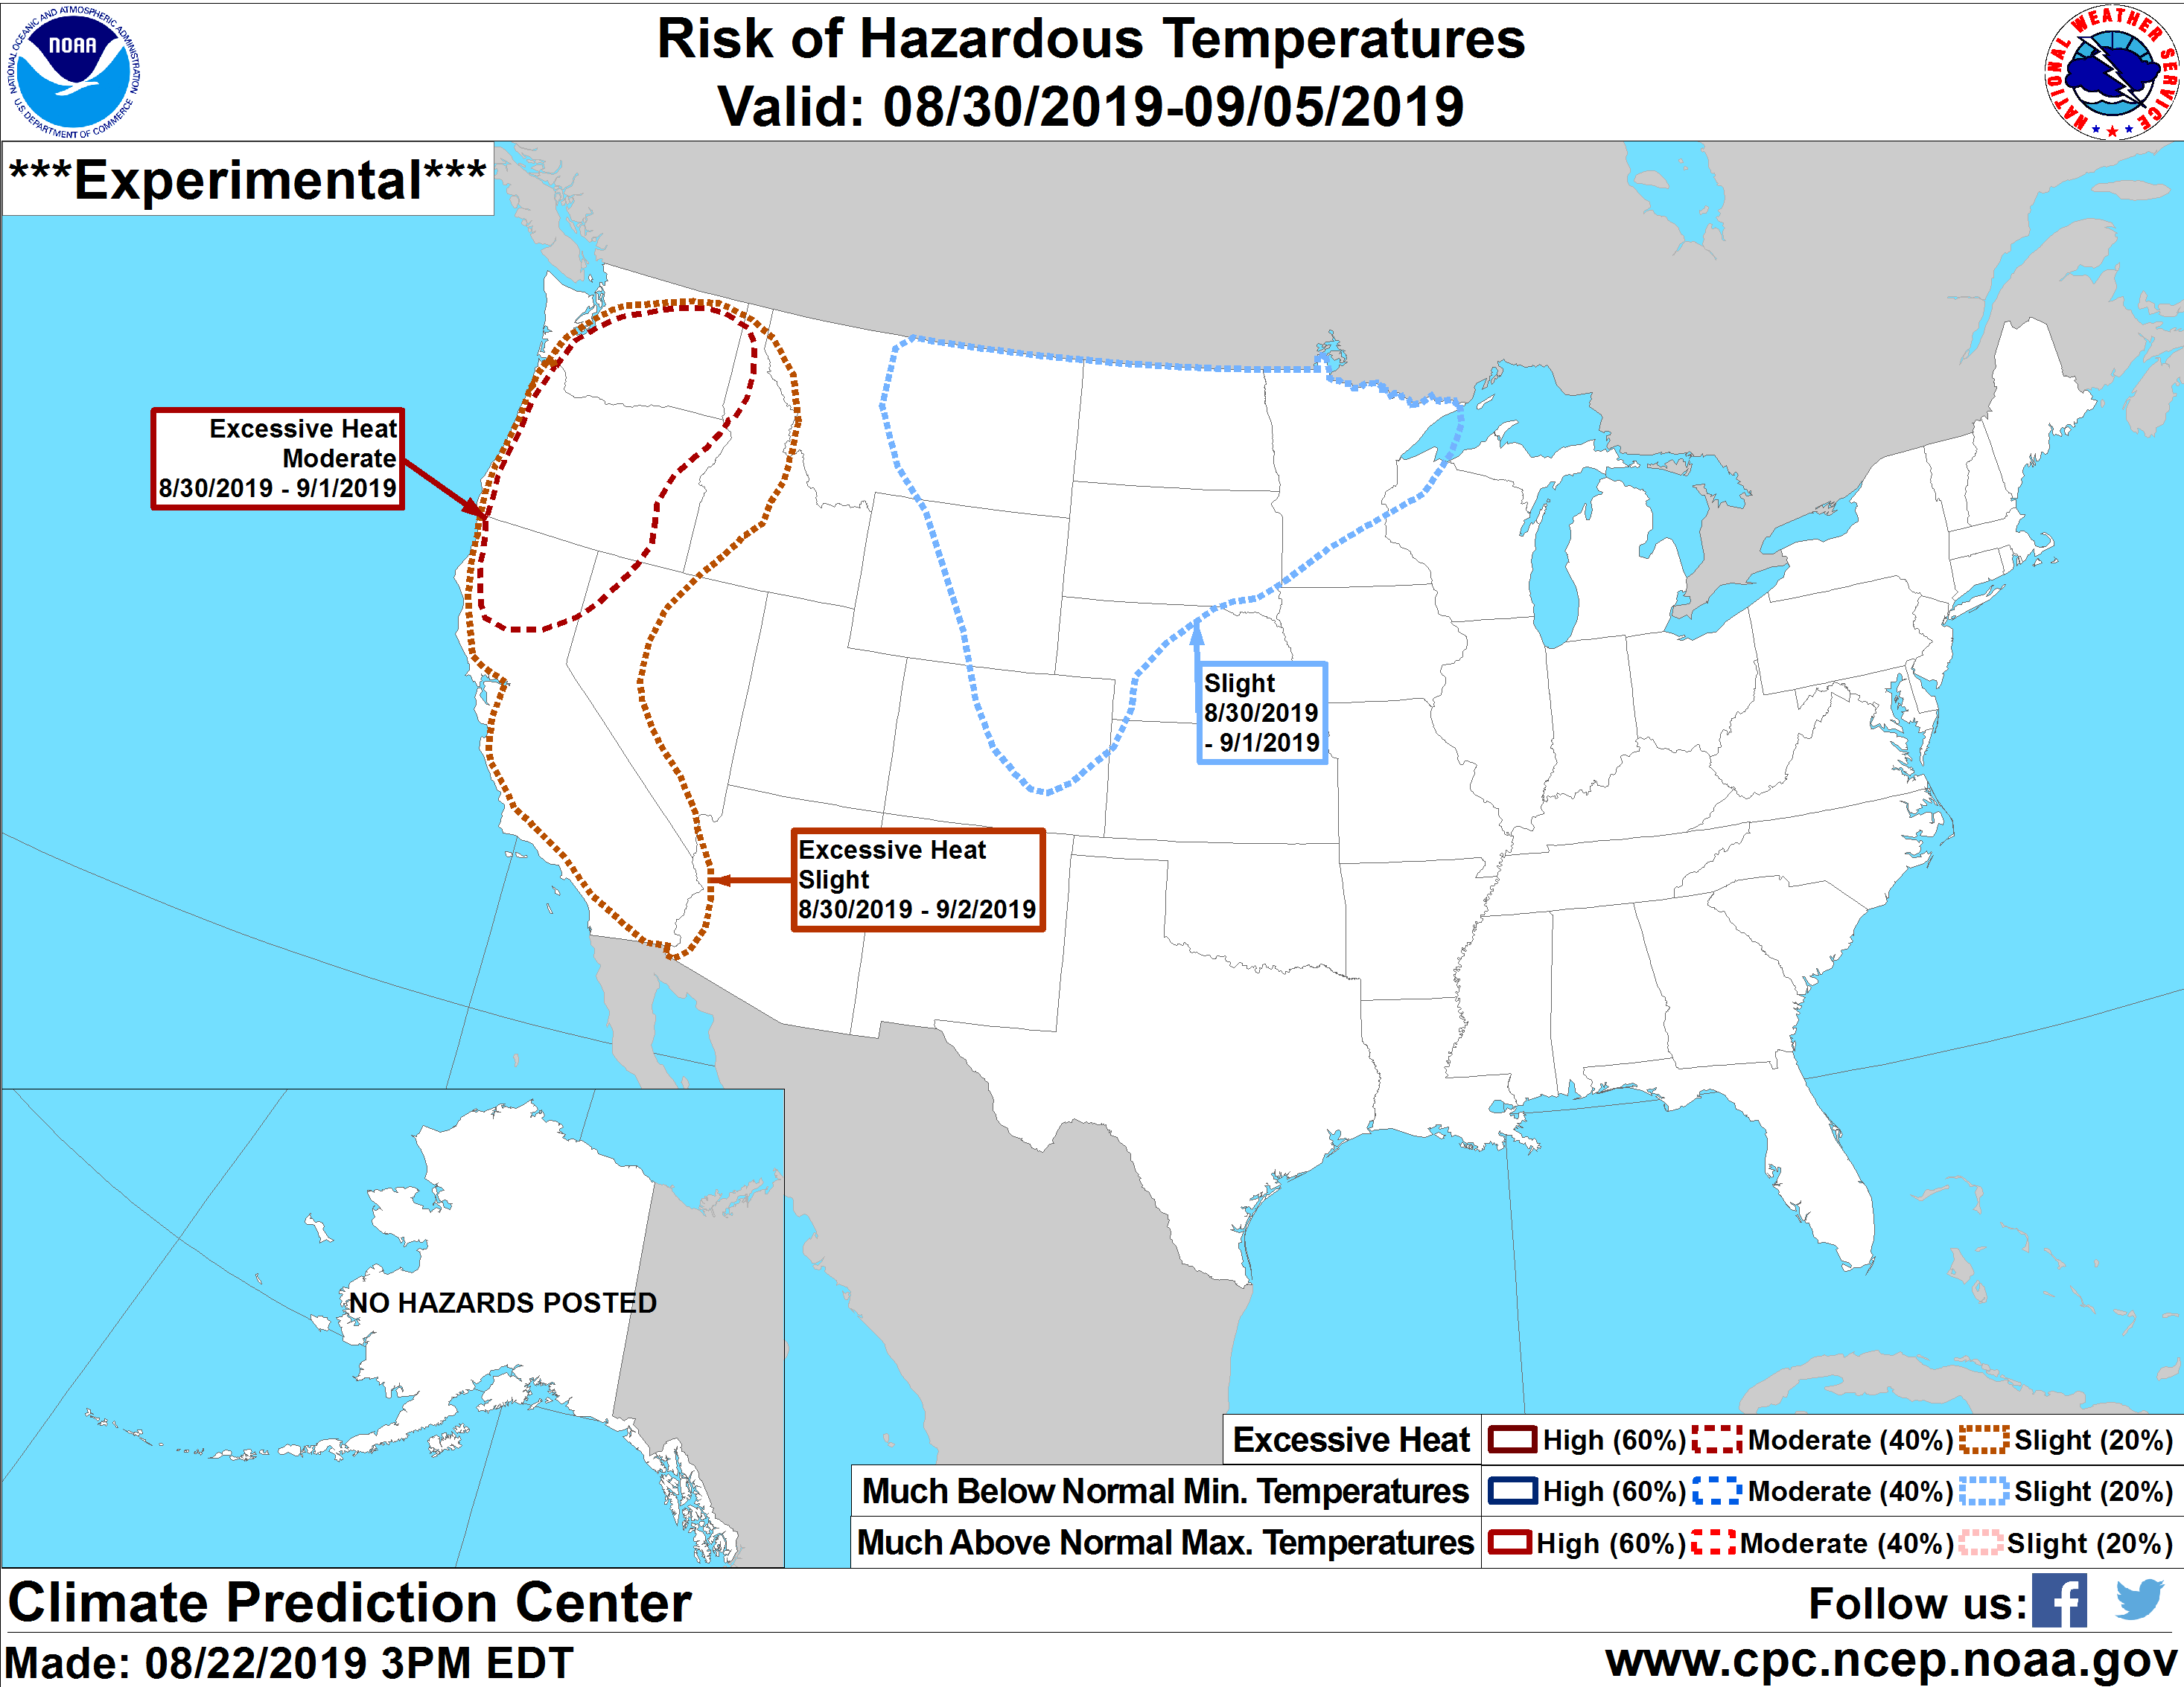

Slide 28
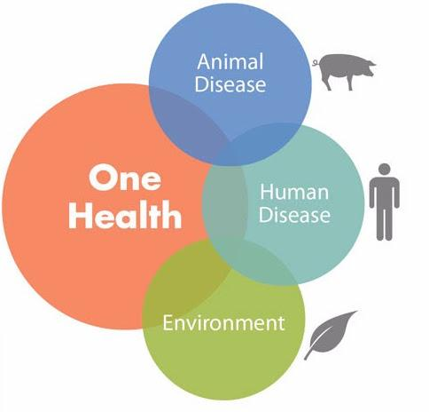
NOAA’s One Health Approach
Need for One Health:
Growing population
Changing climate
Predicting and planning increasing disease and extreme weather threats
Goals:
Interdisciplinary approaches,
programs, research
Information sharing
Better disease prevention
Human health is intimately tied to environmental conditions, and NOAA provides key stakeholders in the public health sector with the environmental intelligence from NOAA they need to mitigate emerging health threats.
Extreme Conditions
Heat, Drought,
Severe Weather
The Arctic
Dramatic climate-driven changes to regional ecosystems impact local human health
Vector-Borne Disease
Climate impacts on ranges and transmission
Extreme Conditions
Heat, Drought,
Severe Weather
Air Quality
Aero-allergens, pollution
Weather patterns and atmospheric drivers
Vector-Borne Disease
Climate impacts on ranges and transmission
Air Quality
Aero-allergens, pollution
Weather patterns and atmospheric drivers
Benefits from the Sea
Marine products and nutrition
Water-Borne Disease
Harmful algal bloom and Vibrio forecasts; Water Quality
Marine Mammal Disease
Marine Mammal Health M.A.P.
Unusual Mortality Events

