Slide 1


SOUTH ASIA HEAT HEALTH SUMMIT
Pune, India
14 February 2020
Local Interventions in South Asia
Impact of heat stress on Livelihoods, productivity and Health
Rohit Magotra
Deputy Director, IRADe

Slide 2




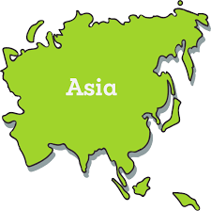


About IRADe
Independent advanced research institute, conducts research and policy analysis to engage stakeholders; government, non-governmental organizations, corporations, academic and financial institutions.
One of the Top Reputed Think Tank in South Asia working in area of Climate Change, Energy and Sustainable Urban Development
Thematic Areas
Sustainable Urban Development (SUD)
Climate Change and Environment (CCE)
IRADe has completed 16 years
Since inception provided decision support to 11 Ministries in India & concluded 110 plus projects
Centre of Excellence – Ministry of Housing & Urban Affairs (Since 2008)
Energy and Power System (EPS)
Agriculture and Food Security (AFS)
Asia Centre for Sustainable Development
Poverty Alleviation and Gender (PAG)

Slide 3
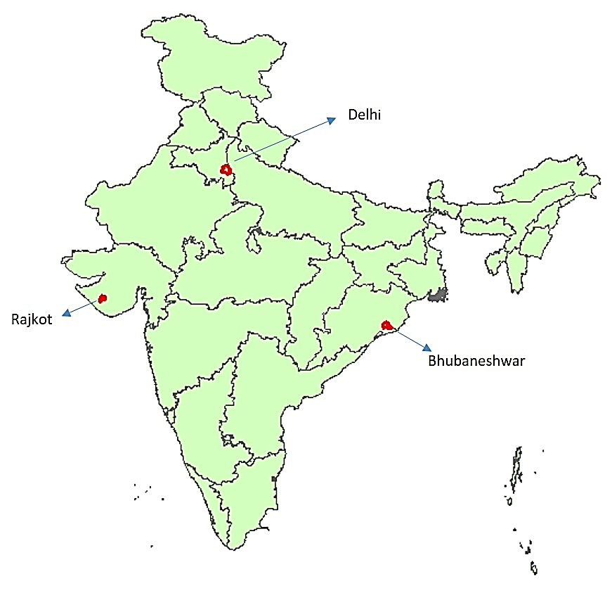

Climate Adaptive Action Plans to Manage Heat Stress
Improve management of heat stress risks in India by developing spatially differentiated (ward wise) gender sensitive Heat Stress Action Plans (HSAPs).
Objectives
Identify spatial vulnerability of populations during extreme heat events
Select appropriate, innovative and affordable climate adaptation measures for improving health and livelihood resilience, with consideration of the associated cost effectiveness as well as gender-based implications
Identify impacts of extreme heat events on health, work productivity and livelihoods of vulnerable population
Project cities

Slide 4
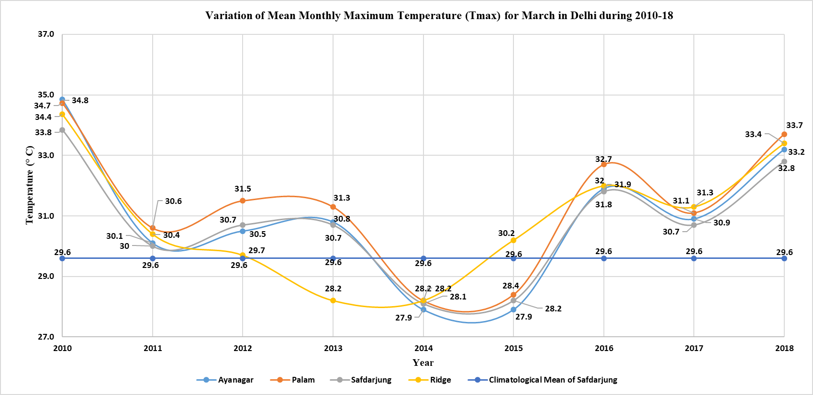
March is getting hotter than rest of summer months in Delhi, in terms of Tmax as well as Tmin

Slide 5
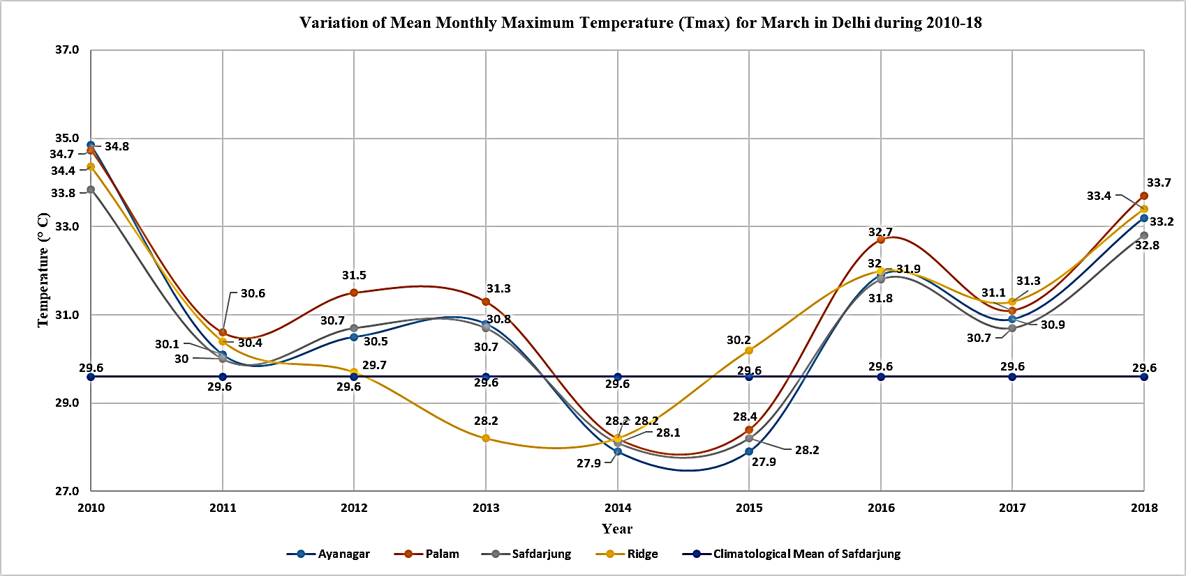
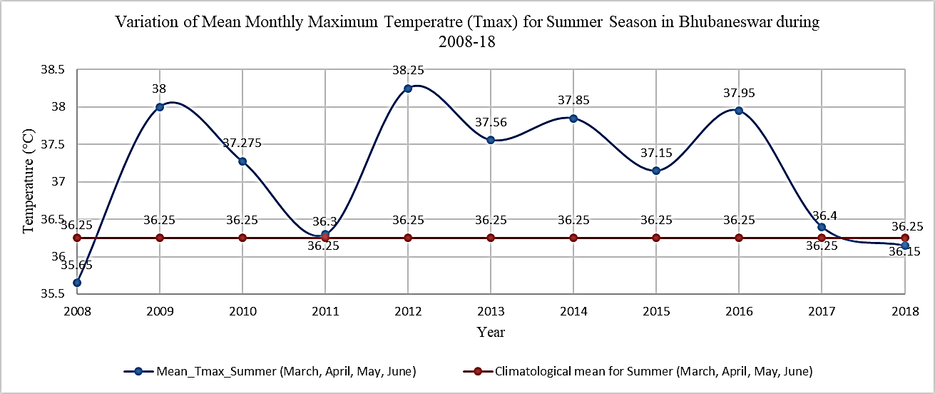
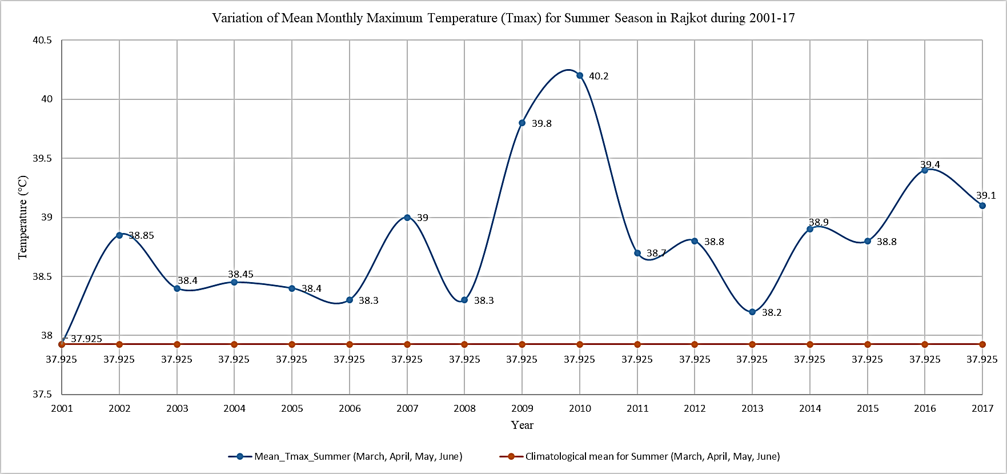
Climatological Variance – Mean Maximum Temperature
Delhi | Bhubaneshwar | Rajkot
March getting heated at relatively faster rate than rest of the summer months. March (1.2 °C) | March records relatively higher temperature than other summer months March (1.42°C) | April records relatively higher temperature than other summer months April (1.2°C)
Relative Humidity RH- NA | Highest deviation in RH - March & June | Highest deviation in RH - June

Slide 6

Analysis of climatological variation in Delhi (2010-2018)
Mean monthly values of parameters for March, April, May and June plotted against long-term climatological mean, to see deviation
Tmax | Tmin
March (1.2 °C) | March (0.9 °C)
April (0.5 °C | April (0.43 °C)
May (0.5 °C)
June (0.1 °C)
March getting heated at relatively faster rate than rest of the summer months. Summer to arrive early and early incidence of heat waves expected | March & April relatively getting more hot than other summer months

Slide 7
Heat Stress Days in Delhi
Highest heat wave days have been recorded in 2012 and 2019
The number of heat wave days have increased from 49 days (2018) to 66 days (2019) in 3 months (April, May, June) – increased by 35%

Slide 8
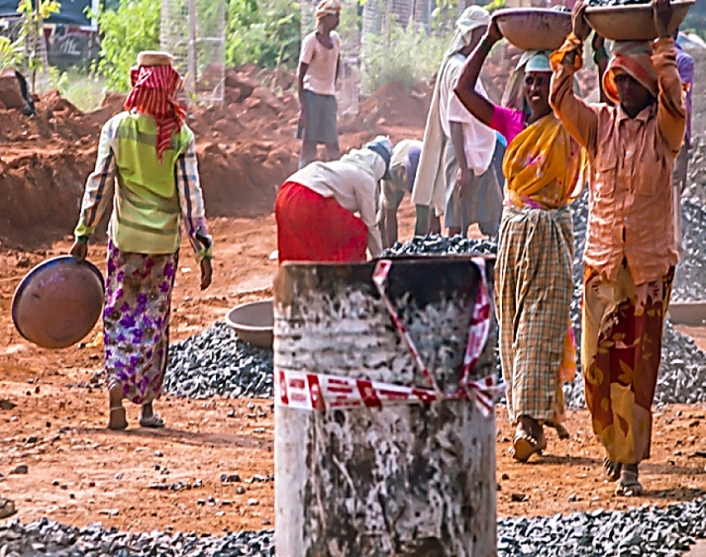
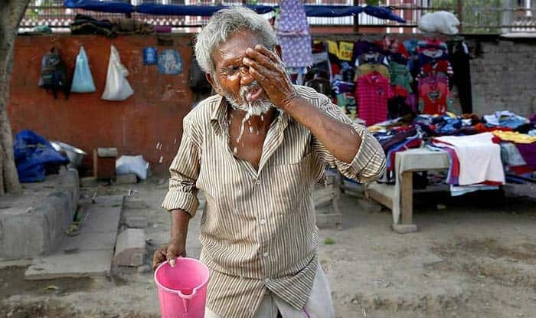
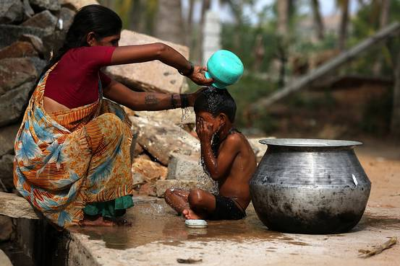
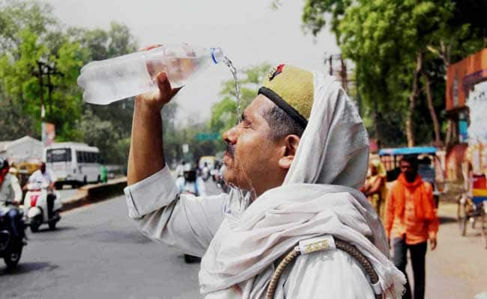
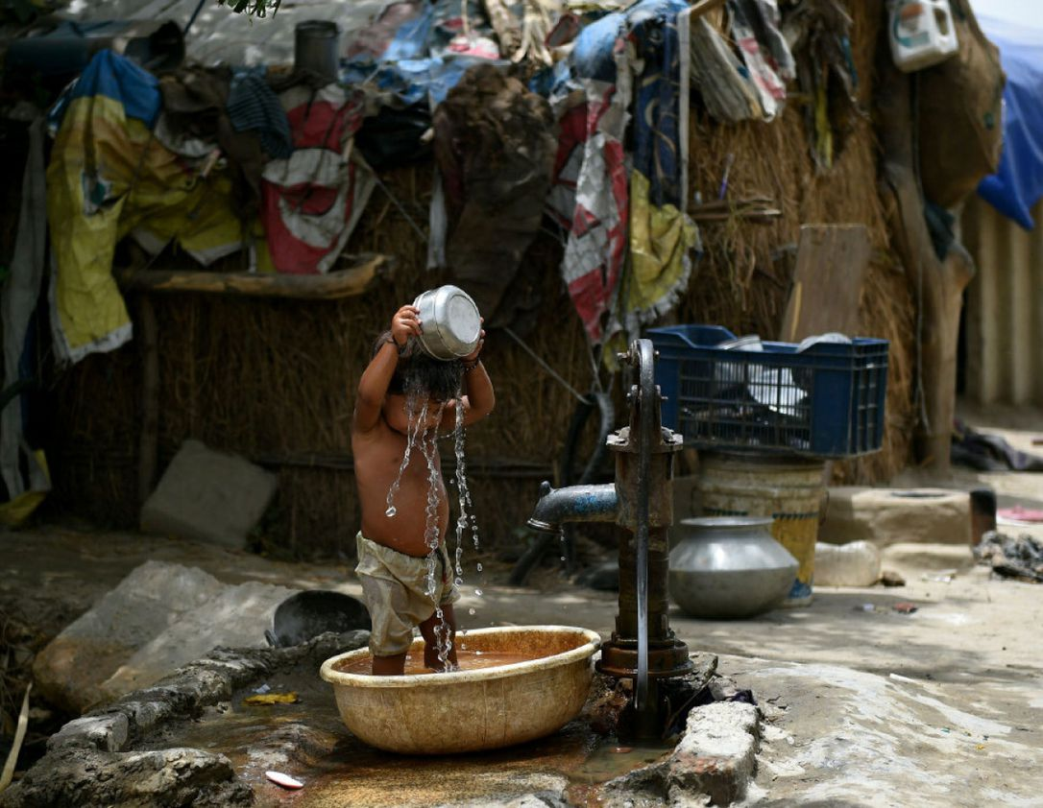
Vulnerability Mapping
Assessing geographic variability in heat wave vulnerability forms the basis for planning appropriate targeted adaptation strategies
Vulnerable areas include:
Less urbanized, slums and scattered settlements,
Minimal access to water and sanitation, and
Minimal presence of household amenities
Vulnerable groups include:
Economically weaker sections
Elderly, Children, Women
Working individuals – construction workers, factory workers, transportation, sweepers, laborers and vendors/street hawkers

Slide 9
Mapping Thermal Hotspots
Thermal hotspot maps for Delhi, Bhubaneshwar and Rajkot developed by IRADe
The surface temperature imageries city are taken by LANDSAT 8 and superimposed on the ward-boundaries map of the city to develop the city hot spot area.
Wards with temperature above 40 degree Celsius were delineated across the cities

Slide 10
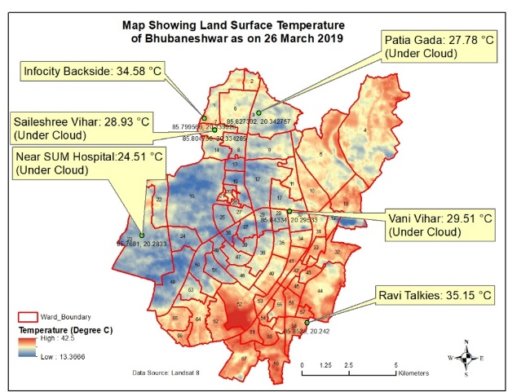
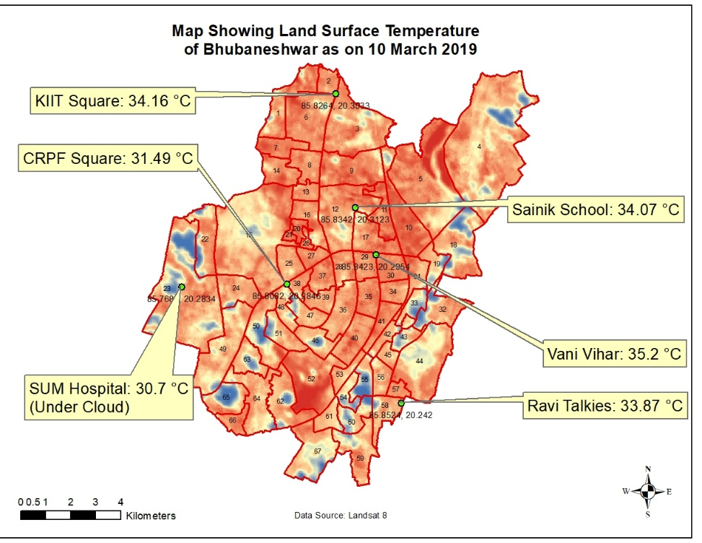
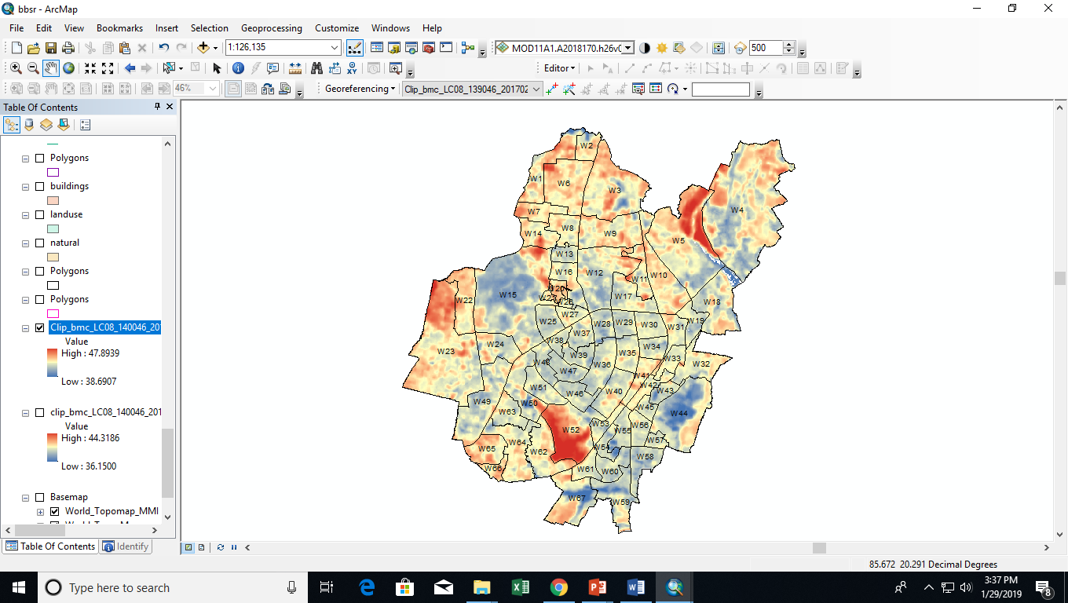
Spatial Variation of Temperature
Thermal Hotspots Maps - Bhubaneshwar
Bhubaneshwar

Slide 11
Thermal Hotspots
Rajkot Surveyed Hotspots | Ward Number
Rajyadhar | 1
Bhimrav Nagar, Pradyuman Park, Sadhu Vasvani Road | 5
Jay Bhimnagar | 10
Bharatnagar, | 11
Bajrang Society Rashulpura | 12
Ambedkar Nagar | 13
liludiwonkdi | 14
Bharatnagar 1 | 15
Shitaldhara | 18
Delhi Surveyed Hotspots | New Ward Name/ No.
Indira kalyan Vihar | Harkesh Nagar 092S
Sanjay colony Okhla phase 2 | Harkesh Nagar 092S
Slum in Khayala | Khyala 008S
Prem bari Bridge | Wazir Pur 072N
Slum near Samalkha | Bijwasan 048S
New Sanjay Amar colony, Vishwas nagar | Vishwas Nagar 017E
Mayapuri slum along Rewari railway line | Harinagar A 010S
Jahangirpuri | Jahangir Puri 021N
Shakoor ki Dandi | Delhi Gate 088N
Buland masjid slums | Shastri Park 025E
Bhubaneshwar Surveyed Hotspots | Ward Number
Neheru palei, Infocity backside | 1
Sriram Nagar slum | 5
Jagannath Ambatota slum | 6
Sailashree vihar, Mahavir vasti | 7
Munda sahi, Rangamatia upara sahi | 9
Doordarshan kendra | 12
Ekamra villa | 15
Ghatikia village | 23
Mangala slum | 20
Subash nagar slum | 65
:
Rajkot – 9 hotspots
Delhi – 10 Hotspots
Bhubaneshwar -10 Hotspots

Slide 12
Survey Methodology
Primary Surveys
Covered nearly 300 households (HHs) in each project city
Nature of work, working hours, occupational pattern, mode of transportation, coping capacity to heat stress Like
Fortnight Surveys
Covered the same HHs after fortnights
Impact of the heat stress experienced by the household

Slide 13
Household Sampling
Stratified Random Sampling Technique
Delhi
Bhubaneswar
Rajkot
Primary - 392
Fortnight 1 - 392
Fortnight 2 - 354
Primary - 290
Fortnight 1 - 290
Fortnight 2 - 281
Primary - 286
Fortnight 1 - 283
Fortnight 2 - 202

Slide 14
Infrastructure & Basic Services

Slide 15
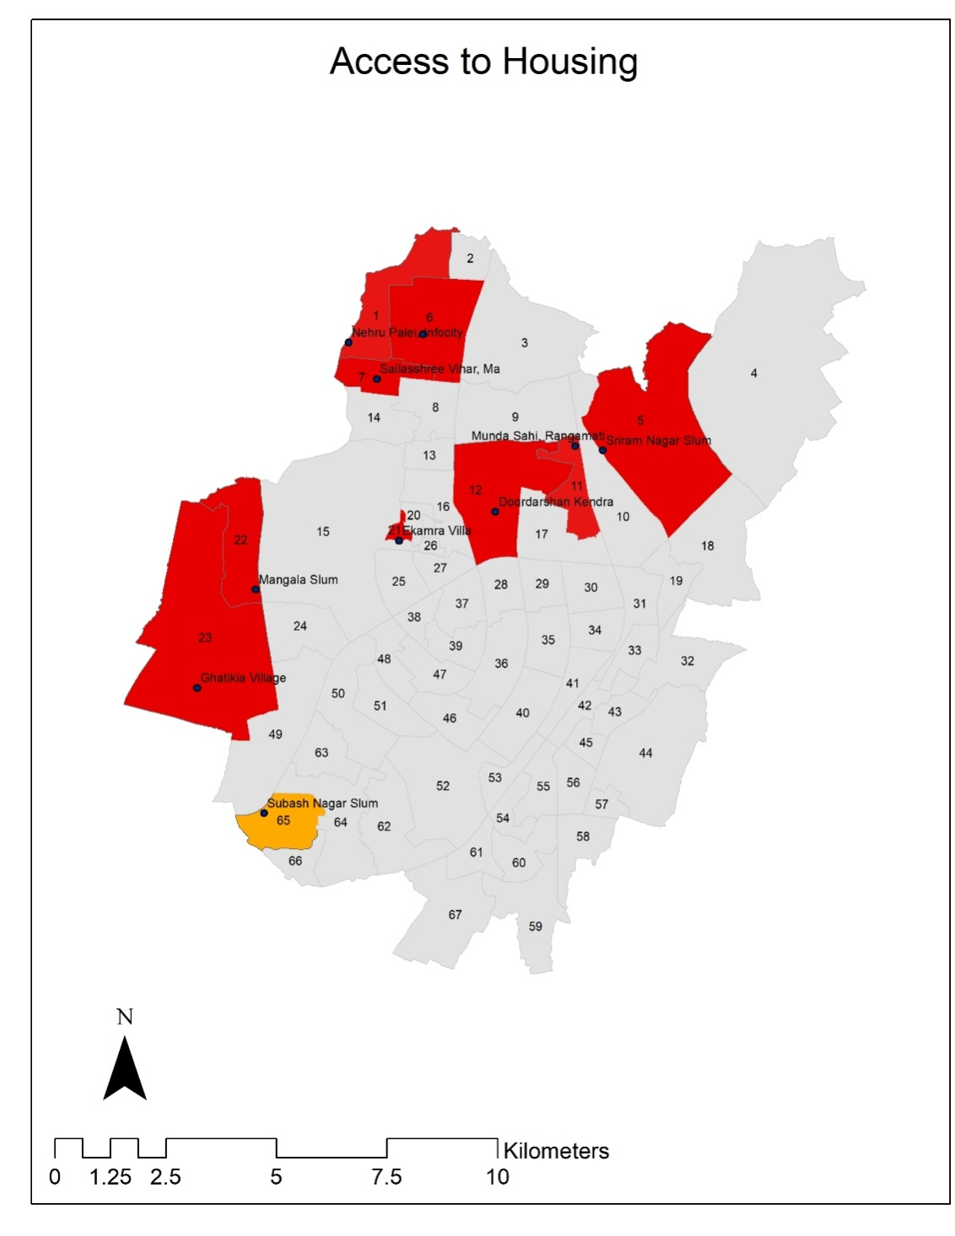
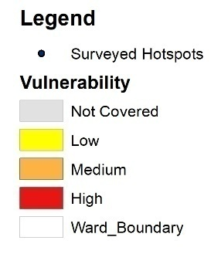
Access/Nature of Housing - Bhubaneswar
Sector | Parameters
Access to Housing | Years of Occupancy
 | Number of Rooms
 | Type of House
 | Floor Type
 | Roof Type
 | Wall Type
 | Wall Colour
The most Vulnerable wards | Wards Number (Out of 10 Thermal Hotspots) | Total
Low | Nil | Nil
Medium | (65) | 1
High | ( 1 , 5, 6 , 7 , 9 , 12 , 15 , 23 , 20 ) | 9

Slide 16
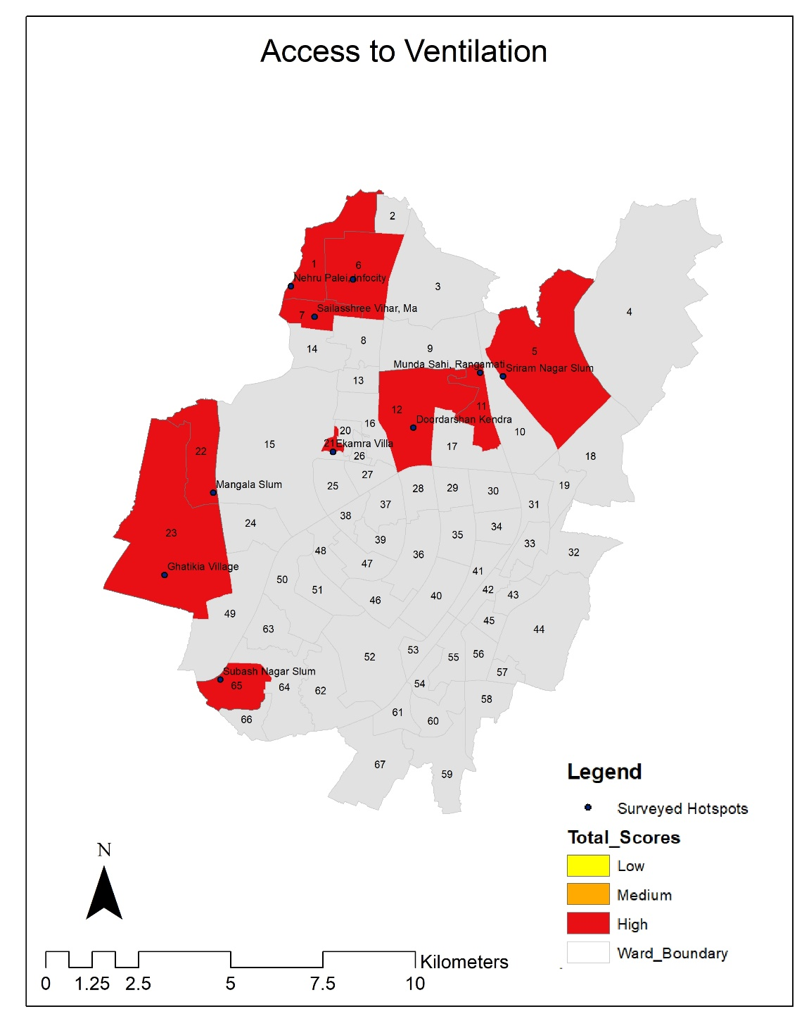
Access to Ventilation - Bhubaneswar
Sector | Parameters
Access to Ventilation | Number of Windows
The most Vulnerable wards | Wards Number (Out of 10 Thermal Hotspots) | Total
Low | Nil | Nil
Medium | Nil | Nil
High | ( 1 , 5, 6 , 7 , 9 , 12 , 15 , 20 , 23 , 65 ) | 10

Slide 17
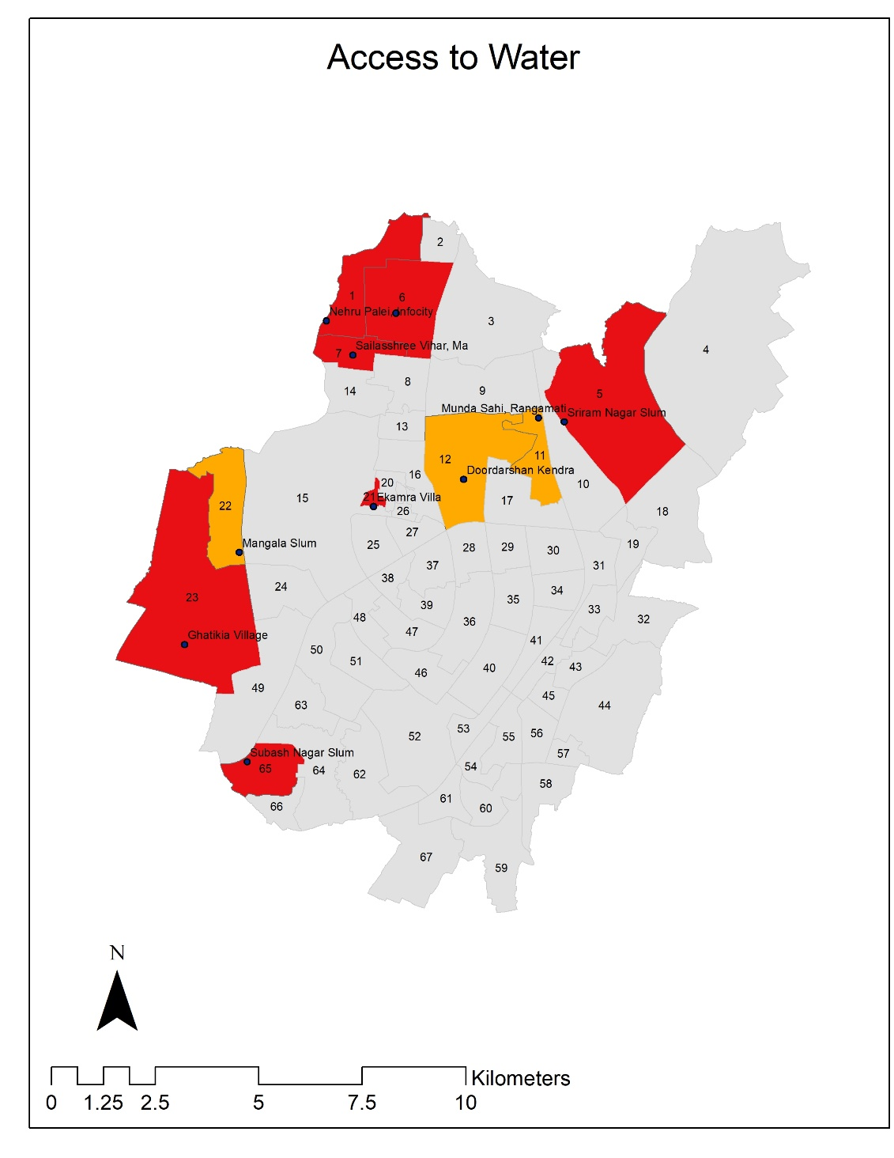
Access to Water - Bhubaneswar
Sector | Parameters
Access to Water | Water Source
 | Water Source Location
 | Water Collection Time
 | Frequency of Water Supply
The most Vulnerable wards | Wards Number (Out of 10 Thermal Hotspots) | Total
Low | Nil | Nil
Medium | ( 9 , 12 , 20 ) | 3
High | ( 1 , 5, 6 , 7 , 15 , 23 , 65 ) | 7

Slide 18

Access to Electricity - Bhubaneswar
Sector | Parameters
Electricity | Electricity Cut-off
The most Vulnerable wards | Wards Number (Out of 10 Thermal Hotspots) | Total
Low | Nil | Nil
Medium | Nil | Nil
High | ( 1 , 5, 6 , 7 , 9 , 12 , 15 , 23 , 20 , 65 ) | 10

Slide 19
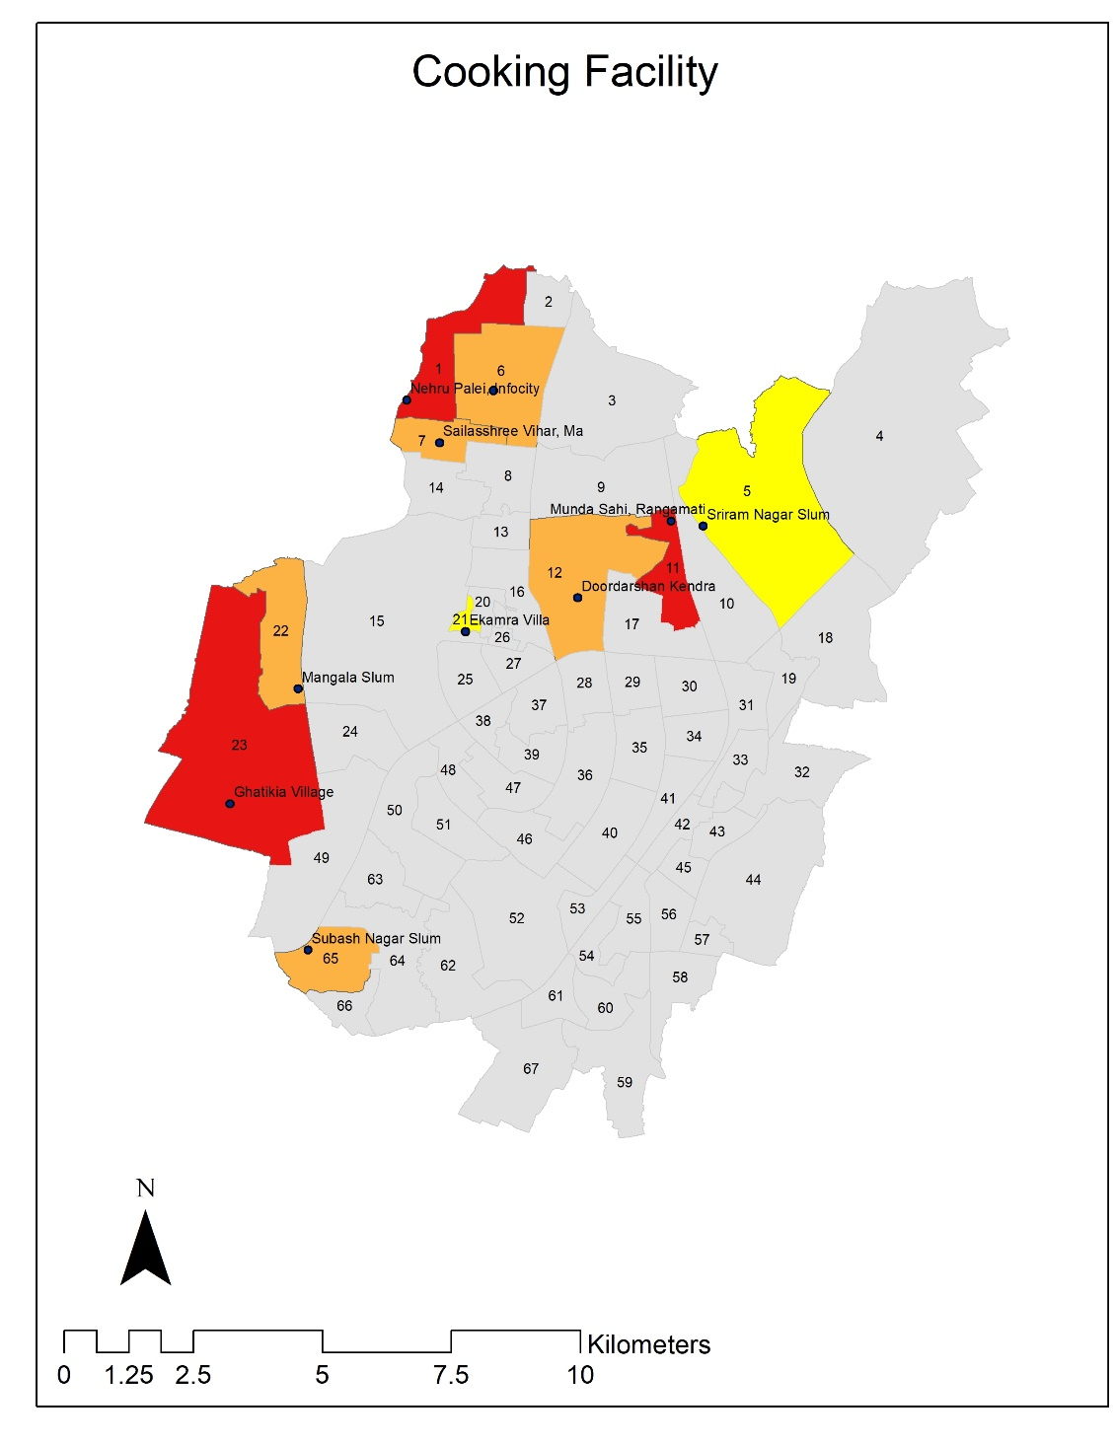
Cooking Facility - Bhubaneswar
Sector | Parameters
Cooking Facility | Cooking Place
 | Cooking Fuel
The most Vulnerable wards | Wards Number (Out of 10 Thermal Hotspots) | Total
Low | ( 5 , 15 ) | 2
Medium | ( 6 , 7, 12 , 20 , 25 ) | 5
High | ( 1 , 9 , 23 ) | 3

Slide 20
Impact of Heat Stress on Livelihood

Slide 21
Wage Loss
Wage Loss
Delhi | Bhubaneswar | Rajkot
42% - INR 1- 999 | 34% - INR 2000 - 2999 | 4% - INR 3000 above 4% - INR 1-900
Wage Losses;
Delhi (36%)> Rajkot (35%) > Bhubaneswar(28%)
Average monthly wage loss ; INR 600

Slide 22
Wage Loss
Wage Loss Gender wise
Total ( majority Males) | Delhi | Bhubaneswar |  | Rajkot
 | 90 % reported | 76% reported |  | 77% reported
Average Loss
Female | INR 20 | INR 600 | INR 200
Male | INR 125 | INR 700 | INR 2000

Slide 23
Wage Loss
Wage Loss Occupation wise
Casual Labourers Reported maximum wage loss | Delhi | Bhubaneswar | Rajkot
 | 32 % | 23 % | 33%

Slide 24
Productivity Loss
Productivity Loss
 | Delhi | Bhubaneswar | Rajkot
Total Productivity loss | 36% | 28% | 35%
No of days | 25% - 1- 5 days | 20% - 1-5 days 20% - 10-15 days | 16% - 1-5 days

Slide 25
Productivity Loss Gender wise
Productivity Loss Gender wise
 | Delhi | Bhubaneswar | Rajkot
Productivity loss reported by Males | 90% | 76% | 77%
No of days | Male- 1 hr Female- 3 hr | Female & Males- 1 day | Female- 12 hr Males- 1 day

Slide 26
Productivity Loss Occupation wise
Productivity losses Occupation wise
Casual Labourers (Majority productivity losses observed in casual labourers 30%) | Delhi | Bhubaneswar | Rajkot
 | 32 % | 23 % | 33%

Slide 27
Stages of Heat Related Illness
Heat Rash;
skin irritation caused by excessive sweating during hot, humid weather.
Heat Cramp;
painful muscle cramps occurs due to low salt level in muscles.
Heat Exhaustion;
body’s response to excessive water and salt loss through excessive sweating due to heavy physical exertion in hot environment
Heat Syncope;
fainting episode occurs in heat, either during prolonged standing or exercise, or when rapidly standing from a lying or sitting position
Heat Stroke;
Most severe form of heat related illness which can sometimes lead to death or permanent disability if not treated at proper time

Slide 28
Heat Stress Symptoms
Heat Stress Symptoms
 | Delhi | Bhubaneswar | Rajkot
Heat Exhaustion | 41% | 14% | 26%
Heat Stroke | 16% | 1% | 2%

Slide 29
Heat Stress Symptoms
Gender
Heat Stress Symptoms in Females
 | Delhi | Bhubaneswar | Rajkot
Females | 42% | 14% | 25%
Heat stroke | 16 % | 1% | 2%

Slide 30
Heat Stress Symptoms
Occupation Type
Heat Stress Symptoms occupation wise
 | Delhi | Bhubaneswar | Rajkot
Heat Exhaustion
Indoor workers | 45% | 8% | 10%
Outdoor workers | 8% | 7% | 22%
Heat Stroke
Indoor workers | 69% | 3% | 3%
Outdoor workers | 15% | 2% | 8%

Slide 31
Heat Stress Symptoms
Age
Heat Stress Symptoms age wise
 | Delhi | Bhubaneswar | Rajkot
Heat Exhaustion
Working class | 51% | 18% | 31%
Senior Citizens | 46% | 23% | 31%
Heat Stroke
Working class | 84% | 5% | 11%
Senior Citizens | 46% | 23% | 31%

Slide 32
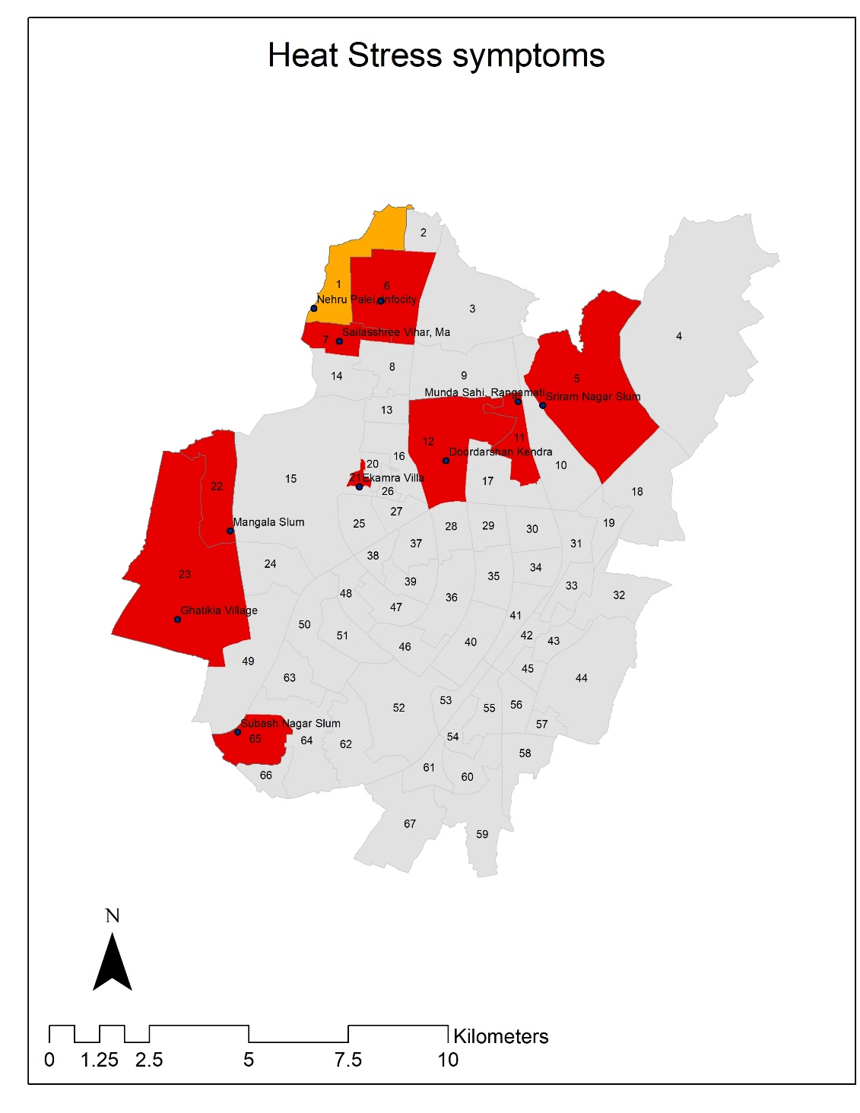
Heat Stress Symptoms - Bhubaneswar
Sector | Parameters
Heat Stress Symptoms | Heat Exhaustion
The most Vulnerable wards | Wards Number (Out of 10 Thermal Hotspots) | Total
Low | Nil | Nil
Medium | ( 1 ) | 1
High | ( 5, 6 , 7 , 9 , 12 , 15 , 23 , 20 , 65 ) | 9

Slide 33


Thank You
For more details contact Mr. Rohit Magotra, r.magotra@irade.org

