Slide 1
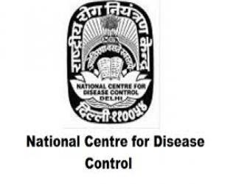
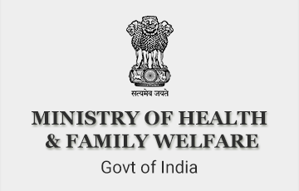
Heat and Human Health
Dr Akshay Kumar
Assistant Director
National Programme on Climate Change and Human Health
National Centre for Disease Control
Ministry of Health and Family Welfare
February 14, 2020

Slide 2
Heat
Year 2015-2018 four warmest years on record globally
In India, 11 out of 15 warmest years were during recent fifteen years (2005-2019)
Five-six heat wave events every year-northern parts (March-June/July)
Notes:
The World Meteorological Organization statements on the State of the global climate in 2018 indicates that the global temperatures continue to increase; and the year 2015-2018 have been the four warmest year on the record.
Heat waves are projected to increase in frequency, intensity and duration over most of the land area in the 21st century

Slide 3
Heat-Wave Definition
World Meteorological Organization
  Five or more consecutive days during which the daily maximum temperature exceeds the average maximum temperature by five degrees Celsius
India Meteorological Department
  Heat wave is considered if maximum temperature of a station reaches at least 40°C or more for plains, 37°C or more for coastal stations and at least 30°C or more for hilly regions

Slide 4
Heat-Wave Criteria
Based on Departure from Normal
  Heat Wave: Departure from normal is 4.5°C to 6.4°C
  Severe Heat Wave: Departure from normal is >6.4°C
Based on Actual Maximum Temperature (for plains only)
  Heat Wave: When actual maximum temperature ≥ 45°C
  Severe Heat Wave: When actual maximum temperature ≥47°C
To declare a heat wave, the above criteria should be met at least at two stations in a Meteorological sub-division for at least two consecutive days.

Slide 5
Heat-Wave Alerts
IMD issues forecast and warnings for all weather related hazards every day (short to medium range)
Exclusively heat-related warning since 2017

Slide 6
Heat Wave Warning
Warning | Impact | Suggested Actions
Nil | Comfortable temperatures | No cautionary action required
Heat wave conditions at district level, likely to persist for 2 days | Moderate temperature. Heat is tolerable for general public but moderate health concern for vulnerable people e.g., infants, elderly, people with chronic diseases | Avoid heat exposure
Severe heat wave conditions likely to persist for 2 days With varied severity, heat wave is likely to persist for 4 days or more | High temperature. Increased likelihood of heat illness symptoms in people who are either exposed to sun for a prolonged period or doing heavy work. High health concern for vulnerable people e.g., infants, elderly, people with chronic diseases | Avoid heat exposure- keep cool. Avoid dehydration
Severe heat wave likely to persist for more than 2 days Total number of heat severe heat wave days likely to exceed 6 days | Very high likelihood of developing heat illness and stroke in all ages. | Extreme care needed for vulnerable people

Slide 7
Heat Season (March-July)
Issue advisories as per alerts
Warning | Impact Suggested Actions
Nil | Normal activity
Heat wave conditions at district level, likely to persist for 2 days | a. Avoid heat exposure b. Wear lightweight, light-coloured, loose cotton clothes c. Cover your head
Severe heat wave conditions likely to persist for 2 days With varied severity, heat wave is likely to persist for 4 days or more | a. Avoid heat exposure- keep cool, avoid dehydration b. Wear lightweight, light-coloured, loose cotton clothes c. Cover your head d. Drink sufficient water-even if no thirsty e. Use ORS, homemade drinks like lassi, torani (rice water), lemon water, buttermilk, etc f. Avoid alcohol, tea, coffee and carbonated soft drinks
Severe heat wave likely to persist for more than 2 days Total number of heat severe heat wave days likely to exceed 6 days | Along with suggested action for Orange alert, extreme care needed for vulnerable people.

Slide 8
Temperature/Humidity Index by NOAA, for USA
Notes:
The National Oceanic and Atmospheric Administration (NOAA)
The level of heat discomfort is determined by a combination of meteorological (temp, RH, wind, direct sunshine), social/cultural (clothing, occupation, accommodation) and physiological
(health, fitness, age, level of acclimatization) factors. There will be no harm to the human body if the environmental temperature remains at 37° C. Whenever the environmental temperature increases above 37° C, the human body starts gaining heat from the atmosphere. If humidity is high, a person can suffer from heat stress disorders even with the temperature at 37°C or 38°C as high humidity does not permit loss of heat from human body through perspiration. To calculate the effect of humidity, Heat Index Values are used in some countries. The Heat Index is a measure of how hot it really feels when relative humidity is factored in with the actual air temperature. Heat index chart used by the National weather Service of the USA given below shows that if the air temperature is 34°C and the relative humidity is 75per cent, the heat index - how hot it feels - is 49°C. The same effect is reached at just 31°C when the relative humidity is 100per cent.
As temperature and humidity outside range of this chart are not uncommon in many parts of India, it cannot be directly used. The notion of looking at temperature and humidity in combination is good; however, in order to develop a usable matrix in the Indian context, more research needs to be done.

Slide 9
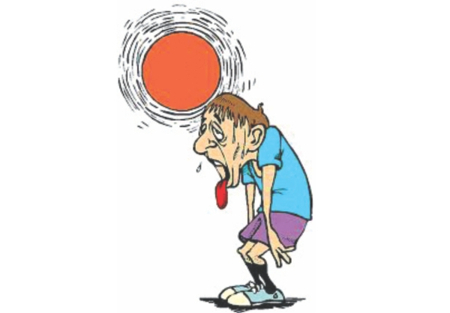
Heat-Health
Global
  250,000 excess deaths/year between 2030 and 2050 due to climate change induced malnutrition, malaria, diarrhoea and heat stress combined
  70,000 excess deaths in Europe (2003) and 56,000 excess deaths in Russia (2010)
*Climate Change and Health. WHO. Available at https://www.who.int/news-room/fact-sheets/detail/climate-change-and-health

Slide 10
Heat-Health
India
  24,223 death from year 1992-2015*
Year | Heat Related Illness Death**
2015 | 2040
2016 | 1111
2017 | 384
2018 | 25
2019 | 215
*National Guidelines for preparation of action plan-prevention and management of heat wave. National Disaster Management Authority. 2019
** Integrated Disease Surveillance Programme. National Centre for Disease Control

Slide 11
Heat-Related Illnesses
Effects of exposure to heat
  Directly heat related (Heat related illnesses)
  Contribute to worsening of respiratory and cardiovascular diseases, electrolyte disorders and kidney problems.
Types
  Minor- Heat rash, heat edema, heat tetany, heat cramps, heat syncope
  Major- Exertion associated collapse, heat exhaustion, heat stroke

Slide 12
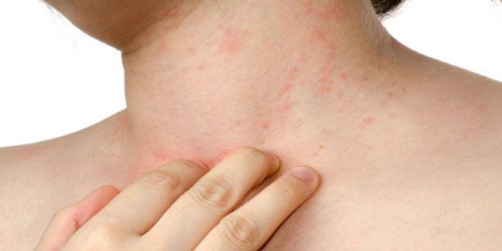
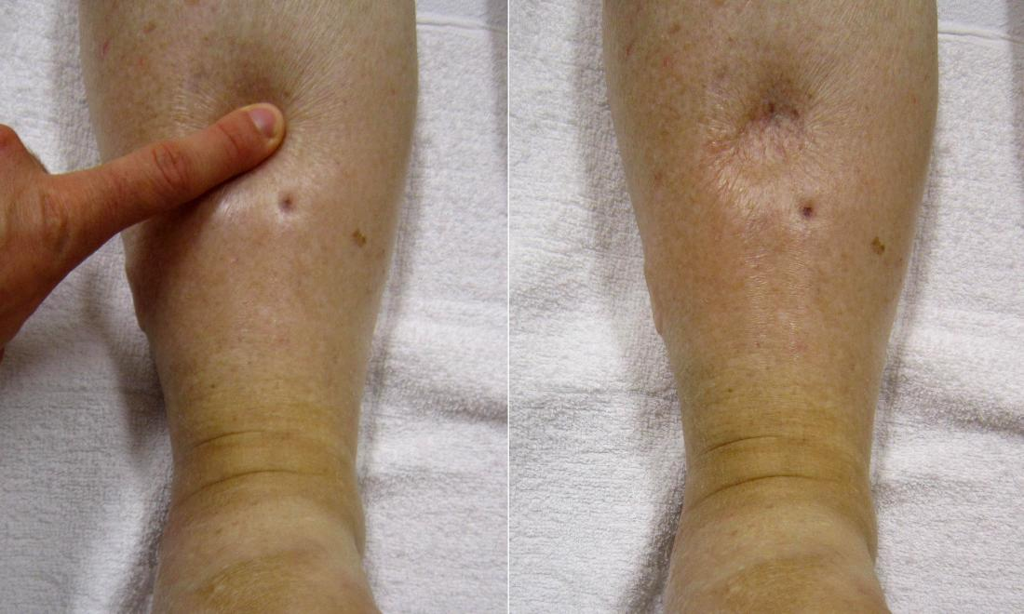
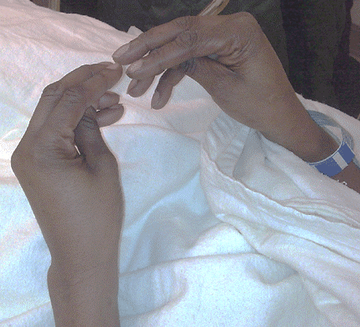
Heat Related Illnesses-Minor
Heat rash
Heat edema
Heat tetany
Diffuse, pruritic, maculopapular or vesicular rash, often with insulating clothing
Mild edema of dependent areas like hands, feet and ankles
Rare and self limiting condition, seen in patients exposed to short, intense heat conditions

Slide 13
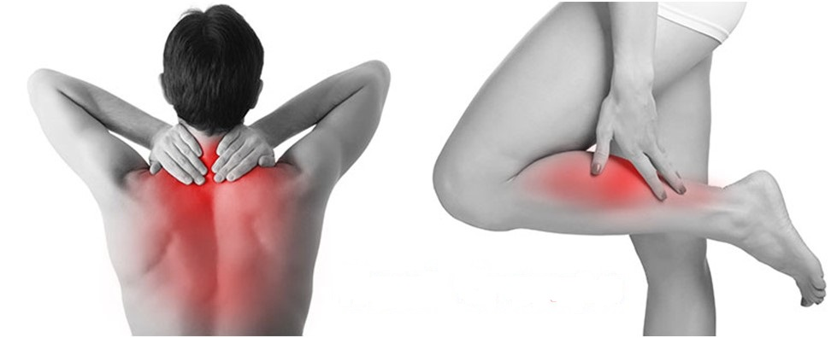

Heat Related Illnesses-Minor
Heat cramps
Heat syncope
Painful, involuntary, spasmodic contractions of skeletal muscles
Seen with prolonged standing in hot environment

Slide 14
Heat Related Illnesses - Major
Heat Exhaustion | Heat Stroke
Sweaty/diaphoretic | Dry skin
Central Nervous System function is preserved | Central Nervous System impairment
Core body temperature 37⁰ C to 40⁰ C (98.6⁰ F to 104⁰ F) | Core body temperature 40⁰ C to 44⁰ C (104⁰ F to 11.2⁰ F)
Feeling overheated, lightheadedness, exhausted and weak, unsteady, feeling of vomiting, sweaty and thirsty, inability to continue activities | Severe overheating; profound weakness; disorientation, not fully alert, convulsion, or other altered mental status

Slide 15
Agencies
National Disaster Management Authority (NDMA) take the lead role in all sector coordination
Ministry of Health and Family Welfare (MoHFW)
  Emergency Medical Relief (EMR) is the main leading agency since 2015
  National Centre for Disease Control (NCDC)
    Integrated Disease Surveillance Programme (IDSP) has an established structure upto sub-district level: surveillance since 2015
    National Programme on Climate Change and Human Health (NPCCHH) in 2019

Slide 16
Ministry of Health & Family Welfare

Slide 17
Content
Basic physiology of heat gain and loss
Etiology and Pathophysiology of Heat related illnesses
Risk factor
Clinical manifestations
Management
Prevention
Public health action plan: surveillance, heat health event investigation, pre hospital and hospital care, logistic, training, awareness

Slide 18
Integrated Disease Surveillance Programme (IDSP)
Programme under National Health Mission (NHM) with Objective of “Strengthening of Disease Surveillance System for epidemic prone diseases to detect and respond to outbreaks”.
Organization Structure
  Central Surveillance Unit (CSU)
  State Surveillance Unit (SSU)
  District Surveillance Unit (DSU)

Slide 19



Diseases Under Surveillance
Measles
Diphtheria
Pertussis
Chicken Pox
Malaria
Dengue / DHF / DSS
Chikungunya
Meningitis
AES/JE
Enteric Fever
Fever of Unknown Origin (PUO)
Acute Respiratory Infection (ARI) / Influenza Like Illness (ILI)
Snake Bite
Dog Bite
Pneumonia
Acute Diarrhoeal Disease (including Acute Gastroenteritis)
Bacillary Dysentery
Viral Hepatitis
Leptospirosis
Acute Flaccid Paralysis < 15 Years of Age
Any other State Specific Disease
Unusual Syndromes

Slide 20
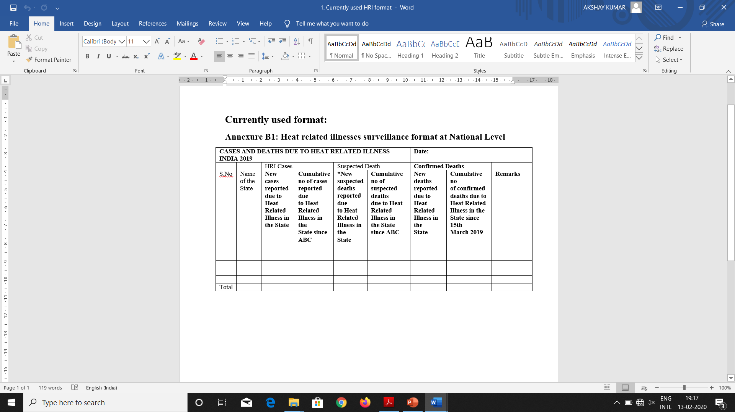
Heat Related Illnesses surveillance
Heat related illnesses
  New cases reported
  New suspected deaths
  New confirmed deaths
  Cumulative no.

Slide 21
The 23 vulnerable States/UTs
Himachal Pradesh
Uttarakhand
Uttar Pradesh
Bihar
Jharkhand
Arunachal Pradesh
Jammu & Kashmir
Punjab
Haryana
Delhi
Rajasthan
Gujarat
Maharashtra
Goa
Karnataka
Kerala
West Bengal
Madhya Pradesh
Chhattisgarh
Odisha
Andhra Pradesh
Telangana
Tamil Nadu

Slide 22
State wise distribution of cumulative number of cases and deaths due to heat related illness, India for 2015-2018
SN. | Name of the State | Cumulative no of cases reported due to Heat Related Illness |  |  |  |  |  | Cumulative no of deaths reported due to Heat
 |  | 2015 | 2016 | 2017 |  | 2018^ | 2015 |  | 2016 | 2017 | 2018
1 | Andhra Pradesh | 28500 | 21800 | 12832 | 309 |  | 1422 |  | 723 | 236 | 8
2 | Bihar | 106 | 990 | 10 | 217 |  | - |  | Nil | 0 | 2
3 | Chhattisgarh | 379 | 310 | 393 | 153 |  | - |  | 1 | 0 | 0
4 | Delhi | Nil | 8 | 269 | 253 |  | - |  | - | 0 | 0
5 | Gujarat | 58 | 447 | 463 | 775 |  | 17 |  | 7 | 0 | 3
6 | Haryana | 2 | 0 | 0 | 0 |  | Nil |  | Nil | 0 | 0
7 | Jharkhand | 177 | 1166 | 316 | 45 |  | - |  | 4 | 0 | 0
8 | Karnataka | Nil | Nil | 6 | 2 |  | - |  | Nil | 2 | 0
9 | Maharashtra | 28 | 686 | 313 | 538 |  | - |  | 7 | 9 | 2
10 | Madhya Pradesh | 826 | 2546 | 2584 | 2201 |  | - |  | Nil | 3 | 1
11 | Odisha | 2071 | 1193 | 1231 | 359 |  | 60 |  | 36 | 17 | 7
12 | Punjab | 2 | 0 | 0 | 0 |  | Nil |  | Nil | 0 | 0
13 | Rajasthan | 412 | 676 | 246 | 919 |  | - |  | 9 | 9 | 1
14 | Tamil Nadu | Nil | 117 | 110 | 19 |  | Nil |  | Nil | 0 | 0
15 | Telangana | 807## | 5107 | 20635 | 264 |  | 541 |  | 324 | 108 | 0
16 | Uttar Pradesh | 4 | 75 | 155 | 82 |  | - |  | Nil | 0 | 0
17 | West Bengal | Nil | Nil | Nil | 1 |  | - |  | Nil | 0 | 1
TOTAL |  | 33372 | 35121 | 39563 | 6137 |  | 2040 |  | 1111 | 384 | 25

Slide 23
State wise cumulative number of cases and deaths due to heat related illnesses, India for 2019
SN. | Name of the State | Cumulative no of cases reported due to Heat Related Illness | Cumulative no of deaths reported due to Heat
1 | Andhra Pradesh | 956 | 29
2 | Bihar | 1466 | 121
3 | Chhattisgarh | 366 | 0
4 | Delhi | 157 | 0
5 | Gujarat | 580 | 8
6 | Haryana | 0 | 0
7 | Jharkhand | 981 | 0
8 | Karnataka | 0 | 0
9 | Maharashtra | 568 | 6
10 | Madhya Pradesh | 4338 | 2
11 | Odisha | 1733 | 0
12 | Punjab | 0 | 0
13 | Rajasthan | 161 | 3
14 | Tamil Nadu | 208 | 1
15 | Telangana | 1094 | 42
16 | Uttar Pradesh^^ | 254 | 1
17 | Kerala | 1671 | 1
18 | Goa | 0 | 0
19 | Uttarakhand | 0 | 0
20 | Jammu & Kashmir (Jammu Division) | 2 | 0
 | Jammu & Kashmir (Kashmir Division) | 5 | awaited
21 | West Bengal | awaited | awaited
22 | Arunachal Pradesh | awaited | awaited
23 | Himachal Pradesh | 0 | 0
TOTAL |  | 14540 | 215

Slide 24
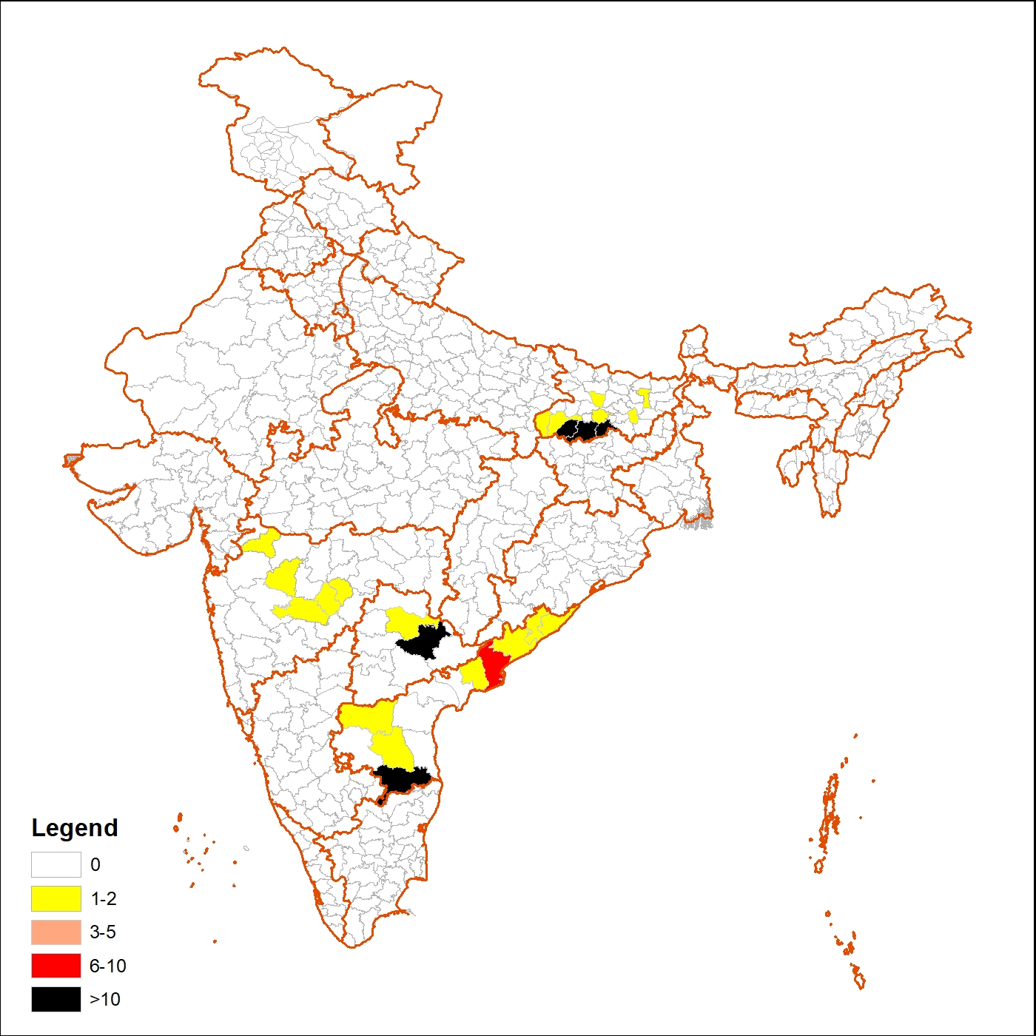
District wise distribution of Heat Related Illnesses deaths in India 2019 (N=191)*

Slide 25
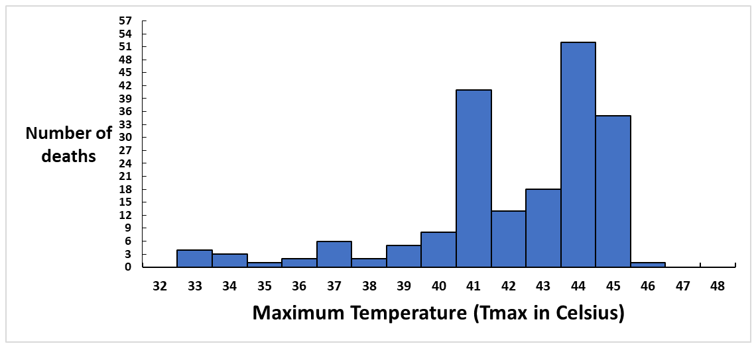
Heat related illnesses deaths and maximum temperature recorded (Tmax) on same day in respective block/mandal of four States, India 2019 (N=191)
Notes:
Maximum temperature (Tmax) for the day within which cases reported to be died due to heat related illnesses ranges from 33 ⁰C to 46 ⁰C (113 deaths). After an initial rise of deaths at 33 ⁰C (7 deaths), deaths declined at 34 ⁰C (3 deaths) and remain at lower range (2-5 deaths) till 39 ⁰C. When the Tmax reaches 40 ⁰C or above the number of deaths were increased, this may be due to the fact that most of the deaths are reported from plain areas and the heat wave is considered if maximum temperature of a station reaches at least 40 ⁰C or more in plains. At 46 ⁰C only one death was reported which may be due to the fact that estimated number of days with Tmax 46 ⁰C or above was less.

Slide 26
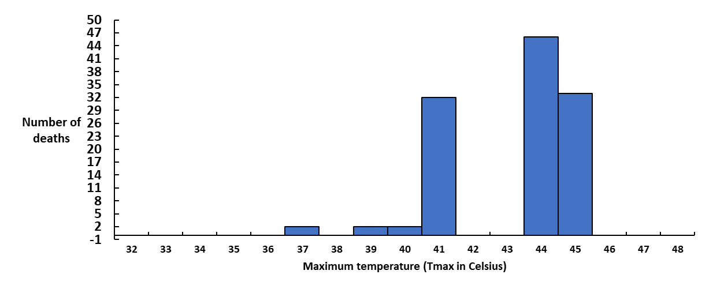
Distribution of heat related illnesses deaths according to maximum temperature recorded (Tmax) on same day in respective block/mandal of Bihar, India 2019 (N=117)
Notes:
Maximum temperature (Tmax) for the day within which cases reported to be died due to heat related illnesses in Bihar ranges from 33 ⁰C to 45 ⁰C (39 deaths). After an initial rise of deaths at 33 ⁰C (3 deaths), number of deaths declined to a total of 3 deaths between 34 ⁰C to 39 ⁰C. Number of deaths again rises at 40 ⁰C and shows a sharp rise at 41 ⁰C (13 deaths). No deaths were reported at 42 ⁰C and 43 ⁰C. Number of deaths again increases at 44 ⁰C and 45 ⁰C.

Slide 27
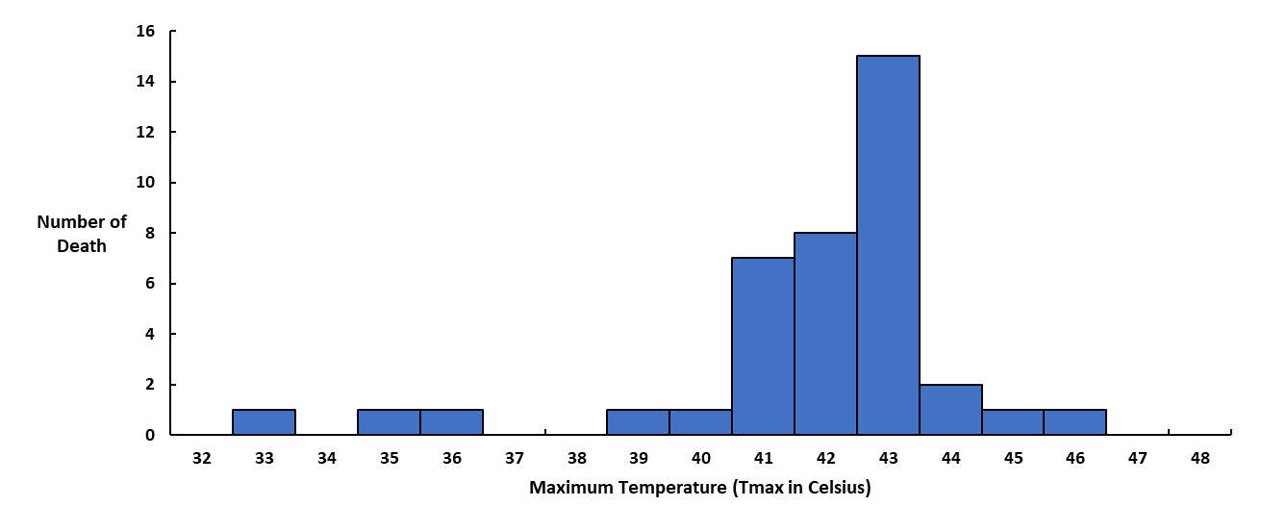
Distribution of heat related illnesses deaths according to maximum temperature recorded (Tmax) on same day in respective block/mandal of Telangana, India 2019 (N=39)
Notes:
Maximum temperature (Tmax) for the day within which cases reported to be died due to heat related illnesses in Telangana ranges from 33 ⁰C to 46 ⁰C (39 deaths). Initially, number of deaths remain zero to one between 33 ⁰C to 40 ⁰C followed by sharp rise in cases from 41 ⁰C (7 deaths) and peak at 43 ⁰C (15 deaths) and shows a sharp decline from 44 ⁰C.

Slide 28
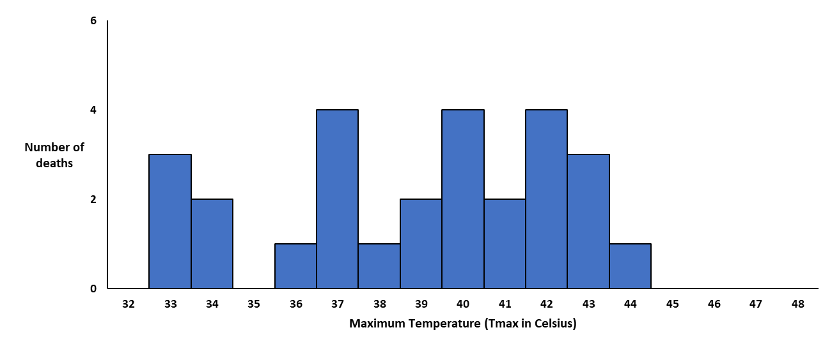
Distribution of heat related illnesses deaths according to maximum temperature recorded (Tmax) on same day in respective block/mandal of Andhra Pradesh, India 2019 (N=27)
Notes:
Maximum temperature (Tmax) for the day within which cases reported to be died due to heat related illnesses in Andhra Pradesh ranges from 33 ⁰C to 44 ⁰C (27 deaths). Deaths due to heat related illnesses start occurring at 33 ⁰C (3 deaths) followed by intermittent fall and rise in number of deaths. Maximum number of deaths were reported at 37 ⁰C, 40 ⁰C and 42 ⁰C (4 deaths each). Andhra Pradesh has reported almost equal number of deaths at <40 ⁰C (13 deaths) and at ≥40 ⁰C (14 deaths), this may be due to the fact that Andhra Pradesh has reported deaths from coastal as well as plain area and for coastal region heat wave is considered if Tmax reaches 37 ⁰C or more.

Slide 29
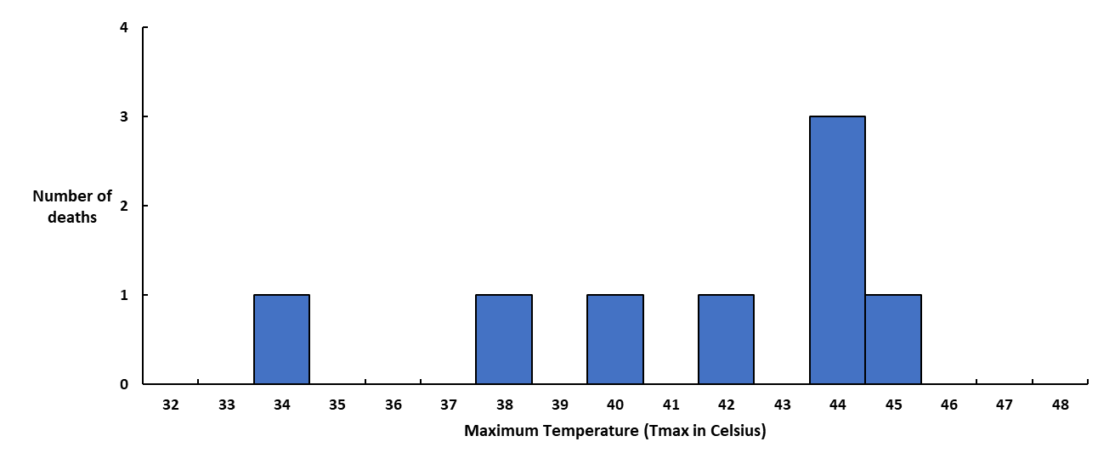
Distribution of heat related illnesses deaths according to maximum temperature recorded (Tmax) on same day in respective block/mandal of Maharashtra, India 2019 (N=8)
Notes:
Maximum temperature (Tmax) for the day within which cases reported to be died due to heat related illnesses in Maharashtra ranges from 34 ⁰C to 45 ⁰C (8 deaths). Initially, number of deaths remain zero to one between 34 ⁰C to 43 ⁰C followed by a peak at 44 ⁰C (3 deaths) and decline at 44 ⁰C (one death).

Slide 30
Heat related illnesses deaths and maximum temperature recorded (Tmax) on same day in respective block/mandal of four States, India 2019 (N=113)

Slide 31
Diseases Under Surveillance
Measles
Diphtheria
Pertussis
Chicken Pox
Malaria
Dengue / DHF / DSS
Chikungunya
Meningitis
AES/JE
Enteric Fever
Fever of Unknown Origin (PUO)
Acute Respiratory Infection (ARI) / Influenza Like Illness (ILI)
Snake Bite
Dog Bite
Pneumonia
Acute Diarrhoeal Disease (including Acute Gastroenteritis)
Bacillary Dysentery
Viral Hepatitis
Leptospirosis
Acute Flaccid Paralysis < 15 Years of Age
Any other State Specific Disease
Unusual Syndromes

Slide 32
Revised Surveillance Format-Draft
Instead of all Heat Related Illnesses (heat rash, heat cramps, heat syncope, heat exhaustion, heat stroke)
  Only Heat Stroke cases
Instead of Suspected Heat Related Illness deaths
  All cause mortality
  Suspected Heat stroke deaths
  Confirmed CVD
  Other
Notes:
NDMA guidelines and MoHFW (EMR) guidelines identified five conditions heat rash, heat cramps, heat exhaustion, heat syncope and heat stroke as heat related illnesses. We were getting report of HRI and not breakup of it.
Collecting too much information in a surveillance is a big bothering reason
It creates a lot of peak in unnecessary data. If you keep very limited condition then we are more confident about that information, we have capacity to check back on them and we have capacity to respond to them.

Slide 33
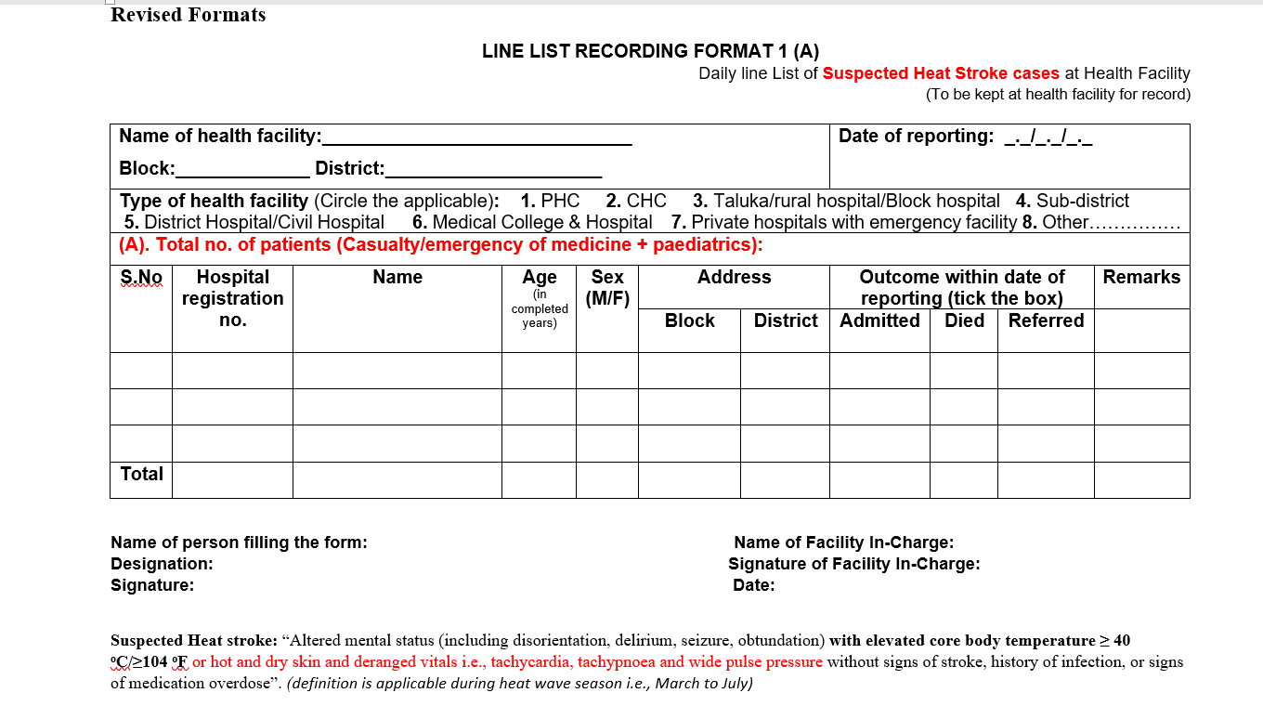

Slide 34
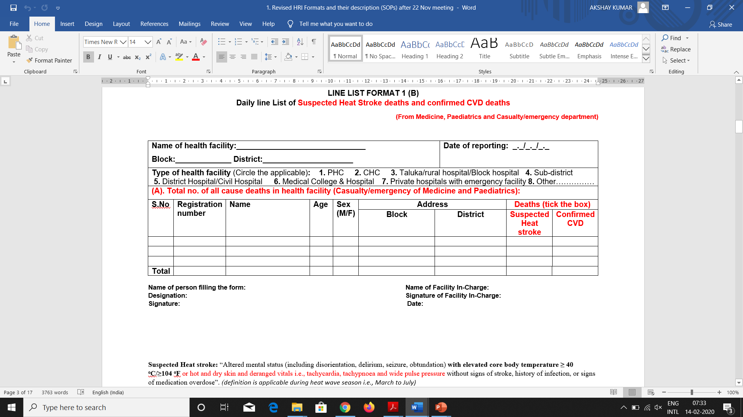

Slide 35
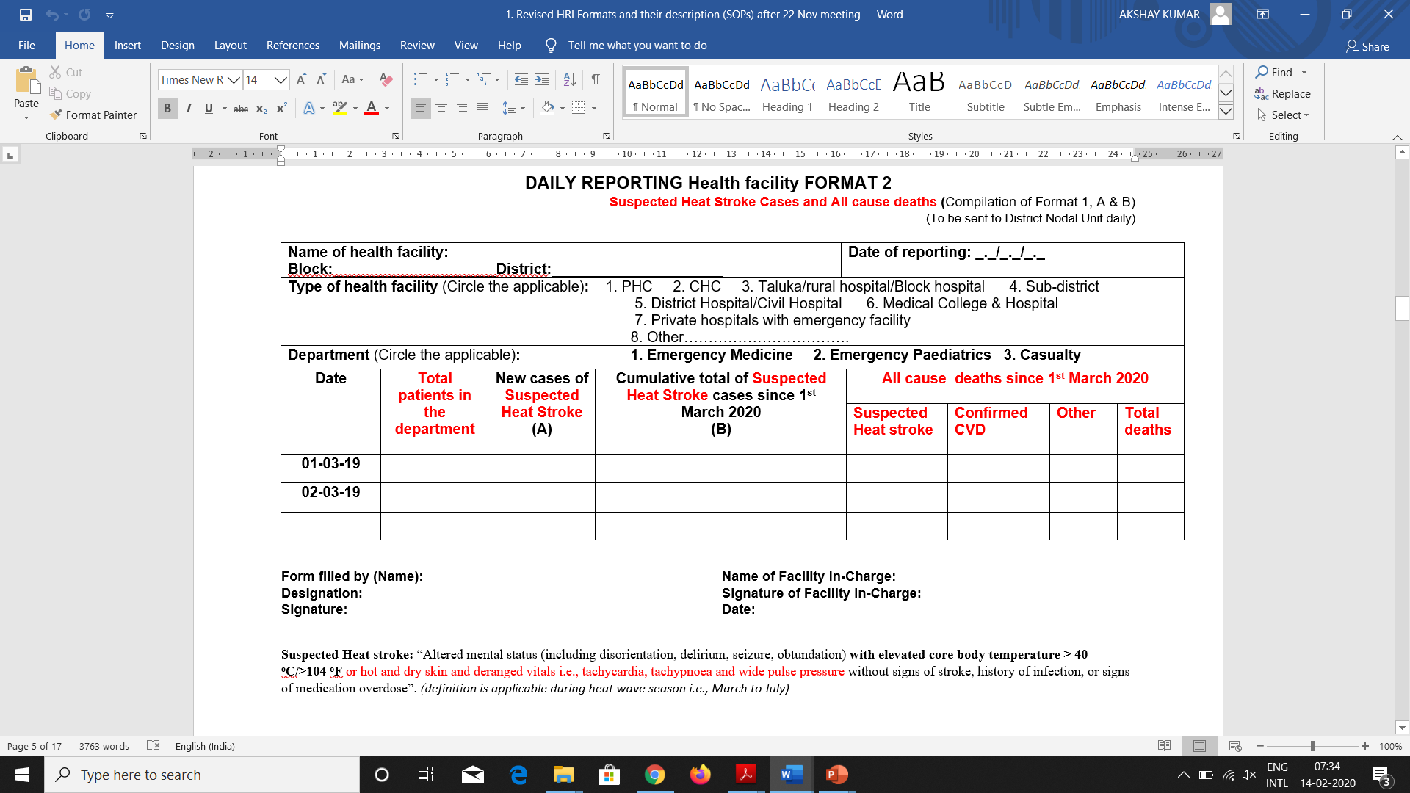

Slide 36
Death investigation form
Sections
  Deceased’s identifier details
  Death detail
  Clinical history in past 24 hr before death
  Outdoor activity just before onset of illness
  Indoor conditions just before the onset of illness
  Past Medical conditions
  Weather data from IMD
Notes:
At present the investigation of heat related deaths is not related to this surveillance. As per our surveillance when we get all cause mortality and put query on suspected death due to CVD or CVA that should be investigated from our side. But at present the investigation of HRI death is from that list only is not necessary. Any death occur, that death is directly reported to revenue department through police, that police officer came to investigate that death and then call a medical officer to become a member of that team and investigate that death. That death investigation is not necessary that is picked up from our list case.
Our purpose is if they are investigating our suspect or their suspect, if doctor is going to be part of that team then atleast the doctor should understand that this is the way in which he/she should investigate the death and also we will sensitize the revenue department officials who formed that team that this is how it can be investigated.
We have created a format so that it helps them to work towards it, to give them more opportunity to get a better understanding that this death is due to HRI or not.

Slide 37
Hospital preparedness plan
Pre, during and post heat season
  Primary health centre (PHC), Community Health Centre (CHC), District hospital (DH)/Medical Colleges
Infrastructure and logistics
Capacity building
IEC/Awareness

Slide 38
Treatment protocol for Heat-related illnesses
Clinical Manifestations of heat related illnesses
Laboratory workup
Management workflow of suspected heat stroke victims (periphery)
Clinical workflow in emergency department

Slide 39
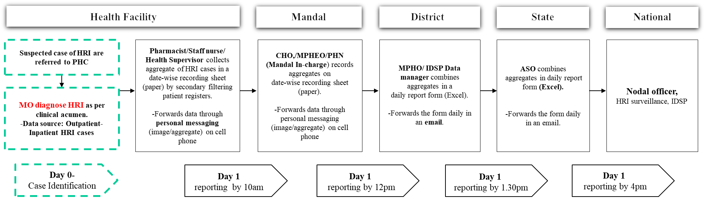
System Operation
Reporting timeline and process
Notes:
MPHEO: Multipurpose Health Extension Officer

Slide 40
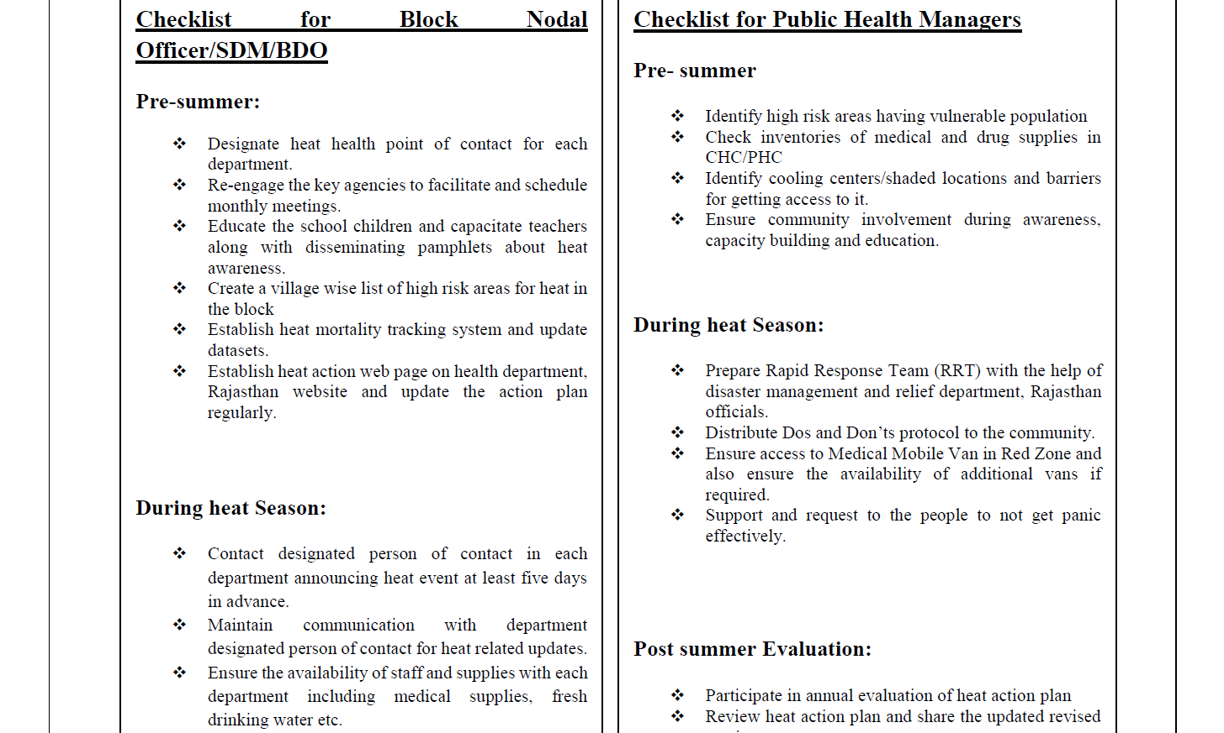
Highlights of Heat Action Plan

Slide 41
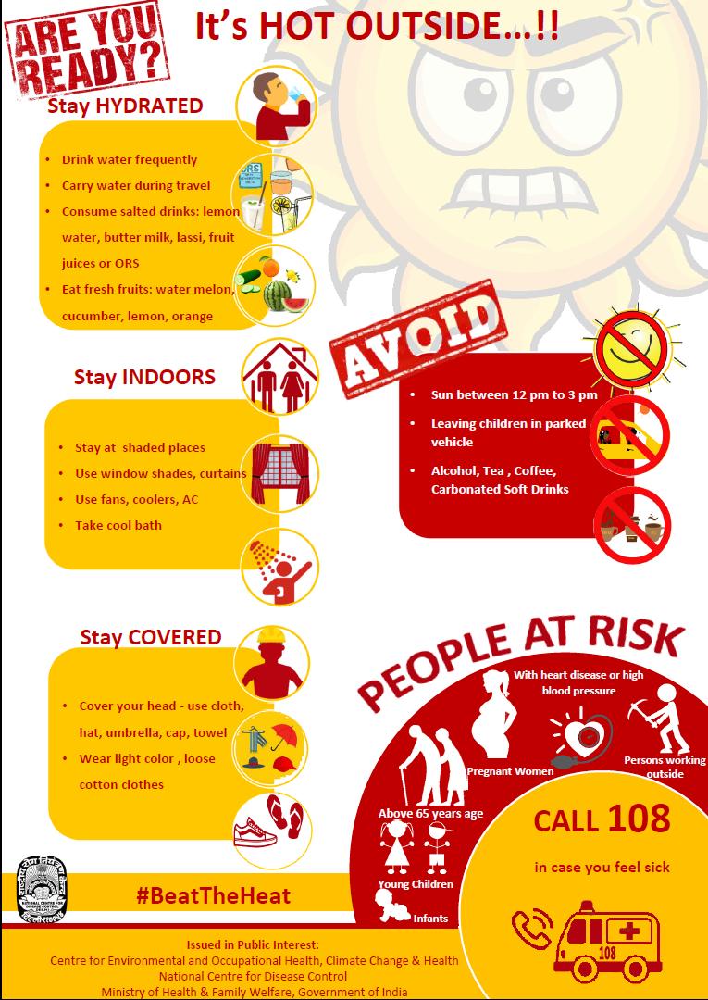
IEC Poster by NCDC

Slide 42
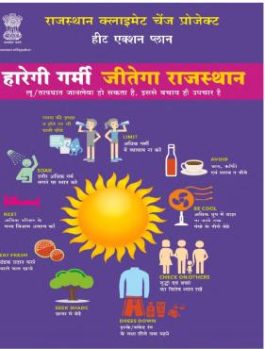
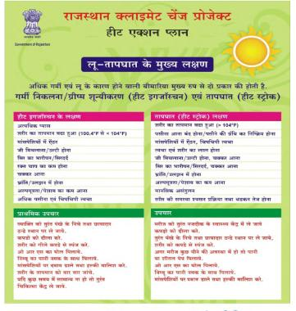
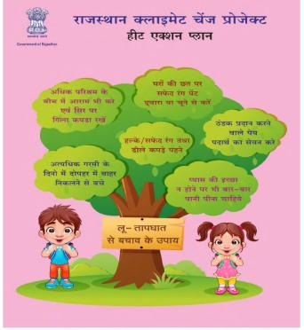
IEC on Heat : Rajasthan

Slide 43
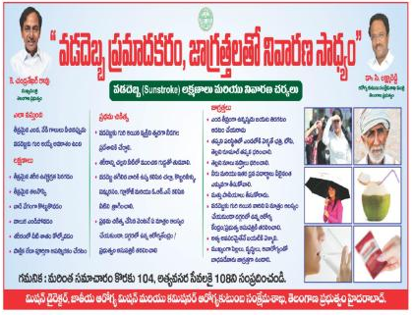
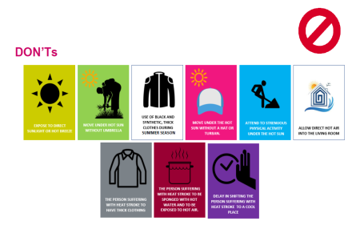
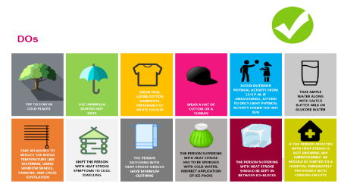
IEC on Heat : Telangana

Slide 44
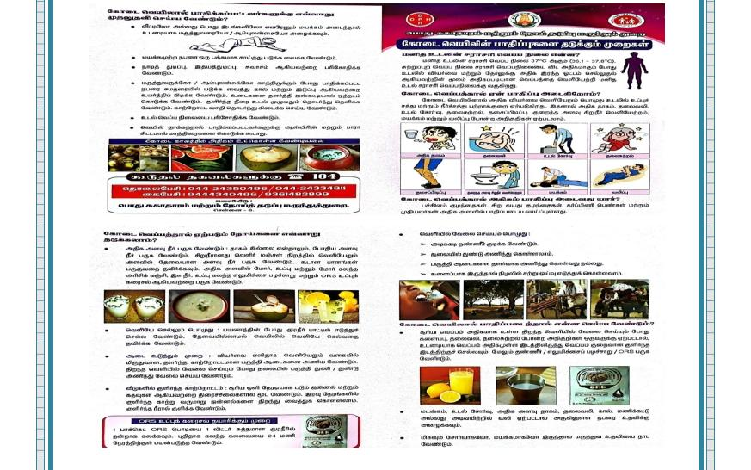
IEC on Heat : Tamil Nadu

Slide 45
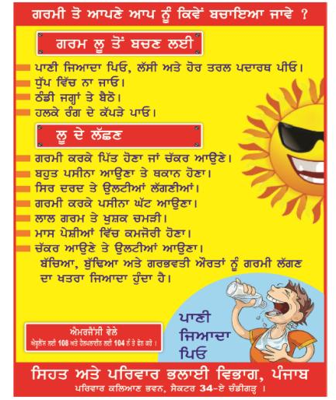
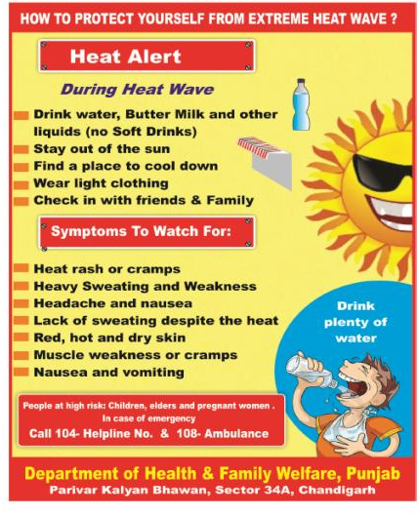
IEC on Heat : Punjab

Slide 46
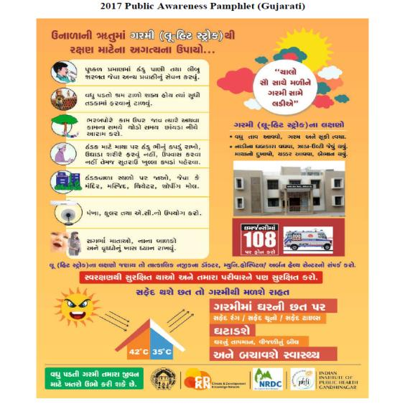
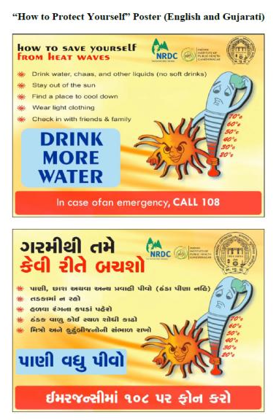
IEC on Heat : Gujarat

Slide 47
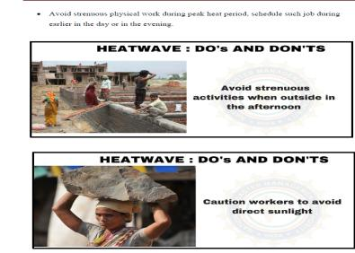
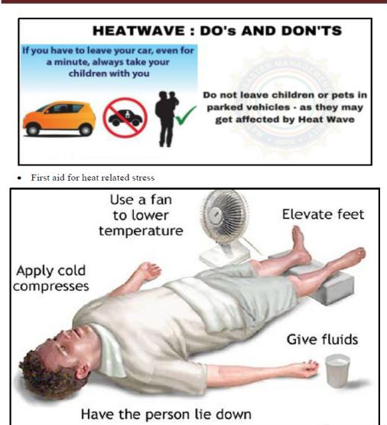
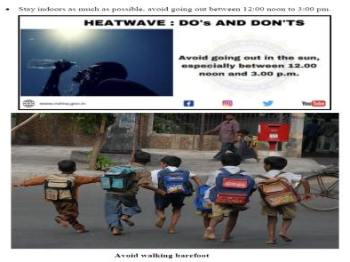
IEC on Heat : Karnataka

Slide 48
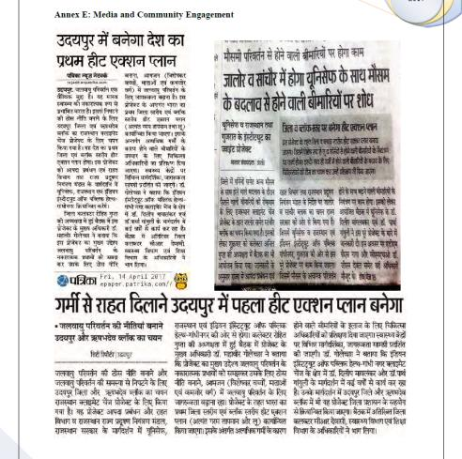
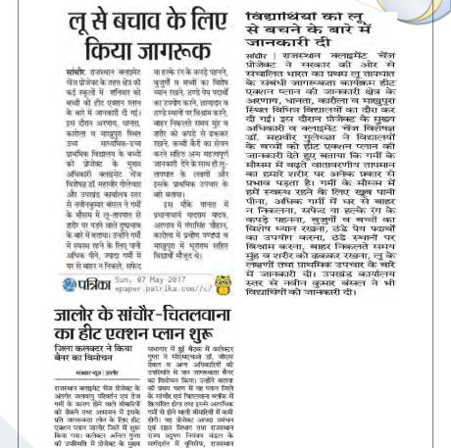
Media on Heat : Rajasthan

Slide 49
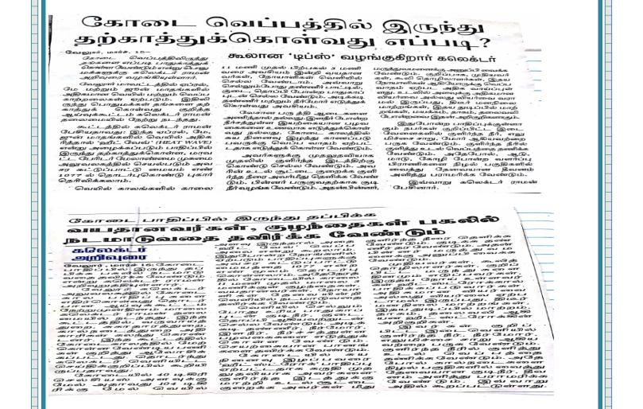
Media on Heat : Tamil Nadu

Slide 50
THANK YOU

